Slide 1

Welcome
You can sit where you like to begin with.
Please log in to your computers, open Teams
and visit this class: Level 2 Coding – Group B

Slide 2
Phones
a small reminder…
once you have authenticated phones should be in the pockets on the wall

Slide 3
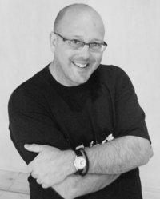

Simon Rundell
I am your teacher for this course.
30+ years experience as a Software Developer,
Project Manager, and IT Consultant.

Slide 4
My lessons
Before each proper lesson I will direct you to a Microsoft OneNote workbook
  You should copy it into your own folder on OneNote.
In that workbook there may be a recall of things we have done in the recent and less recent past
At the end of each lesson I will usually set a small task
  A video to watch
  Something to look up and make some notes
  A task to undertake

Slide 5
My expectations
That you will do the preparation and be equipped for the lesson
That you will do the set task in time for the next lesson
During the lesson:
  Focus Zone – no phones unless I have specified you to use them
  Listen when I am teaching
    No headphones or earbuds during lessons
    Engage with the content and the exercises
  Ask relevant questions
If you have an EHCP which allows Noise-cancelling headphones then I will want to see evidence of that. NO EXCEPTIONS

Slide 6
My expectations
When working:
  Don’t chat with your neighbours – silence is standard
  Headphones/earbuds are not permitted
  Be prepared to stop, turn and listen when I countdown.
  Don’t be distracted by off-topic web browsing, email checking or other time-wasting

Slide 7
You can expect from me
Lessons that are grounded in my experience
Theory and practice
Commitment to teaching and supporting you well
Help as and when you need it – just ask!

Slide 8

Questions on any of that

Slide 9
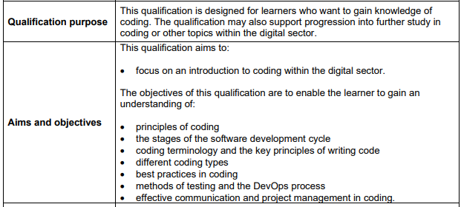
What is this course about?

Slide 10
It is an introduction
The first step towards Software Development.
A solid base for the Level 3 Qualifications in Digital Software Development or Digital Support and Security.

Slide 11
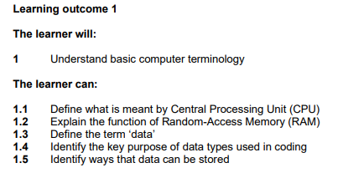
This half term…

Slide 12
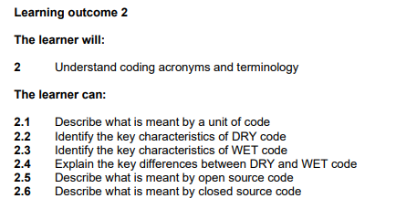
This half term…

Slide 13
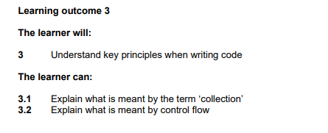
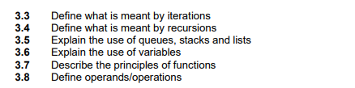
This half term…
The full course specification will be in the Teams Class Folder

Slide 14
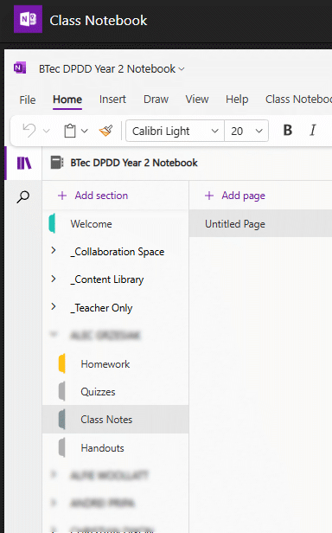
Using the Teams Class Notebook
Teams
Class Notebook
<Your Name>
Class Notes
You should see in there a workbook for this lesson
When you see:
Note this down
This is where I expect you to make notes under the appropriate lesson heading

Slide 15
What is a computer?
Visit https://mwb.toolsforteaching.co.uk and enter code bgm3rg
You will find we visit this site quite a lot.

Slide 16
My definition:
Note this down
A digital machine designed to undertake calculations
A grown-up calculator?

Slide 17
What can you do with these calculations?
Store numbers to undertake Mathematics and Physics
Store text and images as digital information
Manipulate text and images to create documents
Draw images on screen and animate them
Play games with those animated images
Monitor environments and control systems based upon that information
Build systems capable of inferring answers based upon other information (Artificial Intelligence)

Slide 18
A walk around the Motherboard

Slide 19
“Never trust a programmer with a screwdriver”

Slide 20
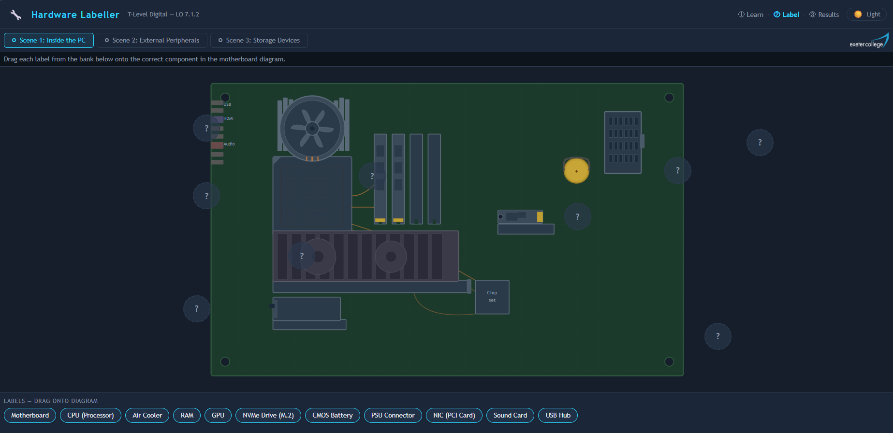

Final Task: label the Motherboard
Visit https://label.toolsforteaching.co.uk/
Do the learn section,
Label as many of the components as you can
Screenshot your results page
Submit via the assignment page

