Slide 1
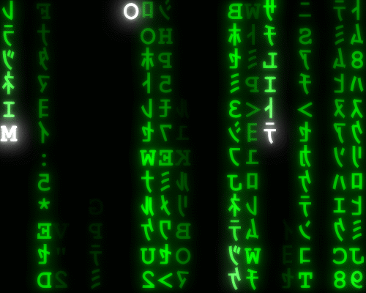
Data:
Data types & Data Storage
Lesson 02

Slide 2
Recall Quiz
Visit:
https://retrieval.toolsforteaching.co.uk
Code is 7o8qkt

Slide 3
Phones
a small reminder…
once you have authenticated phones should be in the pockets on the wall

Slide 4
Data:
Data types & Data Storage
Lesson 02

Slide 5
Learning Objectives
By the end of the lesson the student will be able to:
  Explain the difference between data and information (LO2.1).
  Name and describe the five key data types (LO2.2).
  Describe different methods of data storage (LO2.3).

Slide 6
Key Terms
Term | Definition
Data | Raw facts, numbers, or symbols without context. On its own it is not meaningful.
Information | Data that has been given context and meaning so that it can be understood and used.
Context | The structure and meaning applied to data that makes it useful. Without it, data is just noise.
Integer | A whole number with no decimal point. Examples: 42, -7, 100.
Float (Real) | A number with a decimal point. Examples: 3.14, -0.5, 99.99.
String (Text) | Any sequence of characters — letters, numbers, or symbols — treated as text.
Date/Time | A data type that stores dates and/or times in a structured format.
Boolean | A data type that can only hold True or False. Used for binary decisions.

Slide 7
What elements of data do you think your smartphone collected about you before you came to class today?
Talk to your neighbour
Share some examples
Why might companies want this data?

Slide 8
Data is everywhere & everything
Note this down
The main purpose of computing is:
  To gather data
  To manipulate data
  To store data
  To retrieve data
  To report on data
By itself data is useless

Slide 9
Data vs Information
Here is some data about me:
  74
  David
  161787401
  6818
This raw data is not that useful is it?
Numbers in my Postcode

Slide 10
Data vs Information
Here is some data about me:
  74
  David
  161787401
  6818
This raw data is not that useful is it?
My Grandson’s name

Slide 11
Data vs Information
Here is some data about me:
  74
  David
  161787401
  6818
This raw data is not that useful is it?
The login of a chat app from the 1990s which closed years ago

Slide 12
Data vs Information
Here is some data about me:
  74
  David
  161787401
  6818
This raw data is not that useful is it?
The number of steps I’ve taken today

Slide 13

The most important Computer Science formula you will ever learn:
data + context = information

Slide 14
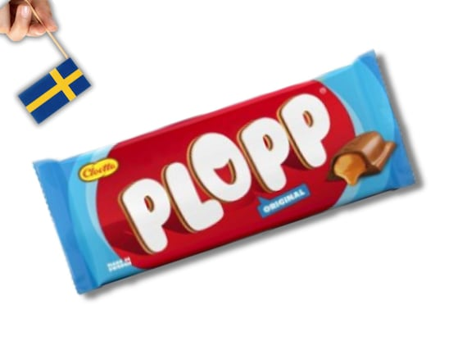
Data
is just raw numbers or letters
It requires some context to make it meaningful.
Even words are just symbols
They mean different things to different people, cultures, languages….
This is the name of a real Swedish chocolate bar

Slide 15

Context
Adds meaning
If I asked for someone to build me something 2m high…
But if they built it 2cm high…

Slide 16


Slide 17
Context
Context is comprised of structure and meaning
Think about dates…
01/09/2025
  In the UK this means 1st September 2025
  In the USA it means 9th January 2025
  In Japan you would write 2025-09-01
dd/mm/yyyy
mm/dd/yyyy
yyyy-mm-dd

Slide 18
Give TWO examples of data being turned into information by adding context:
Raw data | Context added | Information it becomes

Slide 19
The Five Data Types
Data Type | What it stores | Example | My own example
Integer | Whole numbers — no decimal. | age = 17
Float (Real) | Numbers with a decimal point. | height = 1.75
String (Text) | Any text, treated as characters. | name = "Alice"
Date/Time | Dates and/or times. | today = 2025-09-01
Boolean | True or False only. | is_logged_in = True
Why would you store a postcode as a String rather than an Integer? Explain in your own words in OneNote

Slide 20
Data types
Note this down
There are FIVE key data types:
  Integer
  Floating Point (aka Real)
  String (aka Text)
  Date/Time
  Boolean

Slide 21
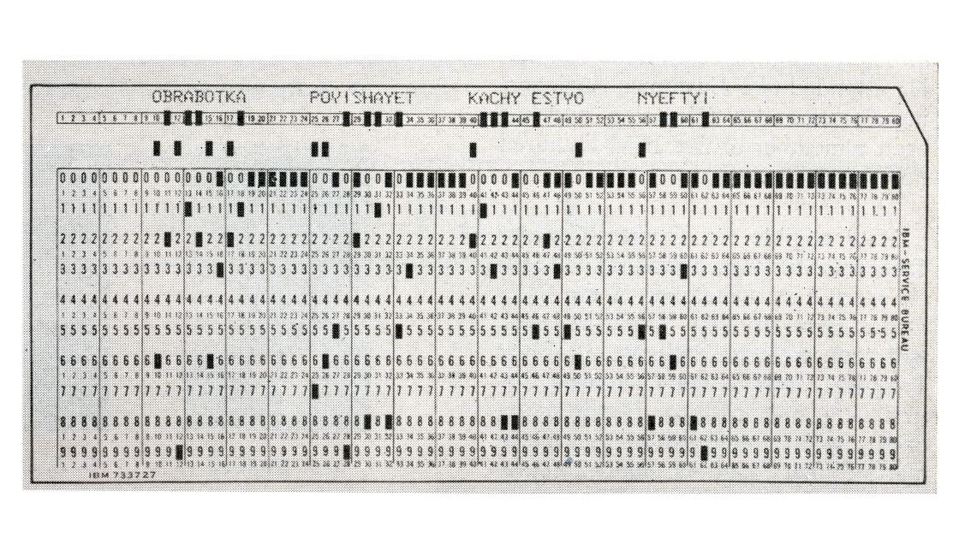
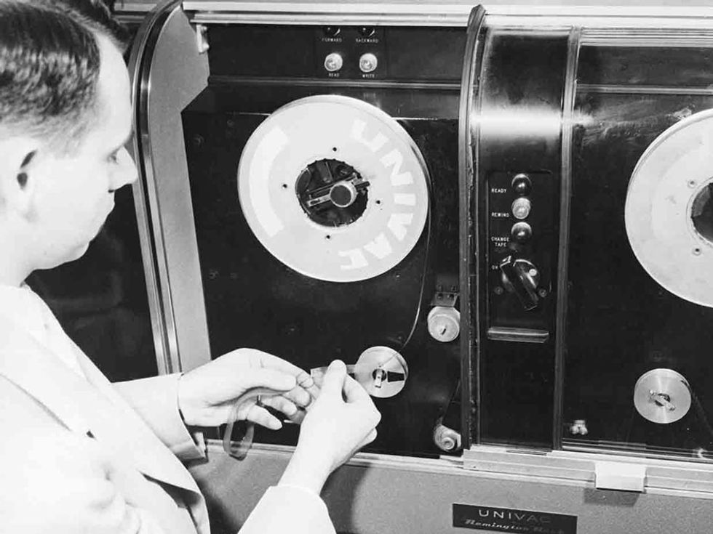

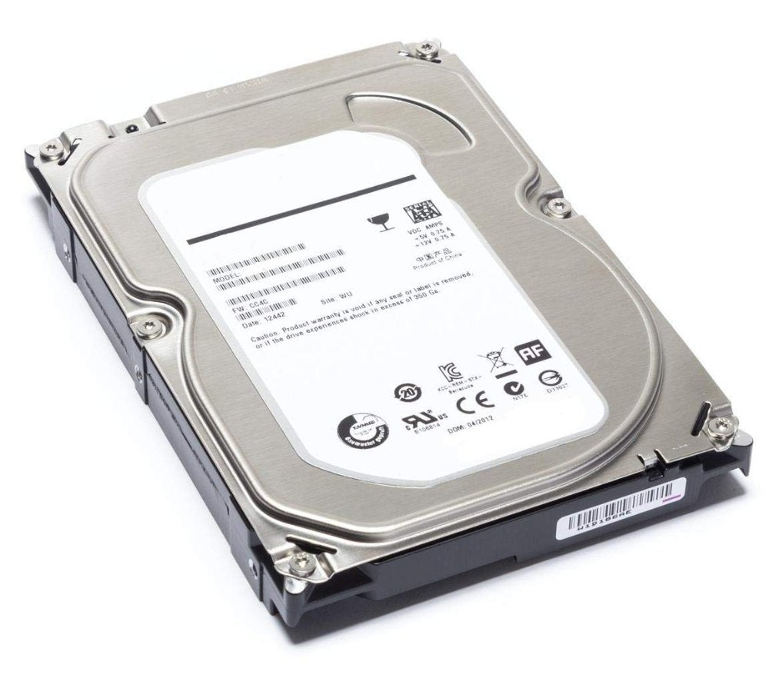
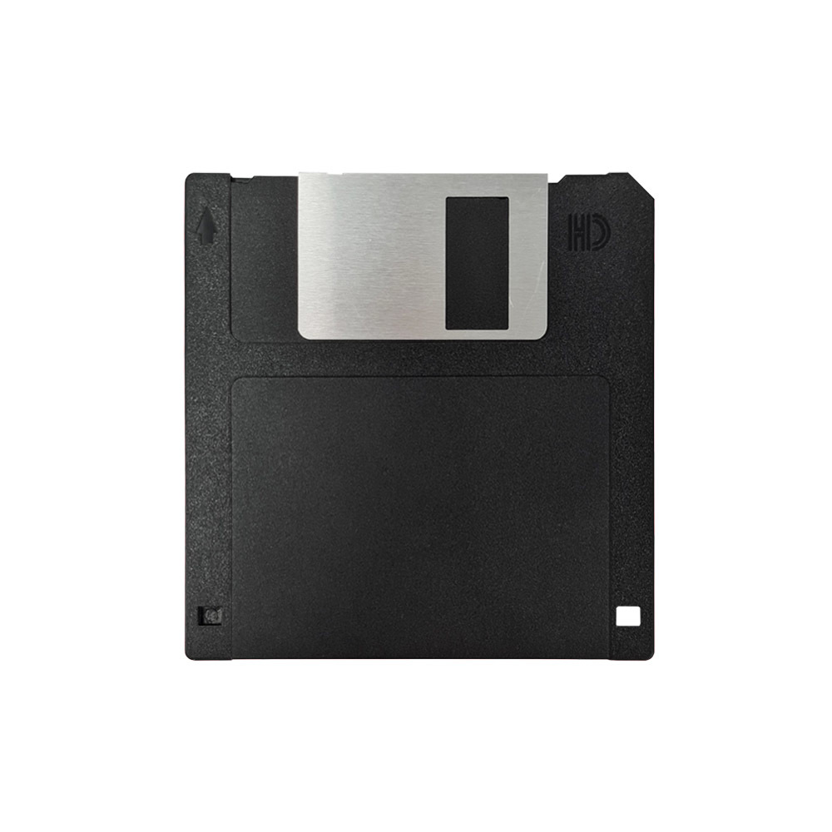
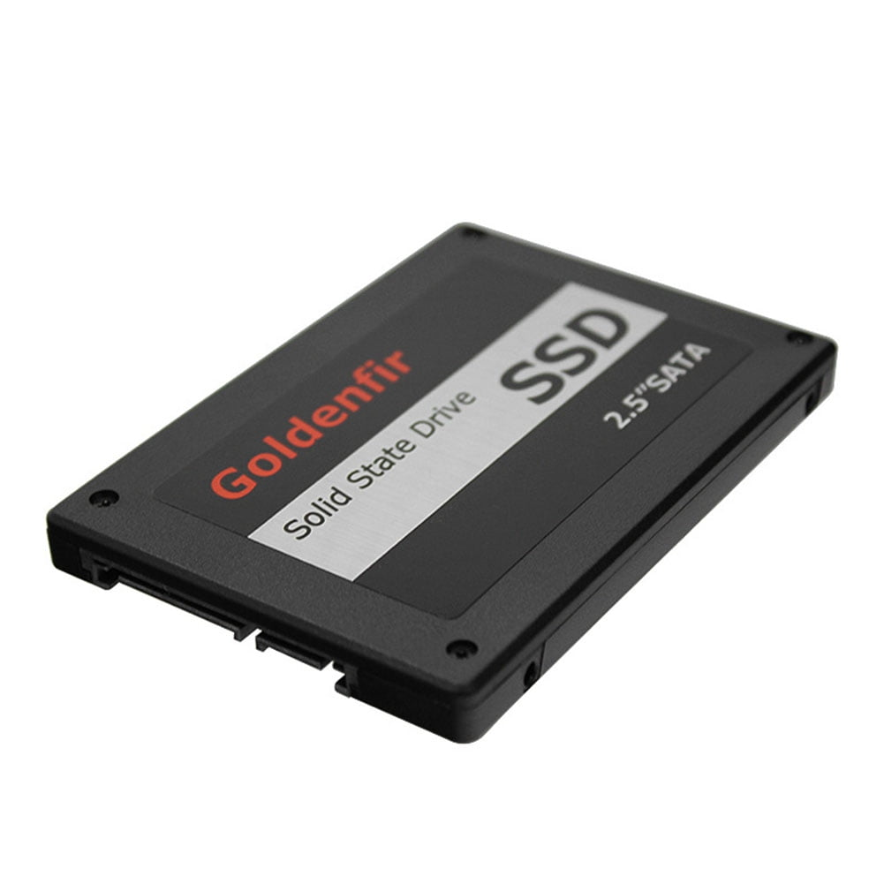
Data Storage
Some examples…
Examine these artifacts.
Think about some of their advantages and disadvantages

