Slide 1
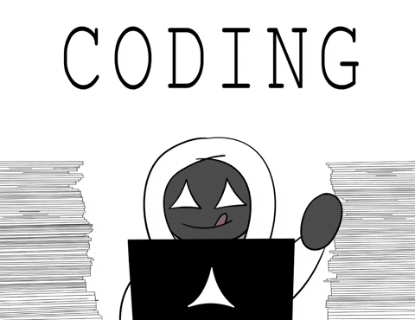
Unit 2 Understand the principles of
Lesson 1

Slide 2
Learning Outcomes
By the end of the lesson, learners should be able to:
Define the term “coding.”
Define what is meant by a “coding language.”
Identify examples of technologies that use code.
Produce a short, written statement for homework.

Slide 3

Which of these use code?
Embedded System
a Microwave
a Website
Microsoft Excel
a Toaster
a Smart Speaker
a Car
Embedded System
Embedded System

Slide 4

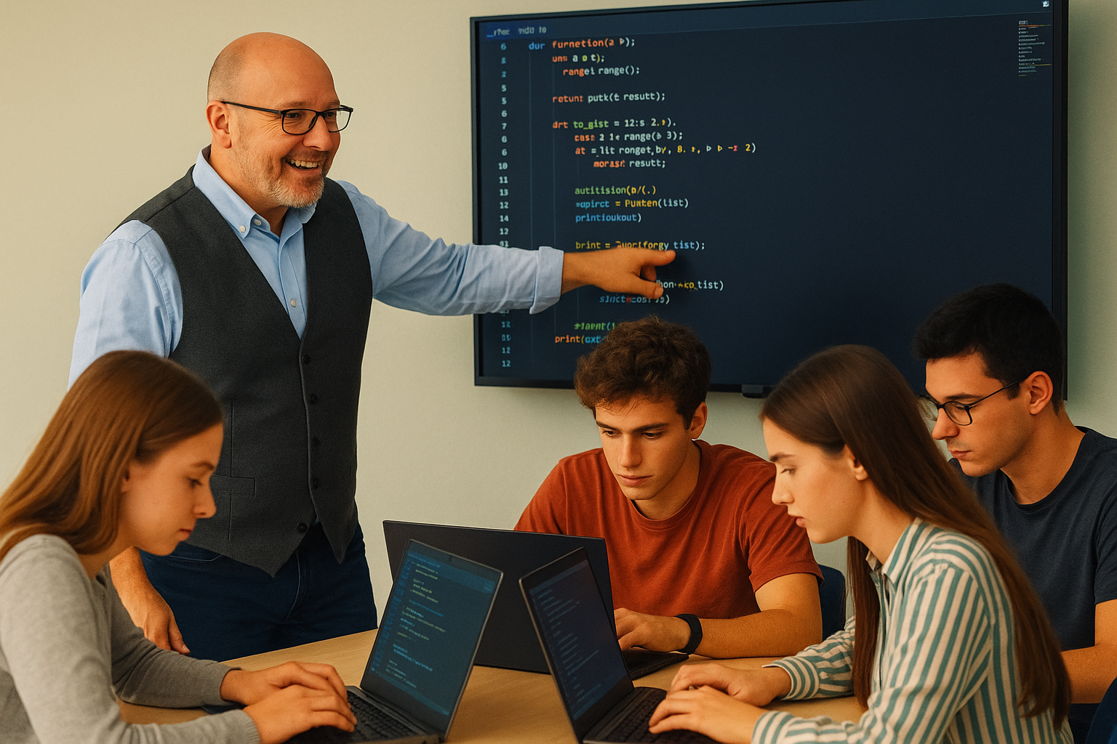


What is Coding?
A Chef creates a recipe
A teacher explains an algorithm
A choreographer teaches a dance routine
A developer writes code
It’s all about instructions

Slide 5

The Recipe Analogy
The ingredients are your data or variables.
The method is your algorithm — each line of code is an instruction.
If you miss a step or measure incorrectly → syntax error or logic error.
Computers can’t “improvise” — if you write “add salt until it tastes nice”, the computer doesn’t know when to stop!

Slide 6
Dance Routine Analogy
Each instruction is like a move in a dance – order and timing matter!
Try this:
Computers can’t ‘freestyle’ – they can only execute steps they have been told to
Loops = a repeating dance move pattern
Conditionals = “If the music stops – freeze!”
  Step left
  Step right
  Spin
  Clap

Slide 7
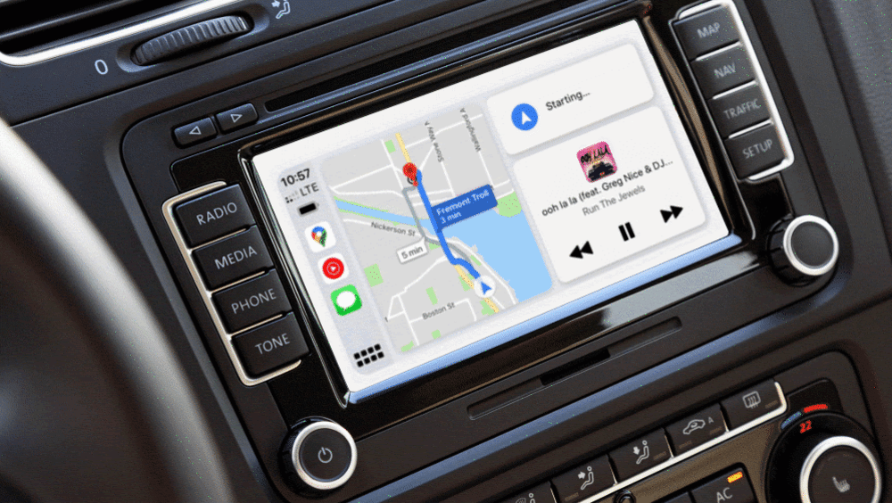
Sat-Nav/GPS Analogy
Coding tells a GPS system how to get somewhere
Each arrow = instruction
Each junction = decision point
Code must handle “what if” cases (road closed → if/else).
Computers follow logic, not common sense — if you don’t code a detour, it drives into the river! (See Apple Maps)

Slide 8
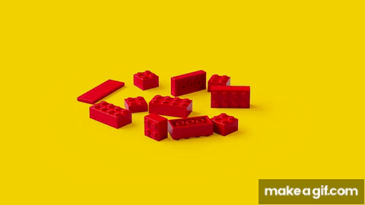
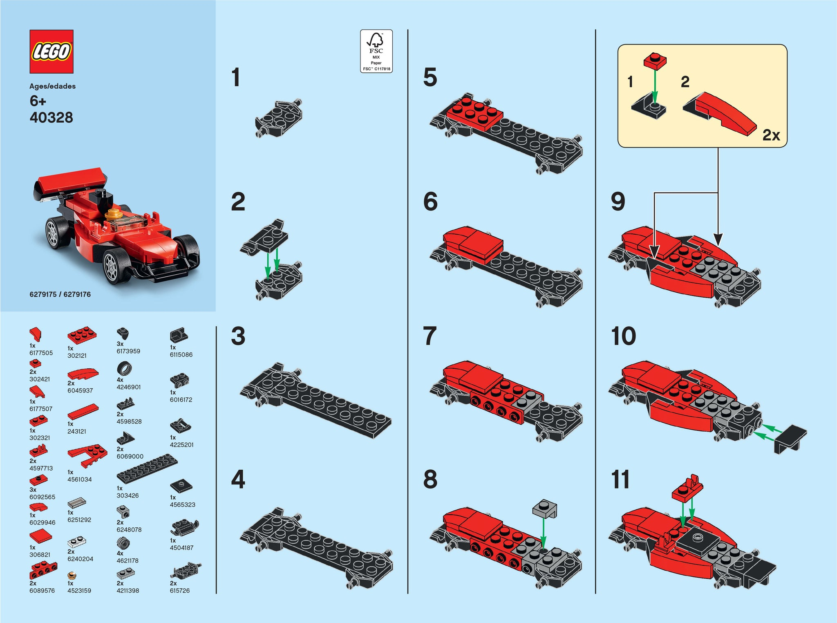
Lego Instructions Analogy
The bricks are data and structures.
The instructions are your lines of code.
Miss a step → the model collapses

Slide 9
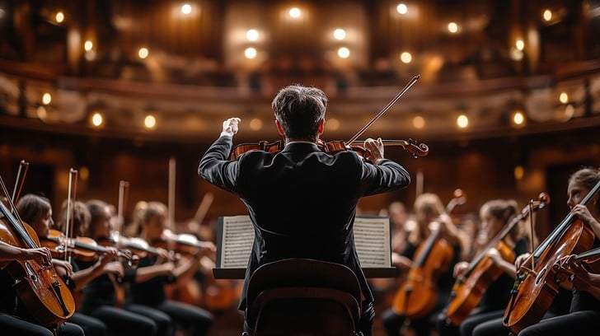
Orchestra & Conductor
Code orchestrates many parts (hardware, software, libraries).
Conductor = programmer
Musicians = computer components.
The programmer writes the “score”.
Each section (strings, brass, percussion) must follow exactly — timing errors cause discord (bugs).

Slide 10

Reflection
Why must a computer follow precise instructions?

Slide 11
“Hello World” in different languages
Python
print("Hello, World!")
JavaScript
console.log("Hello, World!");

Slide 12
“Hello World” in different languages
C++
#include <iostream>
int main() {
std::cout << "Hello, World!\n";
return 0;
}
Java
public class HelloWorld {
public static void main(String[] args) {
System.out.println("Hello, World!");
}
}

Slide 13
“Hello World” in different languages
COBOL
IDENTIFICATION DIVISION.
PROGRAM-ID. HELLOWORLD.
PROCEDURE DIVISION.
DISPLAY "Hello, World!".
STOP RUN.
Go
package main
import "fmt"
func main() {
fmt.Println("Hello, World!")
}

Slide 14
“Hello World” in different languages
Rust
fn main() {
println!("Hello, World!");
}
PHP
<?php
echo "Hello, World!";
?>

Slide 15

Research
26:01
Look at a variety of different languages on W3Schools and research some other sites to discover more
Ignore HTML and CSS as they are styling languages not coding languages
Make notes in OneNote on any that take your fancy
Key ones to include:
  JavaScript
  PHP
  C#
  Python
  Rust
  …and for a laugh: Rockstar
Consider what each language might be used for.
Are some more suited to some tasks than others?
30 mins
Notes:
Ollie should look at https://www.w3schools.com/jquery/default.asp which begins with “JQuery is a JavaScript Library”

Slide 16
Why so many?
There are lots of different needs in programming
So many different tools are used
Techniques and Computer Science improves over time and so what was effective in the 1990s is not always effective now. New languages keep ahead of new techniques.
Some last however – see COBOL
Object-orientated Code
Object Storage
Web languages

