Slide 1

How computers understand code
Lesson 2

Slide 2
Recall from last lesson
Visit:
https://retrieval.toolsforteaching.co.uk
Code: 0pw4av

Slide 3
Phones
a small reminder…
once you have authenticated phones should be in the pockets on the wall

Slide 4
How computers understand code
Lesson 2

Slide 5
Learning Outcomes
Explain what a programming language does.
Describe the difference between high-level and low-level languages.
Define the roles of translators: compilers, interpreters, and assemblers.
Identify examples of high-level and low-level languages.
Demonstrate understanding through short code exploration tasks.

Slide 6
Coding languages
Note this down
Languages are how humans give instructions computers can understand
There are a number of different ways we can categorise these languages
Firstly, the concept of High Level vs Low Level
Basically: Languages of People vs Machine

Slide 7
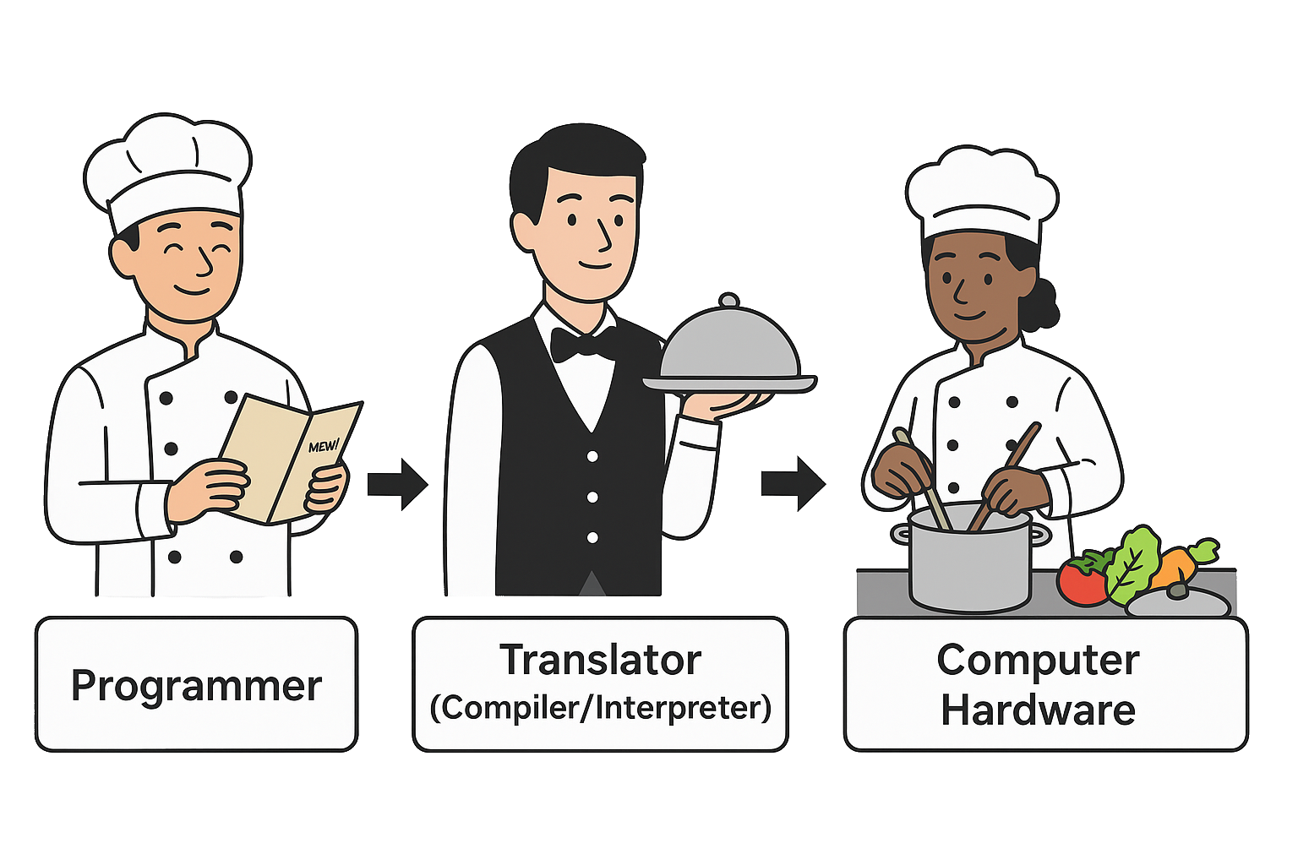
High Level Languages
Note this down
Chef = Programmer
Waiter = Translator
  Compiler/Interpreter
Kitchen Staff = Computer hardware

Slide 8
Compilers, Interpreters, Assemblers
Note this down
Collectively they are known as Translators
They translate the human readable code into code the machine understands (machine code)
Compiler
  Translates the entire program at once (compile time)
Interpreter
  Translates line-by-line in real time
Assembler
  Converts low-level code to machine code
eg C++
eg Python

Slide 9
Compiling
Note this down
Compiling involves a one-off process by the developer to build machine code which the computer can run.
Compiling can take time
Syntax Errors detected during this time
  but not run-time errors
The machine code is the lowest-level of code and therefore runs really quickly
Why can’t a compiler trap run-time errors?

Slide 10

Stage | What Happens | Cooking Analogy | Example (C++)
1. Preprocessing | Handles directives that start with # (like #include <iostream>). These bring in external code libraries before compilation starts. | Gathering all the ingredients before cooking. | Expands all #include files.
2. Compilation (Translation to Assembly) | The compiler translates your human-readable code into an intermediate, lower-level assembly code. Errors in syntax are caught here. | The chef writes a precise recipe in a special cooking shorthand. | Produces .s or .asm files.
3. Assembly | The assembler converts the assembly code into object code (binary). This is not yet a full program. | The shorthand recipe is translated into coded cooking steps. | Produces .obj or .o files.
4. Linking | The linker combines your object file with any libraries (like I/O, math) to form a complete executable program. | Combining your dish with side ingredients before serving. | Produces .exe or .out.
5. Execution | The operating system loads the executable into memory and runs it as machine code. | The final meal is cooked and served — ready to eat! | The program runs and prints output.

Slide 11
Interpreting
Note this down
When using an interpreted language (like Python, JavaScript, or PHP), there is no full translation step before running.
Instead, the interpreter:
  reads your code line by line
  checks it,
  translates it into machine code
  executes it immediately
repeating this cycle for every instruction.
It runs slower than a compiled language
…because Interpretation happens at run-time
Why is it slower?

Slide 12
Stage | What Happens | Cooking Analogy | Example (Python)
1. Source Code Loaded | You write a script in a high-level language like Python (.py file). | You open the recipe. | print("Hello, World!")
2. Lexical Analysis (Tokenisation) | The interpreter reads the text line by line, breaking it into meaningful tokens (keywords, variables, symbols). | The chef reads one sentence and picks out the key actions (“add”, “mix”, “heat”). | Recognises print, (, "Hello, World!", )
3. Parsing | It analyses how the tokens fit together (grammar and syntax rules) to form valid statements. | Checks the recipe makes grammatical sense — “Add milk to sugar” not “Sugar add milk”. | Builds a syntax tree (a structural map of your code).
4. Interpretation / Execution | The interpreter immediately translates and executes each valid line into machine instructions. | The chef performs each instruction as they read it. | The CPU prints Hello, World! to the screen.
5. Error Handling | If a line causes an error, execution stops and an error message is displayed. | If the chef hits a confusing step, they stop cooking until it’s fixed. | SyntaxError: unexpected EOF while parsing

Slide 13
Feature | Compiled Language (C++, Java, Go) | Interpreted Language (Python, JavaScript)
Translation | Entire program translated before running | Code read and executed line-by-line
Error Detection | Caught at compile-time | Found during execution
Speed | Usually faster | Slower (runtime translation)
Portability | Needs recompiling for each platform | Usually more portable
Example Output | .exe, .out, .class files | No separate file, runs directly in interpreter
Notes:
Think of it like language translation:
A compiler translates the entire book before anyone reads it.
An interpreter translates the story as the storyteller reads it aloud — so listeners hear it almost immediately, but translation takes time as it happens.

Slide 14
Language Exploration
TIME UP!
In pairs
Using the worksheet found in Teams / Classwork / Unit 1 / Languages / Programming Languages Exploration
Find:
  What it’s used for
  Whether it’s compiled or interpreted
  An example of “Hello World” code
Complete the worksheet and copy to your OneNote
30 mins
Extension: Research bytecode or virtual machines (e.g. JVM).

Slide 15
Reflection
Why can’t computers understand English?
Why might we choose one language over another?
What does a compiler actually do?

Slide 16
Homework
Research and then write 200 words explaining:
The difference between high-level and low-level languages and why translators are needed.
Include one real-world example.

Slide 17
Stage | What Happens | Cooking Analogy | Example (C++)
1. Preprocessing | Handles directives that start with # (like #include <iostream>). These bring in external code libraries before compilation starts. | Gathering all the ingredients before cooking. | Expands all #include files.
2. Compilation (Translation to Assembly) | The compiler translates your human-readable code into an intermediate, lower-level assembly code. Errors in syntax are caught here. | The chef writes a precise recipe in a special cooking shorthand. | Produces .s or .asm files.
3. Assembly | The assembler converts the assembly code into object code (binary). This is not yet a full program. | The shorthand recipe is translated into coded cooking steps. | Produces .obj or .o files.
4. Linking | The linker combines your object file with any libraries (like I/O, math) to form a complete executable program. | Combining your dish with side ingredients before serving. | Produces .exe or .out.
5. Execution | The operating system loads the executable into memory and runs it as machine code. | The final meal is cooked and served — ready to eat! | The program runs and prints output.
The Compilation Process

Slide 18
Stage | What Happens | Cooking Analogy | Example (Python)
1. Source Code Loaded | You write a script in a high-level language like Python (.py file). | You open the recipe. | print("Hello, World!")
2. Lexical Analysis (Tokenisation) | The interpreter reads the text line by line, breaking it into meaningful tokens (keywords, variables, symbols). | The chef reads one sentence and picks out the key actions (“add”, “mix”, “heat”). | Recognises print, (, "Hello, World!", )
3. Parsing | It analyses how the tokens fit together (grammar and syntax rules) to form valid statements. | Checks the recipe makes grammatical sense — “Add milk to sugar” not “Sugar add milk”. | Builds a syntax tree (a structural map of your code).
4. Interpretation / Execution | The interpreter immediately translates and executes each valid line into machine instructions. | The chef performs each instruction as they read it. | The CPU prints Hello, World! to the screen.
5. Error Handling | If a line causes an error, execution stops and an error message is displayed. | If the chef hits a confusing step, they stop cooking until it’s fixed. | SyntaxError: unexpected EOF while parsing
The Interpretation Process

Slide 19
Feature | Compiled Language (C++, Java, Go) | Interpreted Language (Python, JavaScript)
Translation | Entire program translated before running | Code read and executed line-by-line
Error Detection | Caught at compile-time | Found during execution
Speed | Usually faster | Slower (runtime translation)
Portability | Needs recompiling for each platform | Usually more portable
Example Output | .exe, .out, .class files | No separate file, runs directly in interpreter
Comparison of Compilation and Interpretation
Notes:
Think of it like language translation:
A compiler translates the entire book before anyone reads it.
An interpreter translates the story as the storyteller reads it aloud — so listeners hear it almost immediately, but translation takes time as it happens.

