Slide 1
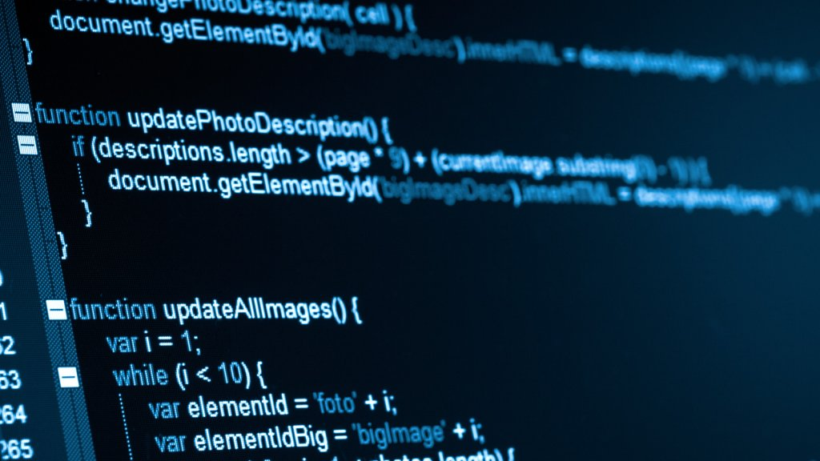
Syntax and Structure
Lesson 03

Slide 2
Recall from last lesson
Visit:
https://retrieval.toolsforteaching.co.uk
Code: 6p2y7j

Slide 3
Phones
a small reminder…
once you have authenticated phones should be in the pockets on the wall

Slide 4
Syntax and Structure
Lesson 03

Slide 5
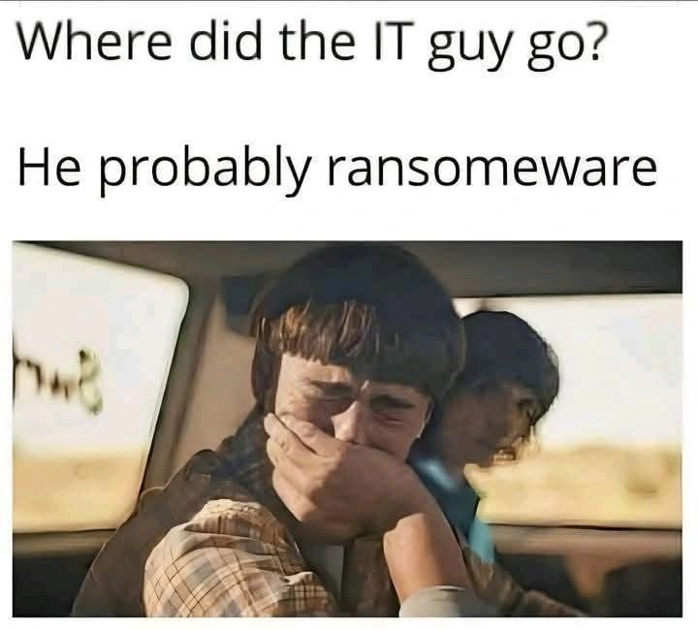

Slide 6
Learning Outcomes
By the end of this lesson, learners should be able to:
Explain the difference between procedural and object-oriented programming.
Define what is meant by syntax in coding.
Identify the importance of consistent and accurate syntax.
Demonstrate examples of syntax errors and describe how they affect program execution.

Slide 7
Two Mindsets
Note this down
All programs give computers instructions - but different languages organise those instructions differently.
Paradigm | How It Thinks | Typical Languages | Analogy
Procedural | The program is a sequence of steps or procedures that operate on data. | Python (C-style), C, Pascal | A recipe: you follow the steps from top to bottom.
Object-Oriented (OOP) | The program is built from objects that contain both data and behaviour. | Java, C#, C++, JavaScript, Python (can do both) | A restaurant: each chef (object) knows how to cook their own dish.
Procedural code focuses on what to do, OOP focuses on who is doing it

Slide 8
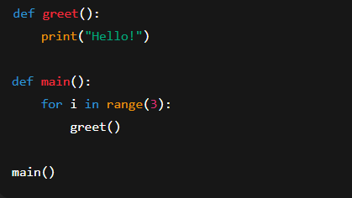
Procedural Code in Python
In the procedural version, everything happens through functions
Notes:
def greet():
print("Hello!")
def main():
for i in range(3):
greet()
main()

Slide 9
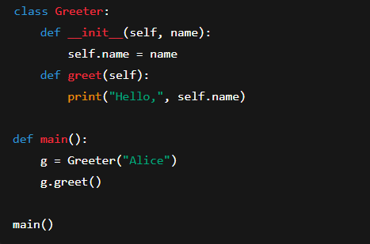
OOP Code in Python
In the OOP version, behaviour belongs to an object (the Greeter)
Notes:
class Greeter:
def __init__(self, name):
self.name = name
def greet(self):
print("Hello,", self.name)
def main():
g = Greeter("Alice")
g.greet()
main()

Slide 10
Comparison
Note this down
Feature | Procedural | OOP
Structure | Flat, step-by-step | Layered: objects interact
Reuse | Via functions | Via classes & inheritance
Best for | Small scripts, utilities, data processing | Large, complex systems (needing reuse & maintenance)
Learning curve | Easier to start | Harder to plan, more concepts
So why do we bother with OOP?

Slide 11
Procedural or OOP?
ATM withdrawal system →
  OOP (different account types, transactions).
Temperature converter script →
  Procedural.
Online shopping cart →
  OOP.
Simple calculator →
  Procedural.

Slide 12
Activity
In pairs
Students complete a two-column worksheet:
Column A: Identify 3 features of procedural programming.
Column B: Identify 3 features of object-oriented programming.
Then write one example of when you’d choose each.
Upload / Copy Paste into your OneNote Notebook
10 mins

Slide 13
Class (work)
05:39
Class bicycle(make, gears, brakes, yearBuilt)
  Method changeGearUp()
  Method changeGearDown()
Can you create another example of a Class with properties and methods for another real-world example?

Slide 14
Ways to get it wrong in Python
Let’s visit Programiz…
These things matter:
  Spelling
  Brackets
  Case
  Indentation
Not in all languages

Slide 15

It has been said before…
One does not write code, one debugs it
Simon Rundell,
September 2025

Slide 16
Bug Hunting
Working Independently
Go to Teams / <location> / Spot_the_Error_Syntax_Worksheet.docx
Identify the bugs and correct them
Check your code if you want in https://python.toolsforteaching.co.uk
10 mins

Slide 17
Reflect
“What happens if code has good logic but bad syntax?”
Note down some of the Syntax rules you have learnt both in this lesson and in what we covered last half-term

Slide 18
Homework
Deadline:
Midnight in 6 day’s time
Create a one page summary answering:
“What is the difference between procedural and object-oriented programming, and why is syntax important in both?”
Include examples or diagrams.
Upload to the Assignments before midnight in 6 day’s time

