Slide 1
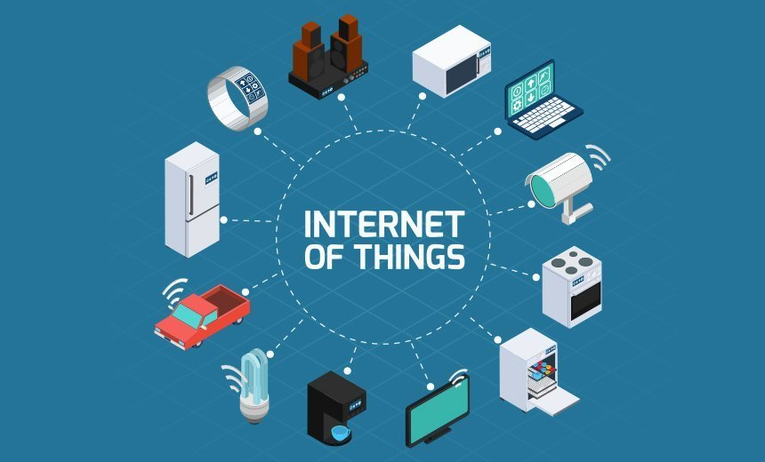
Technologies that use code
Lesson 04

Slide 2
Recall from last lesson
Visit:
https://retrieval.toolsforteaching.co.uk
Code: v8v9mt

Slide 3
Phones
a small reminder…
once you have authenticated phones should be in the pockets on the wall

Slide 4
Technologies that use code
Lesson 04

Slide 5
All of them
This lesson is now finished.
…but there’s more!

Slide 6
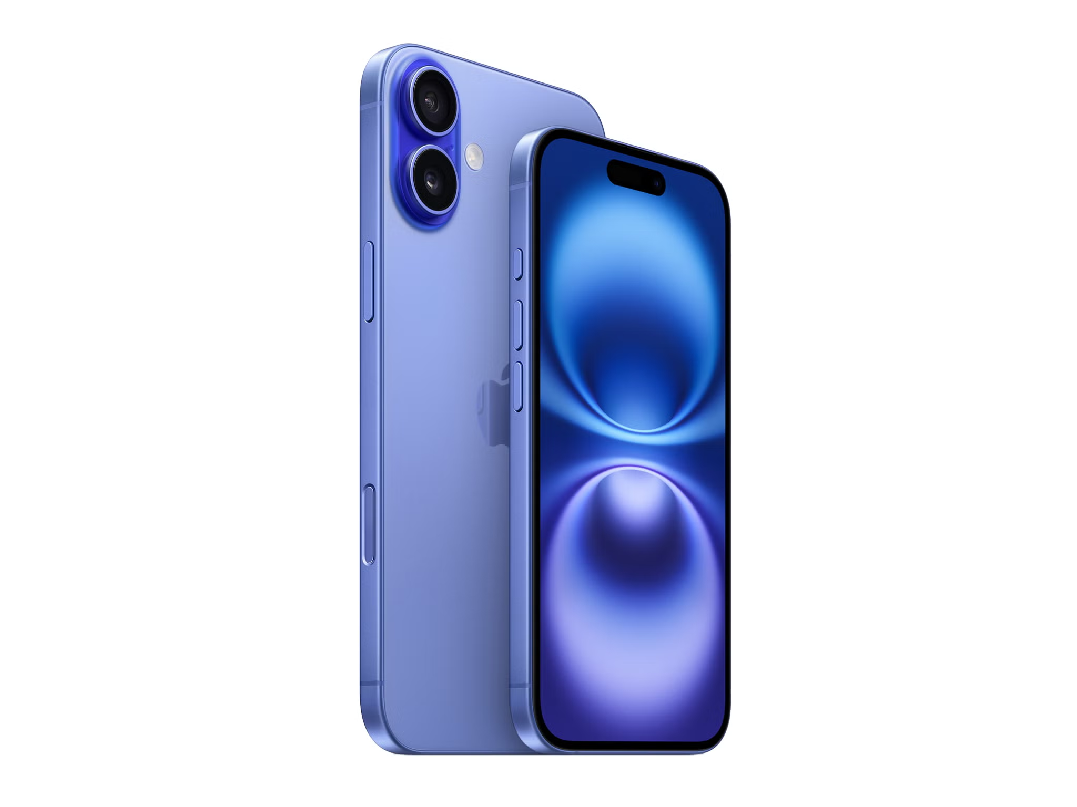
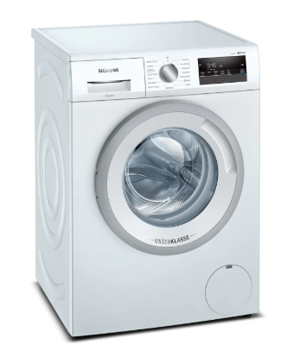
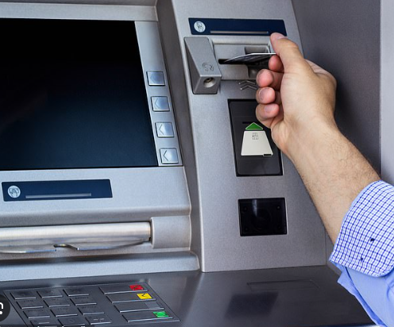

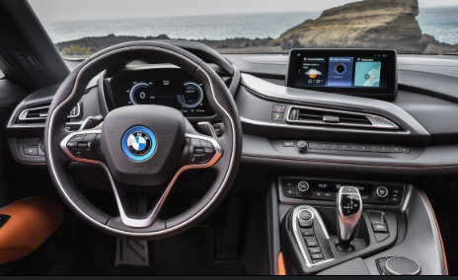
Code is everywhere…
Note this down
Everyday encounters:
  Smartphones
  Washing Machines
  ATMs
  Cars
  Smart Speakers
Why do these systems benefit from having code in them?

Slide 7
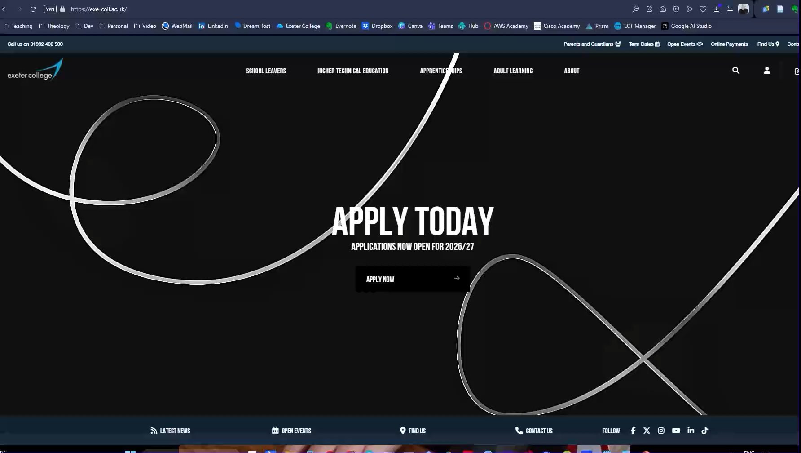

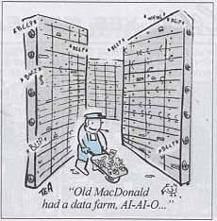
Code is everywhere…
Note this down
Online:
  Websites
  Applications
  Cloud Systems
Why has so much moved to the Cloud environment?

Slide 8


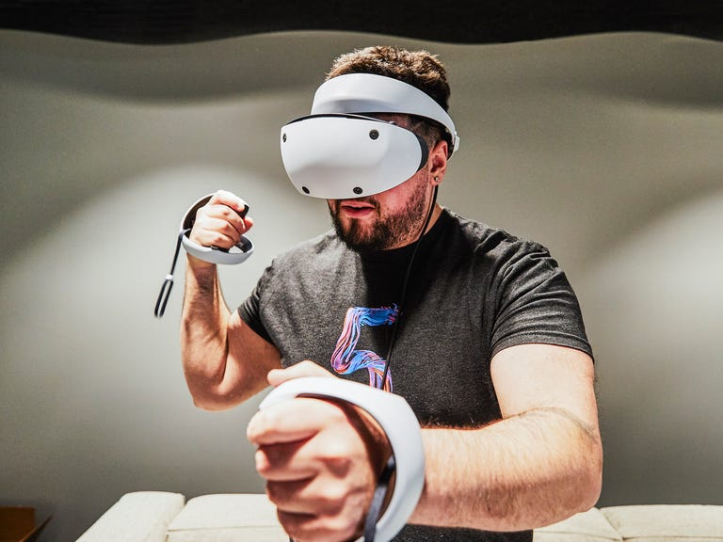
Code is everywhere…
Note this down
Specialist:
  AI
  IoT
  Gaming
  VR
Where do you think this will take us in the next 10 years?

Slide 9

From the obvious to the hidden
Note this down
Code is everywhere.
Not just in things that look like computers but embedded in almost anything electrical
Someone has written code for it.
Could that person be you?
Exeter College offers Level 3, HNC and HND Courses in Computing

Slide 10
The world of code
https://padlet.com/simonrundell/EverythingIsCode
Let’s think about and suggest as many examples as possible for each category.

Slide 11


Slide 12
Mini Research Project
Working Independently
Choose one technology area
  e.g. smart home devices, mobile apps, gaming, AI assistants, automotive systems
Using the Research Template, you must find out:
What the technology does
How code is used within it.
Which programming languages are commonly used.
Why coding is essential to its operation.
25 mins

Slide 13

Reflect
Which technology surprised you most?
What would happen if its code stopped working?

Slide 14

Homework
Write a short reflection (around 150 words):
  “Choose one technology from today’s lesson. Explain how it uses code and what could happen if the code contained an error.”
Add to your OneNote Workbook

Slide 15




















<title>
Note this down
In pairs
<title>
First Point
Second Point
Working Independently
Until EOL
In small groups
Deadline:
Midnight 6 days time
X mins
Complete these definitions during the lesson

