Slide 1
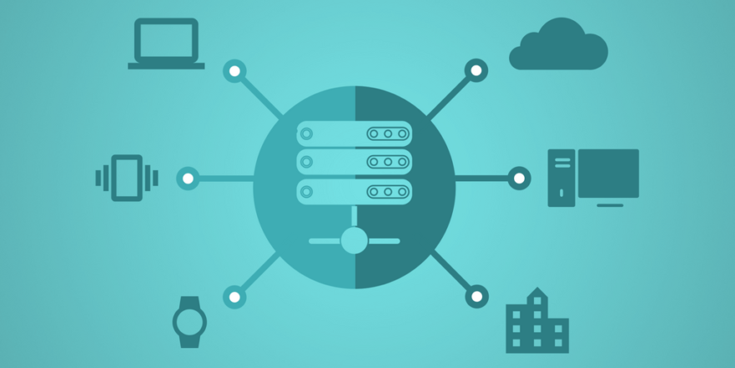
What happens after Implementation?
Lesson 11

Slide 2
Recall from last lesson
Visit
https://retrieval.toolsforteaching.co.uk
Code: wjp786

Slide 3
Phones
a small reminder…
once you have authenticated phones should be in the pockets on the wall
There will be no more toilet breaks in my lessons. If you can’t manage to use the toilet in the breaks then you need to learn to. Going to the toilet is not an excuse for missing a substantial part of the lesson.

Slide 4
What happens after Implementation?
Lesson 11

Slide 5
Learning Objectives
By the end of this lesson, students will be able to:
Describe actions that may take place during the deployment stage.
Explain the importance of the maintenance stage in the software development cycle.
Identify real-world examples of deployment and maintenance issues.
Apply understanding through scenario-based tasks.

Slide 6
Software gone wrong!
Is it…
❌ Deployment stage issue
or
🔧 Maintenance stage issue
A mobile app update causes phones to crash.
A game update deletes player save files.
A website launches but all payment transactions fail.
A school system update makes logins impossible.
A patch introduces a security hole.
A company delays deploying a fix for a bug and loses customers.

Slide 7
Answers
1. “A mobile app update causes phones to crash.”
➡️ Deployment issue
Reason: The update was deployed incorrectly or insufficiently tested before release.
2. “A game update deletes player save files.”
➡️ Deployment issue
Reason: A critical bug slipped into the released build—often a packaging or version-control error during deployment.
3. “A website launches but all payment transactions fail.”
➡️ Deployment issue
Reason: Payment API configuration, database migration, or live environment setup issue during launch.

Slide 8
Answers
4. “A school system update makes logins impossible.”
➡️ Deployment issue (with maintenance implications)But for the starter classification: Deployment issue
Reason: Incorrect configuration during update deployment.
5. “A patch introduces a security hole.”
➡️ Maintenance issue
Reason: They were maintaining the system (issuing a patch), but it created a new vulnerability. This happens post-release during maintenance.
6. “A company delays deploying a fix for a bug and loses customers.”
➡️ Maintenance issue
Reason: The fix belongs to the maintenance stage; failure to act during maintenance caused the loss.

Slide 9
Deployment Stage – What happens?
Actions may include:
Final Testing Before Release
  smoke tests, usability checks, compatibility checks.
Packaging & Distribution
  creating installers, publishing to app stores, hosting on servers.
User Training / Documentation
  manuals, online help, walkthroughs.
Data Migration
  transferring old user data into the new system.
Deploying to Live Environment
  releasing v1.0, scheduling release windows, avoiding peak times.
Rollback Plans (VERY important)
  what to do if the deployment fails.
Monitoring the Release
  checking for errors, feedback, system performance.

Slide 10
Maintenance Stage – Why It Matters?
The maintenance stage is essential because systems are never finished.
Corrective Maintenance
  fixing bugs that appear after release.
Adaptive Maintenance
  changes due to new hardware/software (e.g., iOS updates).
Perfective Maintenance
  improving performance, adding features.
Preventative Maintenance
  stopping future issues (e.g., security patches).
Importance:
  Keeps the system secure
  Improves performance over time
  Ensures user satisfaction
  Prevents financial loss
  Ensures legal compliance (e.g., data protection vulnerabilities)

Slide 11
You are the Deployment Team
In small groups
30 mins
A school is launching a new homework-submission system. Your team must plan the deployment.
  What actions must take place before deployment?
  What must happen during the deployment?
  What could go wrong?
  How will you monitor and test after release?
What maintenance tasks will be needed in the first month?
Produce a short Powerpoint of 5 or so slides and email to simonrundell@exe-coll.ac.uk to deliver a 2 min presentation to the class

Slide 12
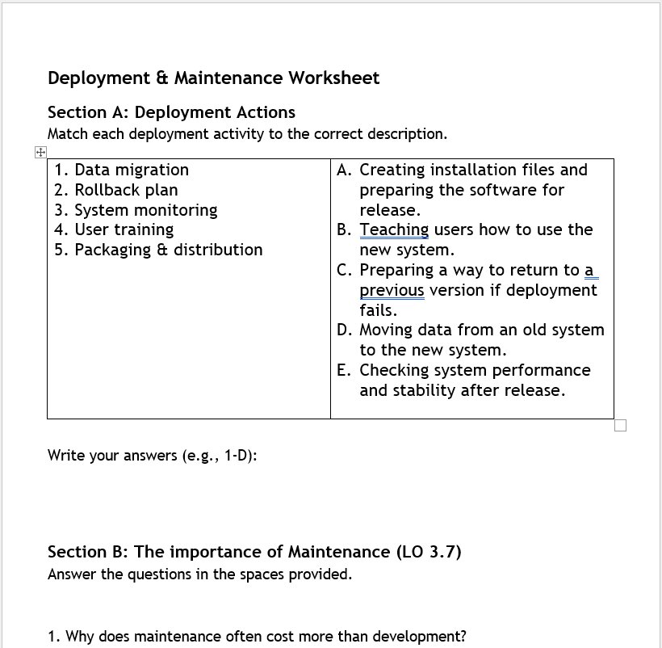
Worksheet Task
Working Independently
20 mins
In your OneNote Workbook see Deployment and Maintenance Worksheet
Complete the sheet

Slide 13
Homework
Deadline:
Midnight 6 days time
Find a real example of a software update that caused problems after launch (e.g., Tesla, Apple, NHS IT).
Write 100–150 words in your OneNote Workbook explaining:
  What went wrong?
  Whether it was a deployment or maintenance problem
  What the company did to fix it

