Slide 1

Unit 3
Object Orientated Coding
Lesson 05

Slide 2
Recall Exercise
Visit:
https://retrieval.toolsforteaching.co.uk
Code: knqcoh

Slide 3
Phones
a small reminder…
once you have authenticated phones should be in the pockets on the wall

Slide 4
Unit 3
Object Orientated Coding
Lesson 05

Slide 5
Learning Objectives
By the end of the lesson, learners will be able to:
Define object-oriented coding
Identify objects, attributes (properties), and methods
Use real-world examples to explain object-oriented ideas

Slide 6
Key Vocabulary
Object
Class
Attribute
Method
Instance

Slide 7
From Functions to Objects
So far, we’ve looked at steps, rules, and functions.
What if we group data and behaviour together?
Object-oriented coding organises code around objects

Slide 8
What Is Object-Oriented Coding?
Let’s start with a Class
The class I am teaching has Students
Students have Attributes (aka properties)
Students do things which we call Methods

Slide 9
Task: Think about a Car class
Working Independently
10 mins
Here is a list of attributes and methods. Sort them in your OneNote worksheet into the right category
Colour
Start engine
Weight
Open door
Fuel level
Sort into Attributes and Methods

Slide 10
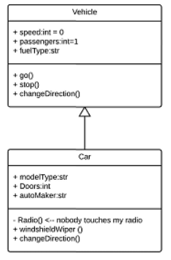
Class Diagram Sketches
<Name of Class>
<Attributes>
<Methods>

Slide 11
Task
Working Independently
In the OneNote worksheet:
Choose a real-world object:
  Phone
  Student
  Game character
  Vending machine (or something else)
Draw in Lucid.app:
  Class name
  List of attributes
  List of methods
Rules:
  Boxes and bullet points only
  No programming language
15 mins

Slide 12
Objects in the Real World
Working Independently
In your OneNote Notebooks
How does your chosen object represent something from the real world?
What data does it need to store?
What actions does it need to perform?
15 mins

Slide 13

Exit Ticket
What is one advantage of organising code into objects?

Slide 14
Task / Homework
Working Independently
Define what is meant by object-oriented coding and give one example
Mention objects and classes
Mention attributes and methods
Use a real-world example
Use your own words as much as you can
This might be useful for your final assessment
10 mins

