Slide 1

Unit 3
Other Coding Types
Lesson 06

Slide 2
Recall Exercise
Visit:
https://retrieval.toolsforteaching.co.uk
Code: l4871r

Slide 3
Phones
a small reminder…
once you have authenticated phones should be in the pockets on the wall

Slide 4
Unit 3
Other Coding Types
Lesson 06

Slide 5
Learning Objectives
By the end of the lesson, learners will be able to:
Identify procedural coding
Identify event-driven coding
Explain what is meant by a multi-paradigm language

Slide 6
Key Vocabulary
Procedural
Event-driven
Event
Multi-paradigm
Scenario

Slide 7
From Functions to Objects
So far, each paradigm we’ve studied has had a clear ‘shape’
But real software often needs to react to users and events
Let’s talk about Procedural and Event-Driven Coding

Slide 8
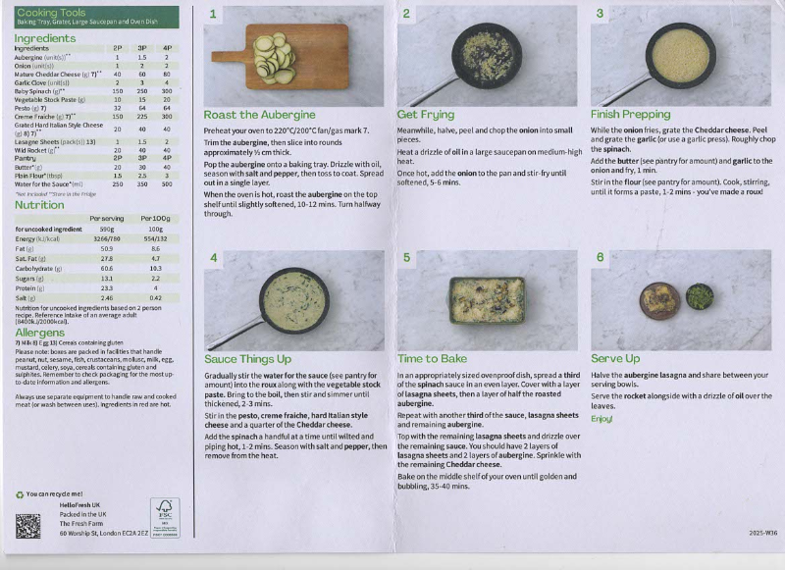
Procedural Coding
Is a type of imperative coding
Organises instructions into procedures
Follows a clear sequence
Analogy:
  Following a recipe broken into stages
  College timetable routines

Slide 9

Breaking a Process into Procedures
You are going to take a familiar step-by-step task and organise it into procedures.
Step 1: Read the process below
Step 2: Group the steps into procedures
Making a cup of tea
Fill the kettle with water
Turn the kettle on
Wait for the water to boil
Put a teabag in a cup
Pour hot water into the cup
Remove the teabag
Add milk if required
Below are three procedure names. Write which steps belong in each procedure.
Procedure 1: Prepare equipment
Procedure 2: Boil Water
Procedure 3: Make the drink
Working Independently
5 mins

Slide 10
Why is breaking a program into procedures useful?
In the OneNote worksheet for this week, answer this question.
Use your own words as much as possible
Write a paragraph making at least 3 points.
We will then display them on a collaborative page in the OneNote notebook.
Working Independently
10 mins

Slide 11

Event-Driven Coding
In Event-driven coding:
The program waits for events
An event triggers an action
Order is not always fixed
Examples
  Button clicks
  Keyboard input
  Sensor triggers
Analogy
  Doorbell
  Fire alarm
  Mobile App button push
Image credit: Menderes Mertoglu

Slide 12
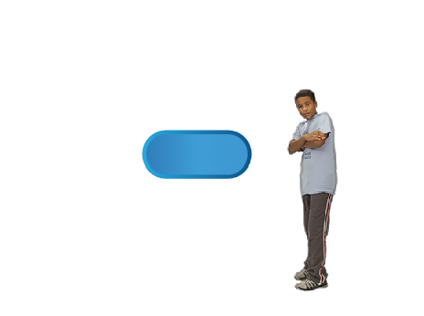
Event-Driven Coding Illustrated

Slide 13
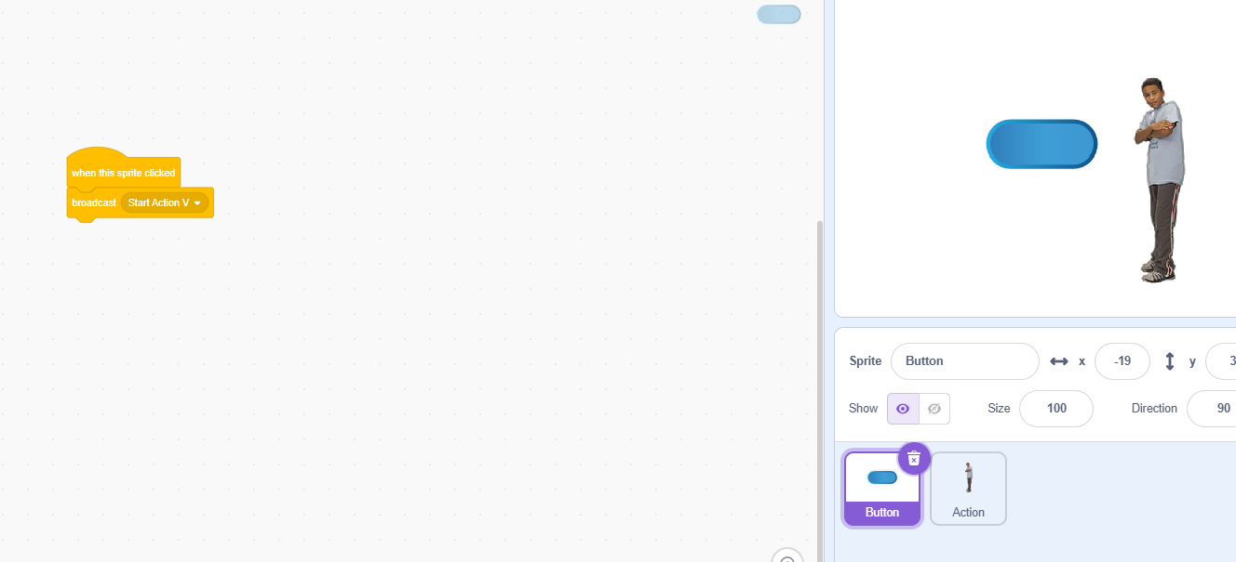
Event-Driven Coding Illustrated

Slide 14
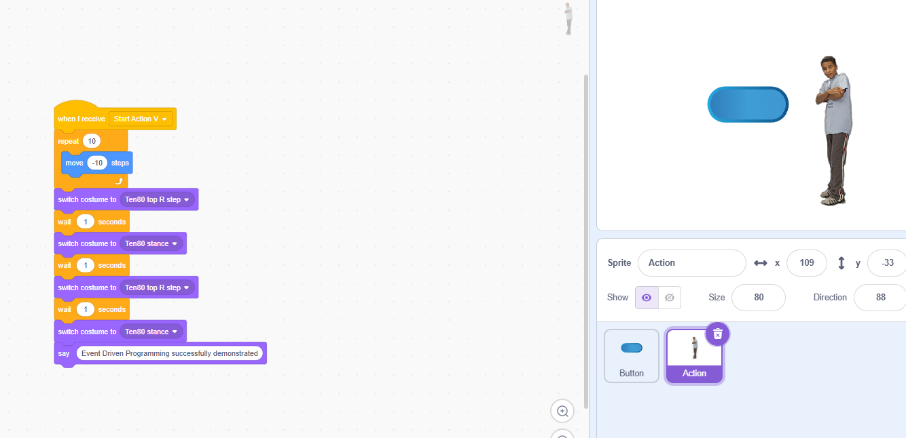
Event-Driven Coding Illustrated

Slide 15

Event-Driven Coding Illustrated
https://scratch.mit.edu/projects/1259816879/editor

Slide 16
Task:
In pairs
30 mins
Visit https://scratch.mit.edu
Create an account (or use the one you used to have!)
Create some event-driven actions.

Slide 17
Matching Coding Types to Scenarios
Working Independently
Which of the following is
Procedural
Event-driven
Example scenarios
  Washing machine cycle
  Clicking a “Submit” button
  Traffic lights
  Game menu selection
  …any others you can think of
10 mins

Slide 18
Multi-Paradigm Languages
We have seen step-by-step programs (procedural)
We have seen programs triggered by user interaction (event-driven)
Many languages are both:
Multi-Paradigm Languages
a language that supports more than one approach.

Slide 19
Task / Homework
In the OneNote Worksheet there are three scenarios
For each one:
  Identify the coding type used
  Give a reason for your choice
This will be useful for your final Unit assessment.
Working Independently
10 mins

Slide 20

Reflect:
Why is it useful for a programming language to support more than one coding paradigm?

