Slide 1

Unit 3
Compiled Code
Lesson 08

Slide 2
Recall Exercise
Visit:
https://retrieval.toolsforteaching.co.uk
Code: zquii5

Slide 3
Phones
a small reminder…
once you have authenticated phones should be in the pockets on the wall

Slide 4
Unit 3
Compiled Code
Lesson 08

Slide 5
Learning Objectives
By the end of the lesson, learners will be able to:
Define what compiled code is
Describe the compilation process in correct order
Identify compiled programming languages such as C and C++
Use correct technical terminology when explaining compiled code

Slide 6
Remind yourself…
In pairs
2 mins
What does it mean when code is executed?
What happens to Python code when it runs?
Why might a computer need instructions in a different form to human-written code?

Slide 7
What is compiled code?
Compiled code is source code that has been translated before execution into machine code by a compiler, producing a standalone executable file.
Write this down
Key characteristics:
Translation happens once, not every time the program runs
Output is machine-readable, not human-readable
Runs faster than interpreted code
Platform-specific (often compiled separately for Windows, macOS, Linux)

Slide 8
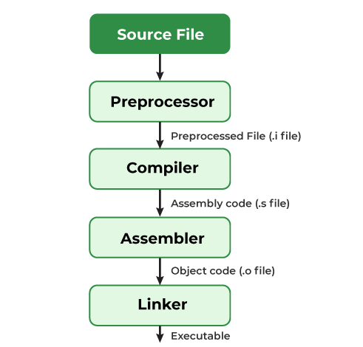
The compilation process
The source file is what the developer writes
Preprocessor creates a complete streamlined version of the source code
Compiler translates the high-level source into low-level Assembler code
Assembler builds the machine code
Linker integrates the machine code with external libraries and produces the final executable file.
Syntax errors are detected during compilation, not while the program is running.

Slide 9
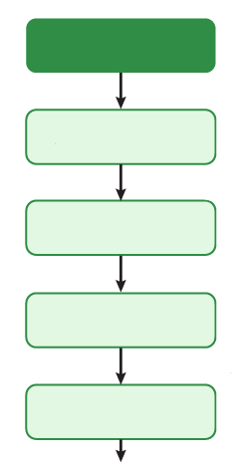
Let’s recall the process…
Place the following labels on the blank diagram in OneNote
Add a sentence to explain what happens at each stage.
Stages:
  Assembler
  Preprocessor
  Compiler
  Linker
  Source File
5 mins

Slide 10
Terminology Matching
Look up what these definitions mean and enter them in the OneNote
Term | Definition
Compiler
Executable
Machine Code
Source Code
Compile Time Error

Slide 11
Terminology Matching (answers)
Term | Definition
Compiler | Program that translates source code into machine code
Executable | A file that can be run directly by the operating system
Machine Code | Binary instructions understood by the CPU
Source Code | Human-readable program written by a developer
Compile Time Error | An error detected before the program runs
Notes:
Answer Key:
Compiler → Program that translates source code into machine code
Executable → A file that can be run directly by the operating system
Machine Code → Binary instructions understood by the CPU
Source Code → Human-readable program written by a developer
Compile Time Error → An error detected before the program runs

Slide 12
Examples of Compiled Languages
C
One of the earliest high-level compiled languages
Used for operating systems and embedded systems
#include <stdio.h>
int main() {
// printf() displays the string inside quotation
printf("Hello, World!");
return 0;
}

Slide 13
Examples of Compiled Languages
C++
Extension of C with object-oriented features
Used in game engines, performance-critical software
#include <iostream>
int main() {
std::cout << "Hello World!";
return 0;
}

Slide 14
Examples of Compiled Languages
Rust
Very popular modern language
Robust, fast and memory safe (where C & C++ are not)
fn main() {
println!("Hello, World!");
}

Slide 15
Assessment Task
Write a paragraph explaining:
  What compiled code is
  How the compilation process works
  One advantage of compiled code
Success Criteria:
  Uses correct terminology (compiler, machine code, executable)
  Explains the process in logical order
  Written in clear, complete sentences
Expected length: 6–8 sentences

Slide 16


True or False?
Compiled code is translated every time it runs
Compiled programs usually run faster than interpreted ones
Rust, C and C++ are compiled languages

Slide 17
Homework
By tomorrow
Research one real-world use of a compiled language
Explain why compilation is useful in that scenario

