Slide 1

Unit 3
Interpreted Code
Lesson 09

Slide 2
Recall Exercise
Visit:
https://retrieval.toolsforteaching.co.uk
Code: hvnj95

Slide 3
Phones
a small reminder…
once you have authenticated phones should be in the pockets on the wall

Slide 4
Unit 3
Interpreted Code
Lesson 09

Slide 5
Learning Objectives
By the end of the lesson, learners will be able to:
Define what interpreted code is
Describe how interpreted code is executed at runtime
Identify examples of interpreted languages such as Python and JavaScript
Explain how errors are handled in interpreted programs

Slide 6

Reflect…
What happened to code before it could run in compiled languages?
When were errors found in compiled code?
Why might a programmer want feedback while the program is running?

Slide 7
What is Interpreted Code?
Learn this
Interpreted code is source code that is executed line by line at runtime by an interpreter, without being translated into a standalone executable file first.
Key Characteristics
  Code is translated as it runs
  No separate compilation step
  Errors appear during execution
  Easier to test and debug
  Often platform-independent
  Slower as the Interpreter is a performance overhead

Slide 8
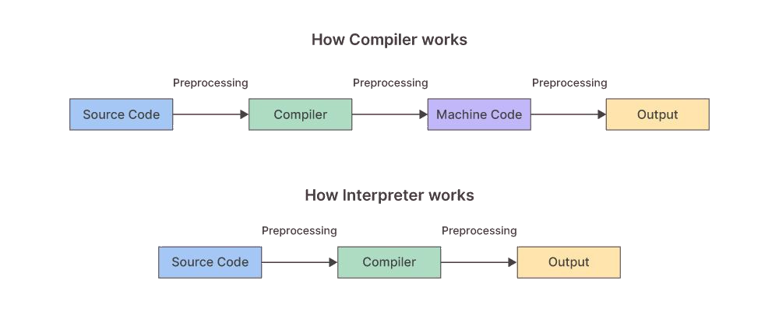

Slide 9
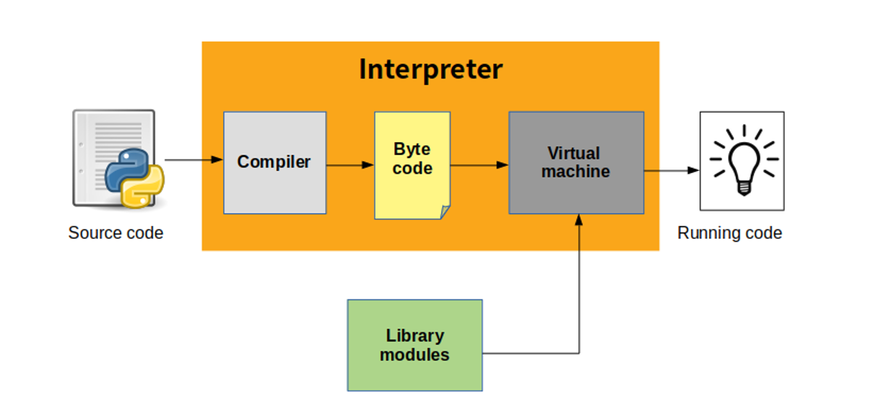

Slide 10
Step by Step Explanation
Source Code
  Written by the programmer (e.g. Python or JavaScript)
Interpreter
  Reads and executes one line at a time
Runtime Execution
  Each instruction is translated and run immediately
Error Handling
  Execution stops when an error is encountered
Key distinction: The program may partially run before an error is encountered.
Note this down
on the diagram in OneNote

Slide 11
Walk the code…
Here is a short piece of Python-like code
Complete the table in OneNote line-by-line
In small groups
1. print("Program starting")
2. x = 10
3. y = 5
4. print(x + y)
5. z = x / 0
6. print("Program finished")
10 mins
Rules:
The interpreter executes one line at a time
If an error occurs, execution stops immediately
Lines after an error do not run
Line Number | What happens? | Does the program continue?
1
2
3
4
5
6

Slide 12
Written Reflection
Working Independently
Which line caused the program to stop?
Why were earlier lines able to run successfully?
What does this show about when errors are detected in interpreted code?
How would this program behave differently if it were compiled?
15 mins

Slide 13
Examples of Interpreted Languages
Python
  Widely used in education, data science, automation
  Clear syntax and immediate feedback
JavaScript
  Runs in web browsers
  Responds to user actions and events
  Node.js is JavaScript running on a server
# This program prints Hello, world!
print('Hello, world!')
// the hello world program
console.log('Hello World');

Slide 14
Error-Handling
A Python program runs for 10 lines and then crashes on line 11.
Why did earlier lines still run?
Why wasn’t the error found earlier?
What is one advantage and one disadvantage of this behaviour?

Slide 15
Assessment Task
Write a paragraph explaining:
  What interpreted code is
  How runtime execution works
  One advantage of interpreted code
Success Criteria:
  Uses correct terms (interpreter, runtime, source code)
  Explains execution clearly
  Written in full sentences
Expected length: 6–8 sentences
Working Independently
15 mins

Slide 16


True or False?
Interpreted code is translated before it runs
Errors in interpreted code occur during execution
Python and JavaScript are interpreted languages

Slide 17
Homework
By tomorrow
Research one situation where interpreted code is preferred
Explain why it is suitable for that task

