Slide 1

Unit 3
Pure & Impure Functions
Lesson 10

Slide 2
Recall Exercise
Visit:
https://retrieval.toolsforteaching.co.uk
Code: duabfz

Slide 3
Phones
a small reminder…
once you have authenticated phones should be in the pockets on the wall

Slide 4
Unit 3
Pure & Impure Functions
Lesson 10

Slide 5
Learning Objectives
By the end of the lesson, learners will be able to:
Define what is meant by a pure function
Explain why a pure function always produces the same output for the same input
Identify side effects in functions
Describe what makes a function impure
Recognise external dependencies such as variables, user input, and files
Classify functions as pure or impure with justification

Slide 6
Key Vocabulary
Function
Input
Output
Pure function
Impure function
Side effect
External dependency
State

Slide 7
Core Knowledge – What is a Pure Function?
A pure function is a function that:
Always produces the same output for the same input
Has no side effects
This means:
It does not change variables outside the function
It does not read from or write to files
It does not rely on user input, time, or randomness

Slide 8
An example of a Pure Function
Python:
This function takes inputs a and b and adds them together.
def add(a, b):
return a + b

Slide 9
What are Side Effects?
A side effect occurs when a function:
  Changes a variable outside itself
  Prints to the screen
  Writes to a file
  Reads external data
Side effects make a function impure.

Slide 10
What is an Impure Function?
An impure function is one that:
  Depends on something outside its parameters
  Causes a side effect
This function is impure because it changes a global variable.
total = 0
def add_to_total(x):
global total
total += x

Slide 11
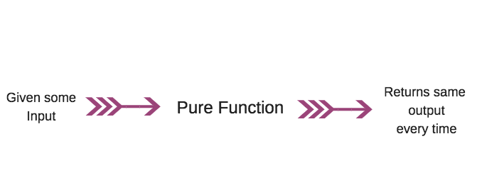
A pure function behaves like a mathematical formula:
Same input → Same output → Every time.

Slide 12
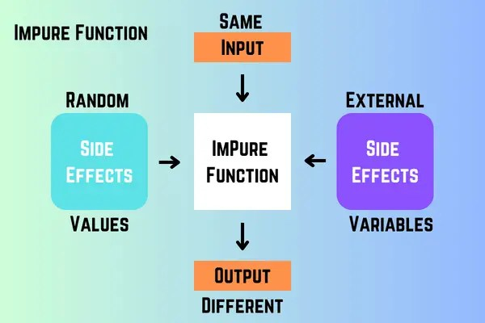
Impure functions interact with the outside world, making their output unpredictable.

Slide 13
Activity 1 – Pure vs Impure Classification
Working Independently
For each function below, tick Pure or Impure and explain why.
Function Description | Pure | Impure | Reason
Adds two numbers and returns the result | ⬜ | ⬜
Reads a value from a file | ⬜ | ⬜
Uses a global variable in a calculation | ⬜ | ⬜
Prints output to the screen | ⬜ | ⬜
10 mins
Complete in OneNote Workbook for Lesson 10

Slide 14
Activity 2 – Input / Output Diagrams
See the two functions in your OneNote Workbook
Function A
Function B
Working Independently
Input: 5
Output: 25
Is this function pure?
Explain your answer.
Input: 5
Output: Depends on current system time
Is this function pure?
Explain your answer.
10 mins

Slide 15
Activity 3 – Dependency Mapping
def calculate_price():
return base_price * tax_rate
Working Independently
Questions:
Where do base_price and tax_rate come from?
Are they passed in as parameters?
Does this function rely on external state?
10 mins

Slide 16
Activity 4 – Identify the Impurity
Working Independently
For each example, underline or highlight the part that makes the function impure:
  A function that reads user input
  A function that modifies a global variable
  A function that writes results to a file
  A function that generates a random number
10 mins

Slide 17
Assessment Evidence – Written Definitions
Working Independently
Answer the following in full sentences:
  Define a pure function.
  Explain what is meant by same input produces the same output.
  Define a side effect.
  State two reasons why a function might be impure.
This might be very useful for your Unit 3 Assessment…
15 mins

Slide 18
Homework
By tomorrow
Why are pure functions easier to test than impure functions?
Why might a programmer still choose to use impure functions?

