Slide 1

Unit 3
Parallelisation
Lesson 11

Slide 2
Recall Exercise
Visit:
https://retrieval.toolsforteaching.co.uk
Code: 443ssl

Slide 3
Phones
a small reminder…
once you have authenticated phones should be in the pockets on the wall

Slide 4
Unit 3
Parallelisation
Lesson 11

Slide 5
Learning Objectives
By the end of the lesson, learners will be able to:
Define parallelisation in the context of computing systems
Explain how tasks can be split and processed at the same time
Describe the relationship between parallelisation and pure functions
Explain the benefits and limitations of parallel processing

Slide 6
Key Vocabulary
Keep updated in the workbook as you go along
Term | Definition
Parallelisation
Task splitting
Sequential processing
Pure function
Dependency
Side effect

Slide 7


Can you juggle?

Slide 8
What is Parallelisation?
Parallelisation is the process of splitting a large task into smaller independent tasks that can be executed at the same time.
Instead of completing one step fully before starting the next (sequential processing), a system can use multiple processors, cores, or threads to work simultaneously.

Slide 9
Sequential vs Parallel Processing
Sequential:
One task → then the next → then the next
Parallel:
Multiple tasks → running at the same time
Parallelisation is commonly used in:
  Multi-core CPUs
  Distributed systems
  Graphics processing (GPUs)
  Cloud computing

Slide 10
The Factory Analogy
Scenario A: Sequential Factory
  A factory has one worker assembling a product:
  Attach base
  Add components
  Test product
  Package product
All steps are done by one person, one after another.

Slide 11
The Factory Analogy
Scenario B: Parallel Factory
  The same factory has four workers, each with a specific role:
  Worker 1: Attach base
  Worker 2: Add components
  Worker 3: Test product
  Worker 4: Package product
All steps happen at the same time on different products.

Slide 12
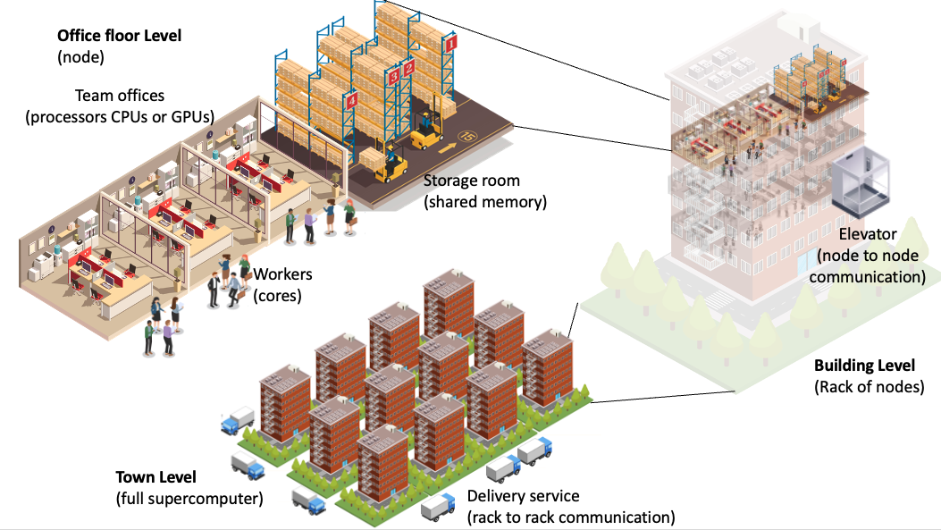
The Factory Analogy for a Supercomputer

Slide 13
Task 1: Written Comparison
Complete the table in your OneNote Workbook for Lesson 11
Working Independently
Aspect | Sequential Factory | Parallel Factory
Number of workers
Speed of production
Waiting time
Efficiency
10 mins

Slide 14
Task 2: Exam-Style Question
Using the factory analogy, explain how parallelisation improves performance.
Working Independently
10 mins
Write 3 or 4 sentences in your OneNote

Slide 15

Task Splitting
Task splitting is the process of breaking a problem into smaller sub-tasks that can be completed independently.
Example: Image Processing
Original task: Apply a filter to a large image
Now split it into:
  Process top-left quadrant
  Process top-right quadrant
  Process bottom-left quadrant
  Process bottom-right quadrant
Each section can be processed at the same time, then combined.

Slide 16
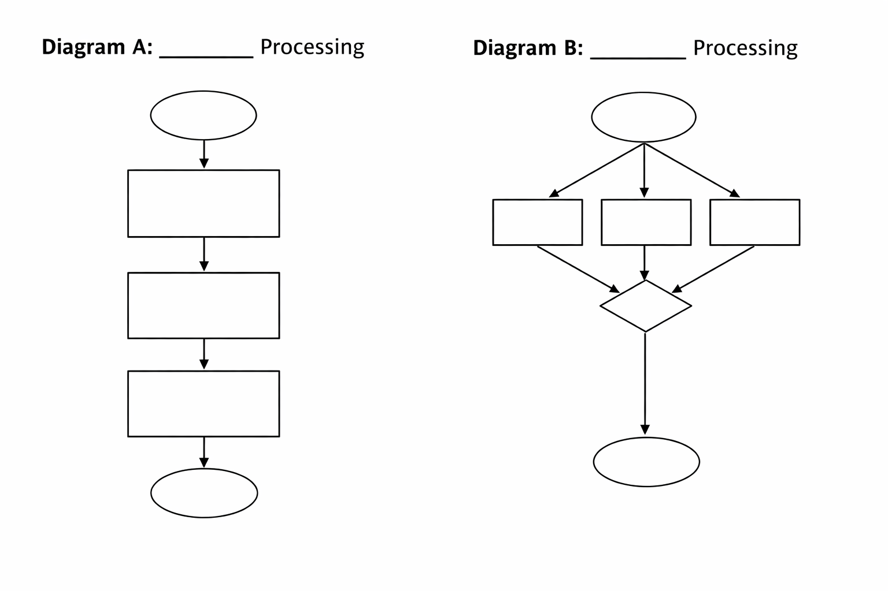
Task 3 Label the Diagram in OneNote
Working Independently
10 mins

Slide 17
Task 4: Create Your Own Diagram
Draw a simple diagram to show how the following task could be parallelised:
Marking 100 multiple-choice tests
Include:
  At least three parallel tasks
  A final step where results are combined
Working Independently
10 mins
You could use Lucid.app, draw.io or PowerPoint for this

Slide 18
Parallelisation and Pure Functions
Parallelisation works best when tasks:
  Do not depend on shared data
  Do not change external variables
  Always give the same output for the same input
These characteristics describe a pure function.

Slide 19
Why Pure Functions Matter
Pure functions:
  Have no side effects
  Do not rely on external state
  Can run safely in parallel without causing errors
Impure functions:
  Use shared variables
  Read/write files
  Depend on user input or timing
These can cause conflicts when run in parallel.

Slide 20
Task 5: Identify Suitability for Parallelisation
Tick whether each task is safe to parallelise and explain why.
Working Independently
Task | Pure? | Safe to Parallelise? | Why?
Calculating VAT from a price
Writing to the same log file
Converting temperatures
Updating a shared score counter
10 mins

Slide 21
Assessment Evidence – Descriptive Paragraph
Write a descriptive paragraph answering the following:
Explain what parallelisation is, how task splitting works, and why pure functions are well-suited to parallel processing.
Success Criteria:
  Correct definition of parallelisation
  Reference to task splitting
  Clear link to pure functions
  Accurate technical vocabulary
(8–10 sentences recommended)
Working Independently
10 mins

Slide 22
Homework
By tomorrow
Find a real-world example of parallelisation (e.g. gaming, video rendering, scientific simulations) and explain:
  What tasks are split
  How they run in parallel
  Why this improves performance

