Slide 1
Phones
a small reminder…
once you have authenticated phones should be in the pockets on the wall

Slide 2
Learning Objectives
By the end of the lesson, students will be able to:
  Define best practice in coding
  Explain why professional coding standards exist
  Use key terminology accurately in written form

Slide 3
Key Vocabulary
Maintainability
Readability
Scalability
Technical Debt

Slide 4

KISS
There is another version but I don’t call anyone stupid!
Don’t worry – there isn’t a practical!
However…
  What does KISS stand for? Keep It Simple and Straightforward

Slide 5

Recap (write in OneNote)
What is a function?
A function is a process with an input and an output

Slide 6
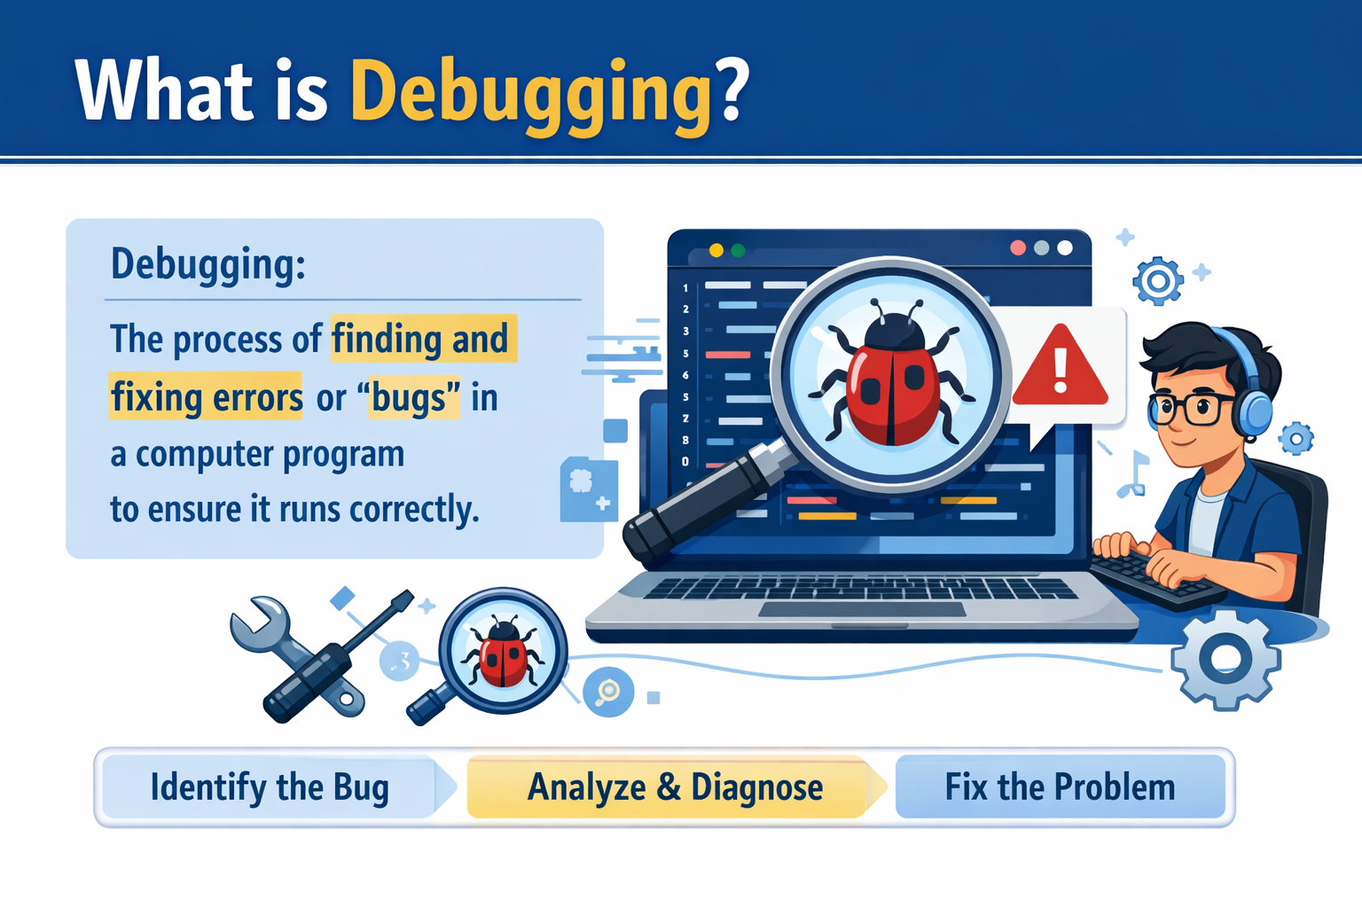
Recap (write in OneNote)
What is debugging?

Slide 7
Making the Connections
KISS → Simplicity = maintainability
Functions → Modularity
Debugging → Why readable code matters

Slide 8

Which codebase would you rather inherit?

Slide 9
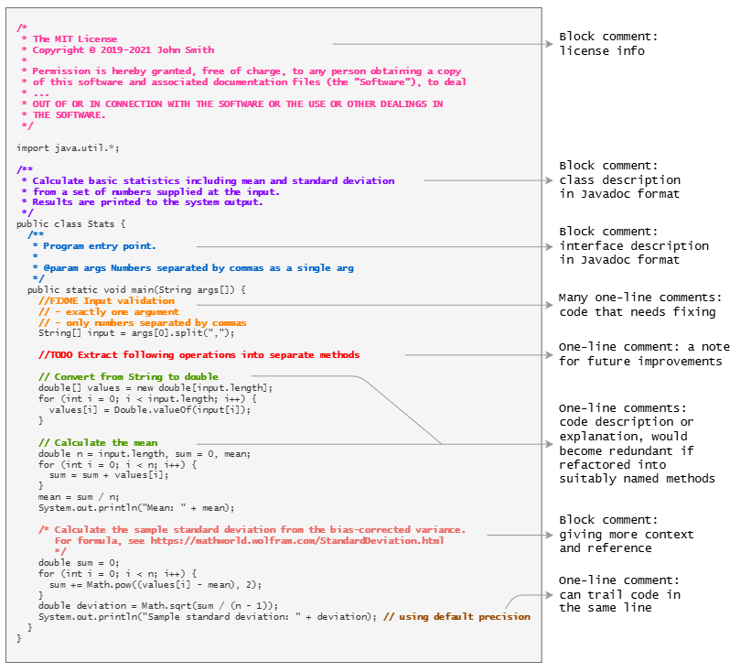
This?

Slide 10
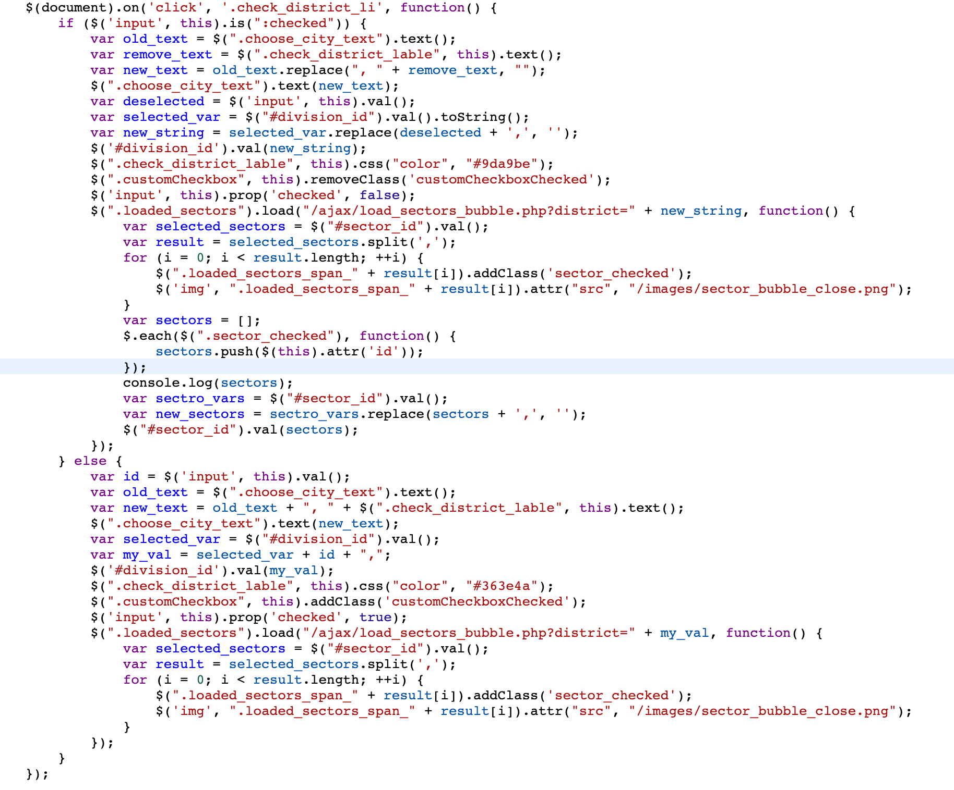
Or this?

Slide 11
Conclusion
Which would you rather maintain?
Which would be easier to debug?
Which would cost a company less money long-term?
Professional coding standards exist because software costs money to maintain — often more than it costs to build.

Slide 12
What is best practice?
shortcuts that cause long-term maintenance costs
Best practice = agreed professional standards that make code:
Principle | Meaning | Why it Matters
Maintainability | Easy to update and fix | Software changes constantly
Readability | Easy for humans to understand | Teams share code
Scalability | Works as user numbers grow | Business growth
Low Technical Debt | Minimal shortcuts that cause future problems | Saves long-term cost

Slide 13
The cost of poor code
Bugs
Security risks
Rewrites
Reputation damage

Slide 14
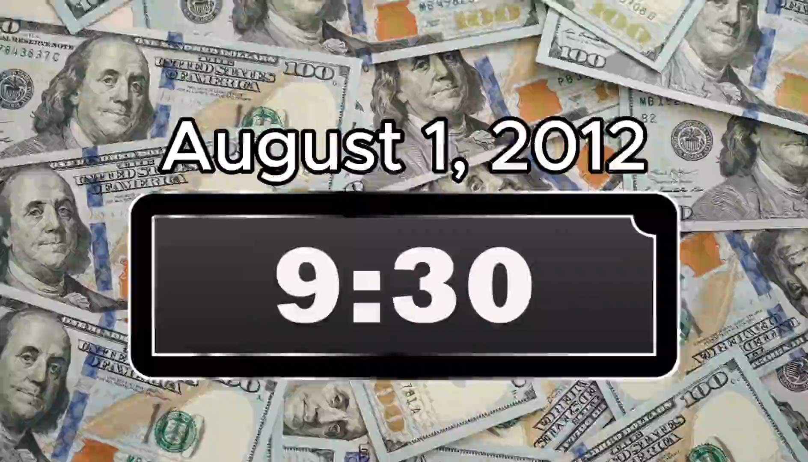
Knight Capital (2012)

Slide 15

Research & Discussion Task
Research one real-world software failure caused by poor:
  Testing
  Version control
  Documentation
  Security practice
Suggested examples
  Boeing (737 MAX software issues)
  British Airways IT outage
  Therac-25
  https://raygun.com/blog/costly-software-errors-history/
Produce a 4 slide PowerPoint:
  What happened?
  What coding/engineering mistake occurred?
  What was the impact?
  How could standards have prevented it?
Email to
simonrundell@exe-coll.ac.uk
In pairs
20 mins

Slide 16

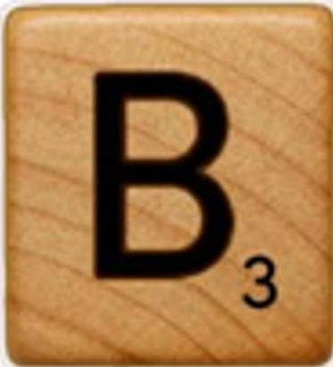
Practical Task: Code Critique
x=5
y=10
z=x+y
print(z)
def calculate():
number1 = 5
number2 = 10
total = number1 + number2
print(total)
15 mins
Annotate the OneNote version:
Improve variable names
Add comments
Break into functions
Improve layout/indentation
Questions:
Which is more readable?
Which scales better?
Which is easier to debug?

Slide 17
Workbook Write-Up Guidance (Assessment Preparation)
Write:
A 150–200 word introduction explaining why coding standards are important in professional software development.
Structure Scaffold:
Paragraph should include:
  Definition of best practice
  At least two key vocabulary terms
  Reference to financial/business impact
  One real-world example
Sentence Starter:
  Professional coding standards exist to ensure that software is…
Research the term
Technical Debt
Produce a 150-word explanation including:
Definition
Example
Long-term impact

