Slide 1
Phones
a small reminder…
once you have authenticated phones should be in the pockets on the wall

Slide 2
Recall Exercise
Visit:
https://retrieval.toolsforteaching.co.uk
Code: wj2lm1

Slide 3
Learning Objectives
By the end of the lesson, students will be able to:
  Define the KISS principle
  Explain the disadvantages of unnecessarily complex code
  Refactor code to improve simplicity and maintainability

Slide 4
What is wrong with this code?
def calculate_sum():
numbers = [5, 10]
total = 0
for number in numbers:
total = total + number
if total > 0:
return total
else:
return 0

Slide 5
Compared with…
Does the same thing
def calculate_sum():
return 5 + 10
Which is clearer?
Which is easier to debug?
Which would you rather maintain?

Slide 6

KISS
  KEEP
  IT
  SIMPLE &
  STRAIGHTFORWARD
We don’t use ‘Stupid’ anymore. If I see it as an answer, I will know that you Googled it, and mark it wrong.
Simpler code is easier to read, test, debug and maintain.

Slide 7
Why Simplicity Matters
Professional Standards
Issue | Result
High complexity | Harder to understand
Deep nesting | Increased bugs
Over-abstraction | Confusion
Unnecessary logic | Slower debugging

Slide 8
What is Complexity?
Complexity increases when:
Too many nested conditions
Poor variable naming
Excessive abstraction
Repeated code
Lack of structure
Refactor = improving code structure without changing its output.

Slide 9


Real-World Engineering Discipline
KISS is widely used across software engineering teams including organisations such as:
  Google
  Microsoft
  NASA
Professional teams avoid over-engineering because:
  Code is read more often than written.
  Multiple developers collaborate.
  Maintenance lasts years.

Slide 10
Research & Discussion Task
In pairs
List at least 3 disadvantages of complex code, each with an example.
Examples you should identify:
  Slower debugging
  Higher maintenance costs
  Increased onboarding time for new developers
  Greater risk of introducing new bugs
  Reduced scalability
  Give applied examples:“A nested if statement 6 levels deep makes it difficult to trace logic.”
20 mins

Slide 11
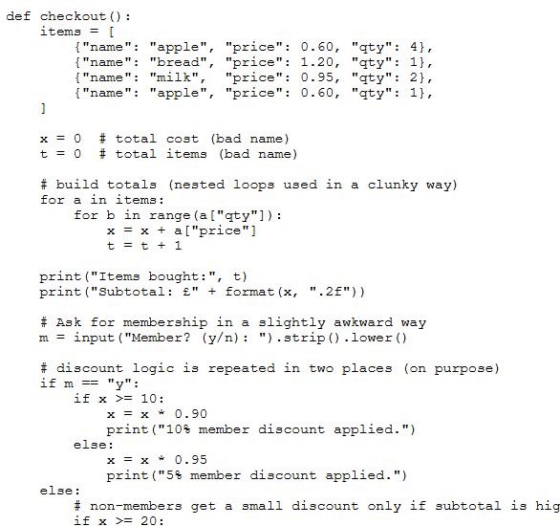
Task - Refactoring
Working Independently
20 mins
In the code in your OneNote:
  A nested structure
  A repeated section
  A poorly named variable
You Must:
  Simplify logic
  Rename variables meaningfully
  Break into functions where appropriate
  Improve formatting and comments

