Slide 1
Phones
a small reminder…
once you have authenticated phones should be in the pockets on the wall

Slide 2
Recall Exercise
Visit:
https://retrieval.toolsforteaching.co.uk
Code: e7kdjn

Slide 3
Learning Objectives
By the end of the lesson, students will be able to:
  Define the Single Responsibility Principle (SRP)
  Identify code that breaks SRP
  Refactor a function to follow SRP
  Explain how SRP improves testing and debugging

Slide 4
Look at this function
def process_order(order):
# Calculate total
total = 0
for item in order:
total += item["price"]
# Apply discount
if total > 100:
total *= 0.9
# Print receipt
print("Order total:", total)
# Save to file
file = open("orders.txt", "a")
file.write(str(total) + "\n")
file.close()
How many different jobs is this function doing?
What happens if the file-saving part breaks?
What if we want to reuse just the discount logic?
The function has multiple responsibilities

Slide 5
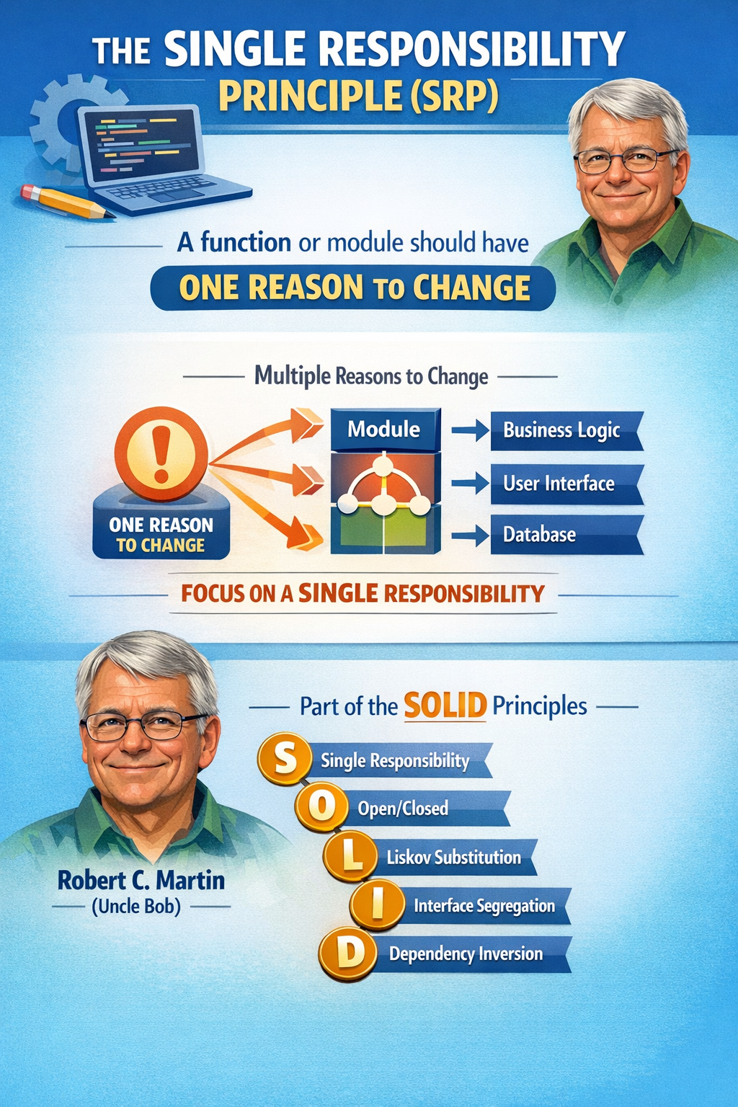
What is the Single Responsibility Principle?

Slide 6
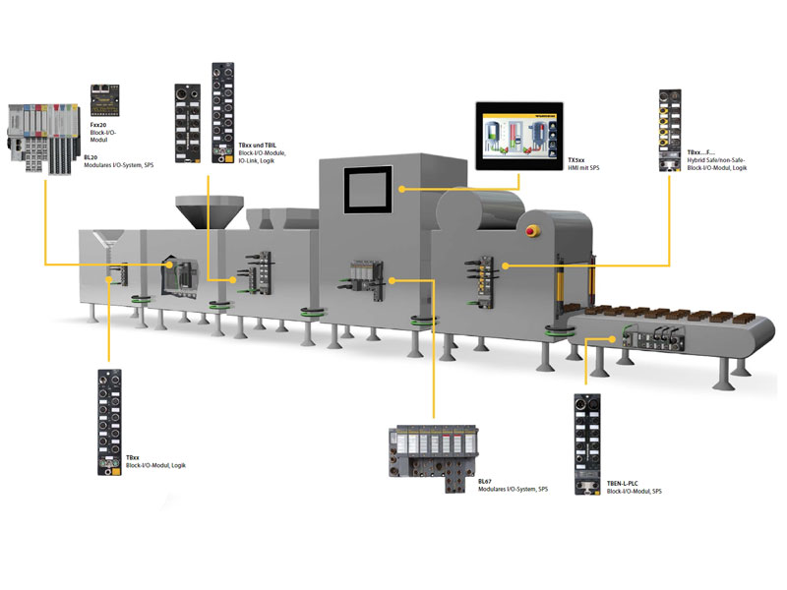
One big machine: multiple parts

Slide 8
Why “One Responsibility”?
If a function:
  Calculates
  Prints
  Saves to file
  Applies business rules
It becomes:
  Harder to debug
  Harder to test
  Harder to reuse
  More fragile when modified

Slide 9
Applying SRP…
def calculate_total(order):
total = 0
for item in order:
total += item["price"]
return total
def apply_discount(total):
if total > 100:
return total * 0.9
return total
def print_receipt(total):
print("Order total:", total)
def save_order(total):
with open("orders.txt", "a") as file:
file.write(str(total) + "\n")
Now each function
Does one job
Has one reason to change
Can be tested independently

Slide 10
Research Task – Put in OneNote
In pairs
Why is smaller modular code easier to debug?
How would you test calculate_total() on its own?
What happens if the discount rule changes?
15 mins
Notes:
Feedback answers should include:
Smaller scope of error
Easier isolation
Reduced side effects
Improved readability

Slide 11
Applied Practical Task
Working Independently
def register_user(username, password):
if len(password) < 8:
print("Password too short")
return
encrypted = password[::-1]
file = open("users.txt", "a")
file.write(username + "," + encrypted + "\n")
file.close()
print("User registered successfully")
30 mins
Document in OneNote workbook.
You need to insert:
Screenshot of original messy function
Screenshot of refactored version
✍️ Create a Written Explanation (min 150 words)
Define SRP in your own words
Explain how their refactor improves maintainability
Explain how it helps debugging
Use keywords: modular, single responsibility, unit testing
You must:
  Identify all responsibilities.
  Break into smaller functions.
  Ensure program still works.
  Comment what each function does
Notes:
Note this is an impure function

Slide 12
Stretch Task
Explain how SRP supports Unit Testing
You should identify:
  Smaller functions = easier to test individually
  Fewer dependencies
  Less setup required
  Clear inputs → clear outputs
You may briefly explore the concept of Clean Code as a professional coding standard text.

Slide 13

Think:
Why should a function only have one responsibility?

