Slide 1
Phones
a small reminder…
once you have authenticated phones should be in the pockets on the wall

Slide 2
Recall Exercise
Visit:
https://retrieval.toolsforteaching.co.uk
Code: gir109

Slide 3
Learning Objectives
By the end of the lesson, students will be able to:
  Explain Separation of Concerns
  Define Abstraction with an example
  Identify basic components of MVC and MVVM
  Draw a simple architecture diagram for their own project

Slide 4


You press X … but what actually happened?
When you press X in a game, what happens?
Do you see the physics engine?
Do you see the collision detection code?
Do you see the animation logic?
ff
You see a jump.

Slide 5
You interact with
A button
A clean interface
This is abstraction
Behind that is:
Physics engine
Collision detection
Sound system
Animation system
Score logic
This is separation of concerns
The complexity is hidden
The different systems are separated

Slide 6
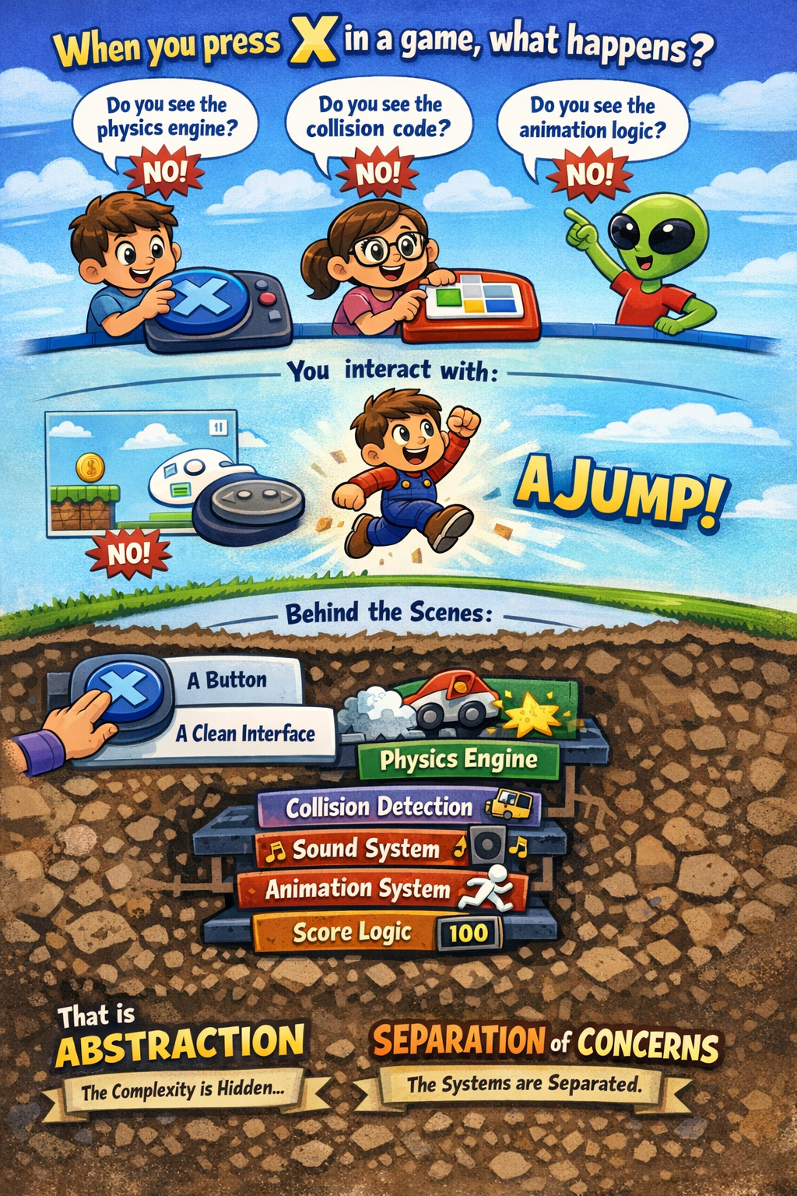

Slide 7
What is Separation of Concerns?
Separation of Concerns means:
  Different parts of a program handle different responsibilities.
Instead of mixing:
  User interface
  Data storage
  Logic
We separate them.
This builds on SRP — but now at system level rather than function level.

Slide 8
What is abstraction?
Abstraction means:
Hiding complexity and exposing only what is necessary.
The user of this function does not need to know how multiplication works internally
They just use it.
def calculate_area(width, height):
return width * height
Notes:
Note this is a pure function

Slide 9
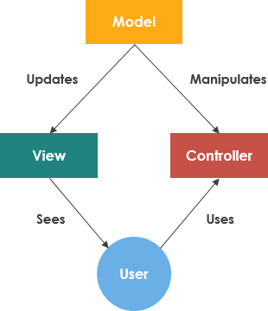
Introducing MVC Structure
MVC = Model-View-Controller
Model
  Data
  Business logic
View
  What the user sees
Controller
  Handles input
  Connects Model and View
Notes:
Introducing MVC

Slide 10
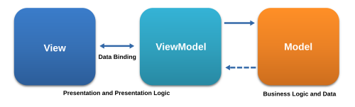
Introducing MVVM
MVVM = Model-View-ViewModel
Model
  Data and logic
View
  UI
ViewModel
  Connects View to Model
  Handles presentation logic
MVVM is common in modern app frameworks.

Slide 11
Research – SwiftUI Architecture
Working Independently
Research:
  What architecture does SwiftUI use?
  What role does ViewModel play?
Summarise your findings in 5 bullet points
25 mins
Notes:
Expected findings:
SwiftUI heavily uses MVVM style.
Data binding connects View and ViewModel.
Encourages separation of UI and logic.

Slide 12
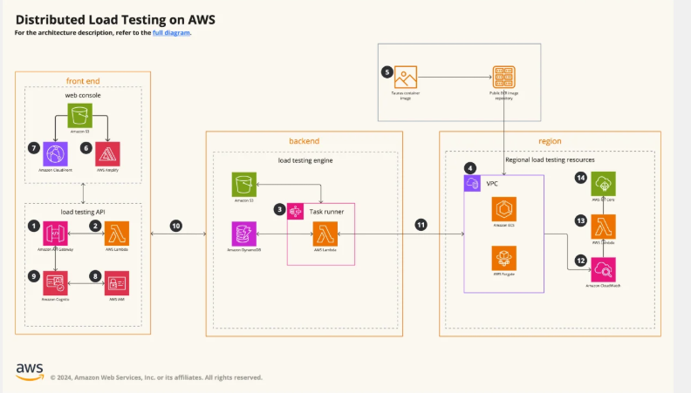
What is an Architecture Diagram?
It is an illustration of the relationship between structures and processes

Slide 13
Architecture diagrams explained
Architecture diagrams help teams visualize and understand systems.
They map out components, relationships, and workflows to provide clarity.
Think of them as a guide that shows how everything connects, whether it’s technical, organizational, or conceptual.
  Why they matter
  Simplify complex ideas: Break down technical workflows into approachable visuals.
  Improve collaboration: Make diagrams useful for developers, product managers, and stakeholders alike.
  Align teams: Ensure everyone shares the same understanding of a system.
It’s a visual representation of your system’s structure—whether that system is technical, organizational, or conceptual.
By mapping components, relationships, and flows, architecture diagrams provide a clear, shared understanding of how everything fits together.
They don’t just work for developers. They’re also approachable for stakeholders, product managers, and anyone else involved in the process.

Slide 14
Task
Working Independently
Choose your own app/project.
Identify:
  Model components
  View components
  Controller or ViewModel components
Draw architecture diagram (hand-drawn or digital).
Label arrows clearly.
Consider:
  What handles user input?
  Where is data stored?
  Where does logic live?
25 mins

Slide 15
Write up guidance:
You must include:
a Screenshot or photo of architecture diagram.
150–200 word explanation including:
  Definition of abstraction
  Explanation of separation of concerns
  Explanation of chosen architecture (MVC or MVVM)
  Use keywords:
    Abstraction
    Architecture
    Modular
    Separation of concerns
15 mins

Slide 16
Extension Task
Compare MVC and MVVM
Explain:
  Advantages of MVC:
    Simple to understand
    Clear separation
  Advantages of MVVM:
    Better for modern UI frameworks
    Supports data binding
    Cleaner UI logic separation
Extension question:
Which architecture would you choose for your project and why?

