Slide 1
Phones
a small reminder…
once you have authenticated phones should be in the pockets on the wall

Slide 2
Recall Exercise
Visit:
https://retrieval.toolsforteaching.co.uk
Code: lsy3wf

Slide 3
Learning Objectives
By the end of the lesson, students will be able to:
  Describe the purpose of the SOLID principles
  Identify what each letter in SOLID stands for
  Explain the principles at a conceptual depth
  Recognise where a SOLID idea appears in their own project work

Slide 4
Key Vocabulary
Term | Definition
SOLID
Principle
Single Responsibility
Open/Closed
Dependency
Interface
Maintainability

Slide 5

Creator of the SOLID principles
Author of the hugely influential ‘Clean Code’

Slide 6
Why should we listen to Uncle Bob?
Large frameworks used worldwide follow design principles so they don’t collapse under complexity.
Some examples of real-world professional frameworks you may have heard of:
  React
  Angular
  Django
These frameworks are used by thousands of developers at once.
Without design principles, they would become unmaintainable chaos.

Slide 7


Slide 8
What is SOLID?
SOLID is a set of 5 design principles created by Robert C. Martin to make software:
  Easier to maintain
  Easier to extend
  Less fragile

Slide 9
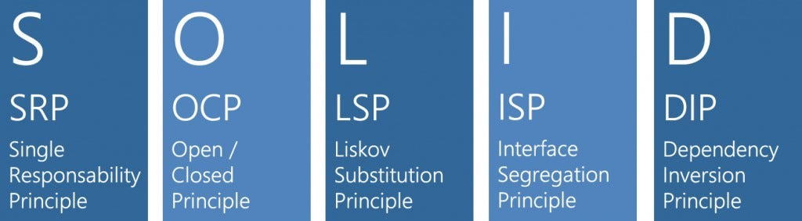

Slide 10
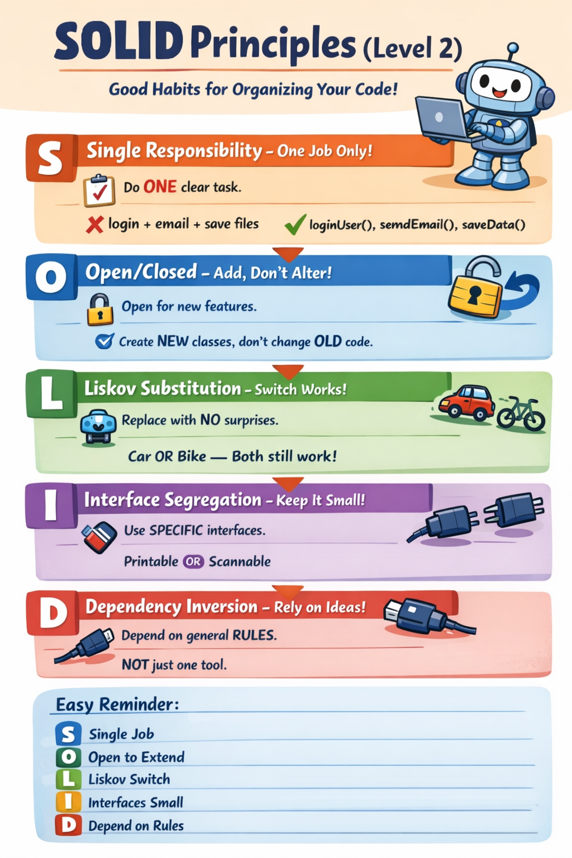
Notes:
S — Single Responsibility Principle (SRP)
A module or function should have one reason to change.
Example (Level 2 appropriate):
A class that calculates scores should not also save files.
If it does two jobs → two reasons to change.
O — Open/Closed Principle
Code should be:
Open for extension
Closed for modification
Meaning:
We should add new behaviour without rewriting existing code.
Simple example:
Instead of editing old code, create a new class that extends it.
L — Liskov Substitution Principle
If one class replaces another, the program should still work correctly.
Plain English:
Subclasses should behave like their parent class.
Bad example:
A “Bird” class that assumes all birds can fly.
But a Penguin cannot.
I — Interface Segregation Principle
Do not force code to depend on methods it does not use.
Simple explanation:
Small, specific interfaces are better than one huge interface.
D — Dependency Inversion Principle
High-level modules should not depend on low-level modules.
Both should depend on abstractions.
Level 2 simplification:
Important parts of your program should not directly control small details.
Use interfaces or abstraction layers instead.

Slide 11
Research Task
In small groups
20 mins
Include:
Definition
Example
Why it matters
Connect to:
Abstraction
Separation of concerns
5 Groups (I will allocate now)
Each group researches ONE principle
  Define it in simple language
  Create one example
  Explain why it prevents bad code
  Produce a 3-minute PowerPoint presentation (share and work collaboratively)

Slide 17
Workbook Write-Up
Working Independently
Paragraph Model:
  Define SOLID
  Choose one principle
  Explain it
  Give an example
  Explain why it improves maintainability
Sentence starters:
  “The SOLID principles are…”
  “The Single Responsibility Principle states that…”
  “This improves software because…”
15 mins

Slide 18
Extension
Find a real-world framework that follows SOLID.
Possible examples:
  Spring Framework
  ASP.NET Core
You should:
  Identify one SOLID feature in that framework
  Explain it briefly
Higher-level question:
  Which SOLID principle do you think is most important — and why?

