Slide 1
Recall Exercise
Visit:
https://retrieval.toolsforteaching.co.uk
Code: bsxfb6

Slide 2
Phones
a small reminder…
once you have authenticated phones should be in the pockets on the wall

Slide 3
Learning Objectives
By the end of the lesson, students will be able to:
  Define software testing
  Explain why testing is essential in software development
  Describe how testing improves reliability and quality
  Do some actual testing
  Create a simple test plan for a software feature

Slide 4
Key Vocabulary
Word | Definition
Unit Testing
Integration Testing
System Testing
User Acceptance Testing (UAT)
Black Box Texting
White Box Texting
Automated Testing
Before the end of the lesson make sure you have completed each entry in the OneNote Worksheet

Slide 5
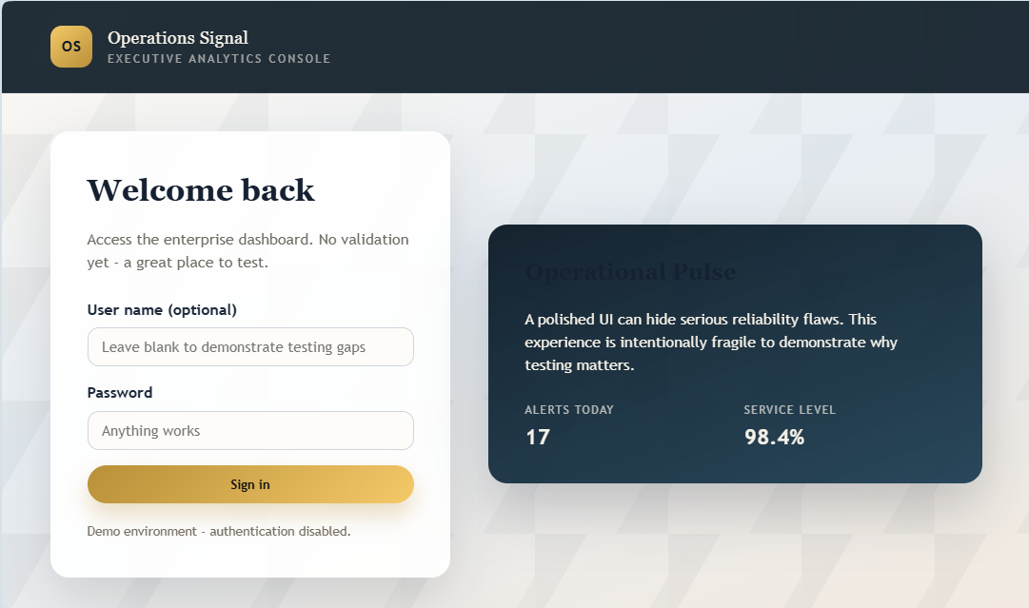
Why testing is important

Slide 6
Bad eh?
In this case: intentionally
Would you trust this app?
Would a business release this?
What happens to reputation?
Testing protects users, businesses, and developers.

Slide 7
What is testing?
Testing is the process of checking that software:
  Works as expected
  Produces correct results
  Handles errors properly
  Does not crash

Slide 8
The importance of Software Testing
See “Programming’s Greatest Mistakes” by Mark Rendel
Link in Teams / Classwork
Software bugs can cause potential monetary and human loss. There are many examples in history that clearly depicts that without the testing phase in software development lot of damage was incurred. Below are some examples:
1994: China Airlines Airbus A300 crashed due to a software bug killing 264 people.
1996: A software bug caused U.S. bank accounts of 823 customers to be credited with 920 million US dollars.
1999: A software bug caused the failure of a $1.2 billion military satellite launch.
1999: Fujitsu’s Horizon IT system caused more than 900 Subpostmasters to be wrongly accused and even prosecuted for theft and fraud, caused by bugs in the system,
2015: A software bug in the F-35 fighter plane resulted in making it unable to detect targets correctly.
2015: Bloomberg terminal in London crashed due to a software bug affecting 300,000 traders on the financial market and forcing the government to postpone the 3bn pound debt sale.
2023: Starbucks was forced to close more than 60% of its outlet in the U.S. and Canada due to a software failure in its POS system.
Which example was worse: financial loss or human loss?

Slide 9
“You do not write code, you debug it”

Slide 10
Different Levels of Testing
Working Independently
5 mins
A developer checks a single function that calculates tax.
Two modules (login + database) are tested together.
The whole finished app is tested before release.
Customers try the system before launch.
UAT
Unit
System
Integration
Research and match the definition to the testing level
Notes:
1B
2D
3C
4A

Slide 11
Different Levels of Software Testing
In Software testing there are Different Levels of Testing can be majorly classified into 4 levels:
Unit Testing: In this type of testing, errors are detected individually from every component or unit by individually testing the components or units of code to ensure that they are fit for use by the developers. It is the smallest testable part of the software.
Integration Testing: In this testing, two or more modules which are unit tested are integrated to test i.e., technique interacting components, and are then verified if these integrated modules work as per the expectation or not, and interface errors are also detected.
System Testing: In system testing, complete and integrated Software are tested i.e., all the system elements forming the system are tested as a whole to meet the requirements of the system.
User Acceptance Testing (UAT): This is a kind of testing conducted to ensure that the requirements of the users are fulfilled before its delivery and that the software works correctly in the user’s working environment.

Slide 12
Real world context
Large companies invest heavily in QA teams.
Examples of companies where testing is critical:
  Microsoft
  Google
  Apple
Imagine if your banking app crashed during a transfer.

Slide 13
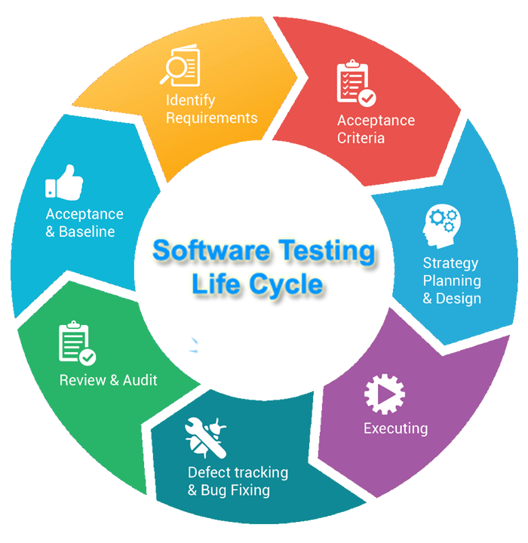
Notes:
Detect bugs before users do
Protect reputation
Improve reliability

Slide 14
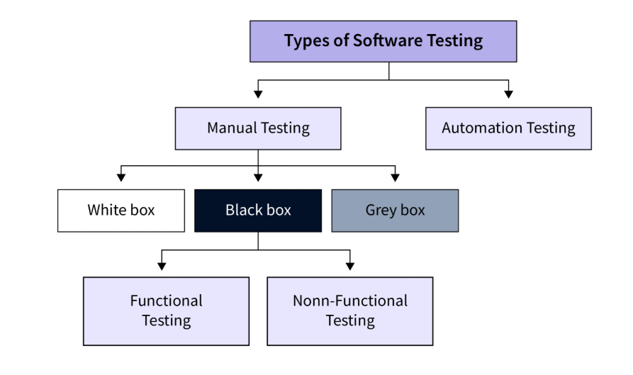
Types of Software Testing

Slide 15
What are the colour boxes?
White Box
Black Box
Gray Box
Focus on internal operation with ref to Source Code
Focus on function only
A mix of White & Black Box testing
Usually done by developers
Can be done by anone
Often done by end-users

Slide 16
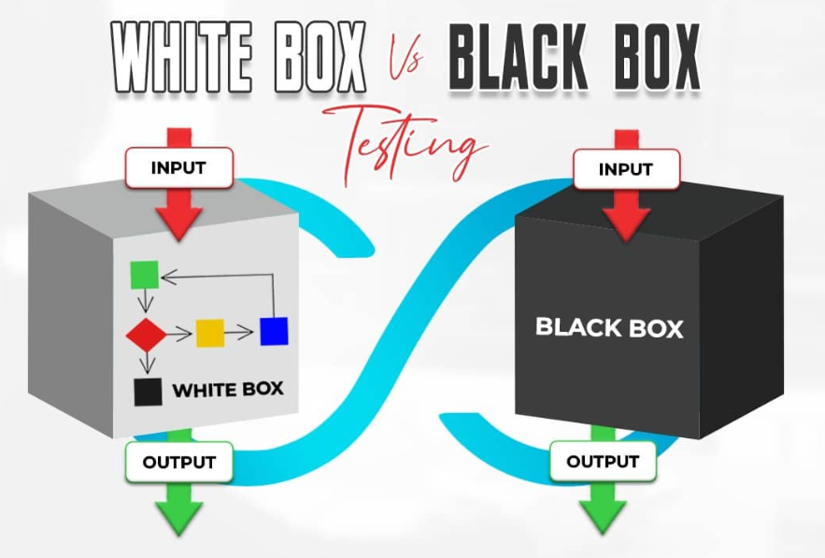

Slide 17
Testing Strategies - Smoke Tests
Note this down
  aka confidence testing, sanity testing, build verification test (BVT) and build acceptance test)
Preliminary testing to reveal simple failures severe enough to halt further testing.
It is a subset of test cases that cover the most important functionality of a component or system
Used to aid assessment of whether main functions of the software appear to work correctly.
If software passes Smoke Testing it may be subjected to further, more fine-grained testing, so it might be called a pretest or an intake test.
“Does it work at all?”

Slide 18
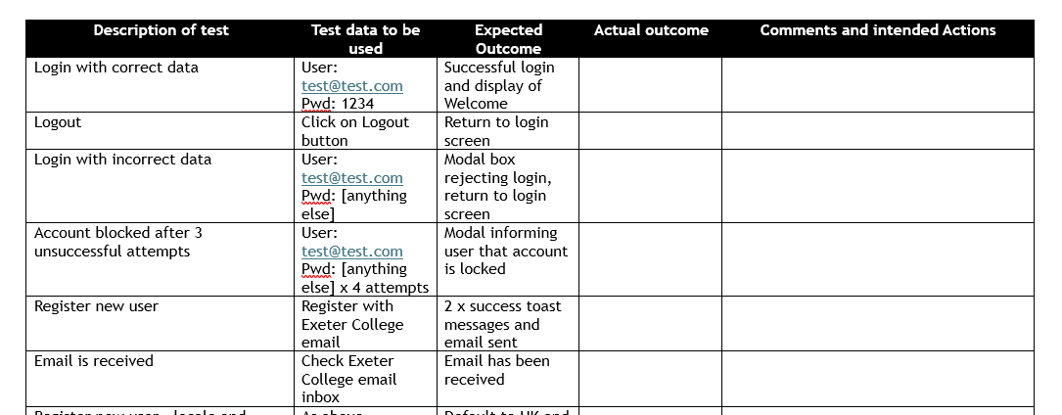
Actual Testing
Working Independently
Use the Testing Script in OneNote
Visit: https://unittest.toolsforteaching.co.uk/
Follow the test script and note any bugs
  There will be some!
30 mins

Slide 19
Workbook Write-Up
Complete the definitions to the Key Vocabulary
Write a number of paragraphs to
Define Testing
include:
  Definition
  Purpose
  Example
Explain the importance of testing
Example Structure:
  Reason 1 → Explanation → Example
  Reason 2 → Explanation → Example
  Reason 3 → Explanation → Example
Link to:
  Reliability
  User trust
  Financial impact
Working Independently
20 mins

Slide 20
Extension
What security risks occur if software is not tested properly?
Consider:
  Vulnerabilities
  Data leaks
  Injection attacks
  Authentication bypass

