Slide 1
Recall Exercise
Visit:
https://retrieval.toolsforteaching.co.uk
Code: 89ndh5

Slide 2
Phones
a small reminder…
once you have authenticated phones should be in the pockets on the wall

Slide 3
Learning Objectives
By the end of this lesson students will be able to:
Describe the characteristics of Test Driven Development (TDD)
Explain the benefits of TDD
Identify how TDD differs from traditional development
Simulate the TDD cycle using pseudocode

Slide 4
Key Vocabulary
Word | Definition
Test-Driven Development
Red–Green–Refactor
Unit Test
Refactor
Automated Testing
By the end of this lesson you should have enough information to complete these definitions in your OneNote Workbook

Slide 5
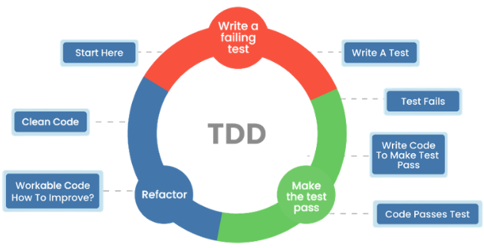
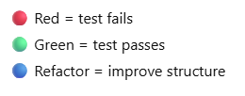
Test-Driven Development
Notes:
Why might developers test first rather than coding?

Slide 6
What is TDD?
Test Driven Development is a software development method where:
Tests are written before the code
Code is written to pass the test
Code is improved (refactored) once the test passes
Popularised in Agile development practices and strongly associated with automated unit testing.

Slide 7
Characteristics of TDD
Tests written before production code
Small development cycles
Frequent automated testing
Refactoring after passing tests
Focus on minimal working solution

Slide 8
Benefits of TDD
Improves reliability
Reduces bugs early
Encourages simple design (KISS link)
Provides automatic regression testing
Makes teamwork safer

Slide 9
Comparison: Traditional vs TDD
Traditional Approach | TDD Approach
Write code | Write test
Test later | Write code to pass test
Fix bugs | Refactor
Which approach is more controlled? Why?

Slide 10

Research Task
In pairs
How might TDD help in team development?
Consider:
Shared understanding
Safer collaboration
Confidence when changing code
Reduced integration problems
Examine Platforms like:
  GitHub
  GitLab
where automated tests can run before merging code.
15 mins

Slide 11
Applied Practical Task – Simulated TDD Cycle
Task: “Create a function that checks if a number is even”
Step 1 = write test (red)
Step 2 = write minimal code to pass (green)
Step 3 – Refactor - Check:
Is it readable?
Is naming clear?
Does it follow SRP?
Test: isEven(4) should return True
Test: isEven(5) should return False
Task:
Choose one simple feature
Write 2 tests
Write minimal solution
Describe refactor step
Once completed copy into OneNote workbook
function isEven(n):
return n % 2 == 0
Working Independently
20 mins

Slide 12
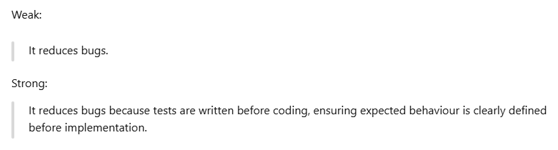
Workbook Write-Up
Working Independently
Complete Vocabulary definitions in OneNote workbooks
Complete a 150-200 paragraph demonstrating the
  Characteristics of TDD
  Benefits of TDD
20 mins

Slide 13
Extension
Compare TDD to traditional testing.
Explain:
  Difference in order
  Impact on reliability
  Impact on development speed
Higher-level thinking:
  Could TDD slow down development initially but speed it up long term?

Slide 14

What does Red mean in TDD?
Why is refactoring important?

