Slide 1
Recall Exercise
Visit:
https://retrieval.toolsforteaching.co.uk
Code: 0n8i2k

Slide 2
Phones
a small reminder…
once you have authenticated phones should be in the pockets on the wall

Slide 3
Learning Objectives
By the end of the lesson, Students will be able to:
Define bug and debugging
Identify and describe syntax, runtime, and logic errors
Use debugging techniques: print tracing, breakpoints, step over/into, inspecting variables
Explain how they fixed a bug using a clear process

Slide 4
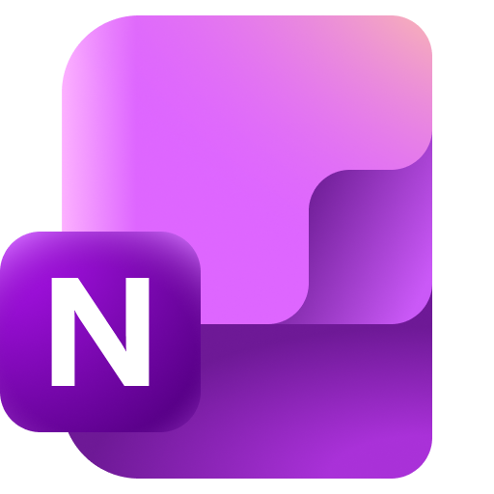
Key Vocabulary
Word | Definition
Bug
Debugging
Syntax Error
Runtime Error
Logic Error
Breakpoint
By the end of the lesson complete the key vocabulary table in the OneNote workbook

Slide 5
This should work…
def calculateTotals(number1, number2):
return number1 + number2
numb1 = input('Enter first number')
numb2 = input('Enter second number')
print (calculateTotals(number1, number2))
Can you see anything wrong with this code?
Let’s try it in Programiz and see…
Notes:
def calculateTotals(number1, number2):
return number1 + number2
numb1 = input(“Enter first number”)
numb2 = input(“Enter second number”)
print calculateTotals(number1, number2)

Slide 6
Two different kinds of errors…
def calculateTotals(number1, number2):
return number1 + number2
numb1 = input('Enter first number')
numb2 = input('Enter second number')
print (calculateTotals(number1, number2))
The first error was a syntax error:
  “number1” instead of numb1
The second error is a logical error
  I didn’t change the inputs from strings to integers!
Notes:
What’s your first debugging move?
Look at the line number, and possibly the before or after it to check for spelling/syntax errors

Slide 7
“You do not write code, you debug it”

Slide 8
A process for debugging
Reproduce the bug (same steps cause same failure)
Read the error message (line number + error type)
Isolate the problem (smallest code that still breaks)
Inspect variables (print / debugger / breakpoint)
Fix one thing at a time
Retest (and prevent regression)

Slide 9
Tools for debugging
Print Tracing
  Print tracing means adding temporary print() statements to show the value of variables while the program runs.
It helps you see:
  What values variables actually contain
  Whether a loop runs the correct number of times
  Whether a condition is true or false
Why It Works
  Programs don’t make mistakes randomly: they follow logic exactly.
  If the output is wrong, the data somewhere is wrong.
  Print tracing exposes that data.
  You can also do this by logging it to the console in a web browser
numbers = [2, 4, 6]
total = 0
for n in numbers:
total = n
print("Total:", total)

Slide 10
When to use print tracing
When you don’t understand why a value is wrong
When debugging loops
When debugging conditions
When learning
Limitations
  Can clutter output
  Must remember to remove later
  Not practical in very large systems
The total is being replaced not added!
for n in numbers:
print("n =", n)
total = n
print("total =", total)
n = 2
total = 2
n = 4
total = 4
n = 6
total = 6

Slide 11
Tools for debugging
Assertions
  An assertion is a statement that checks whether something must be true at a certain point in the program.
  If the condition is false, the program stops with an error.
In Python we can use assert <condition>
As total is -5 the code will stop and show AssertionError
This tells us something undesirable has just happened
total = -5
assert total >= 0
Notes:
def divide(a, b):
assert b != 0
return a / b
If someone tries divide(10,0) it will prevent a crash later.

Slide 12
Why assertions are powerful
Catch logic errors early
Document expectations
Make debugging faster
Support TDD
"An assertion is the program saying: ‘This must always be true. If not, something is broken.’"

Slide 13
Tools for debugging
Breakpoints
A breakpoint pauses the program at a specific line so you can:
  Inspect variables
  Step through code line-by-line
  Watch how values change
Let me demonstrate in Visual Basic for Applications in Microsoft Word

Slide 14
Why Breakpoints are superior to Print
Print tracing shows snapshots.
Breakpoints let you:
  Pause execution
  Step forward slowly
  Inspect all variables at once
  Watch changes live

Slide 15
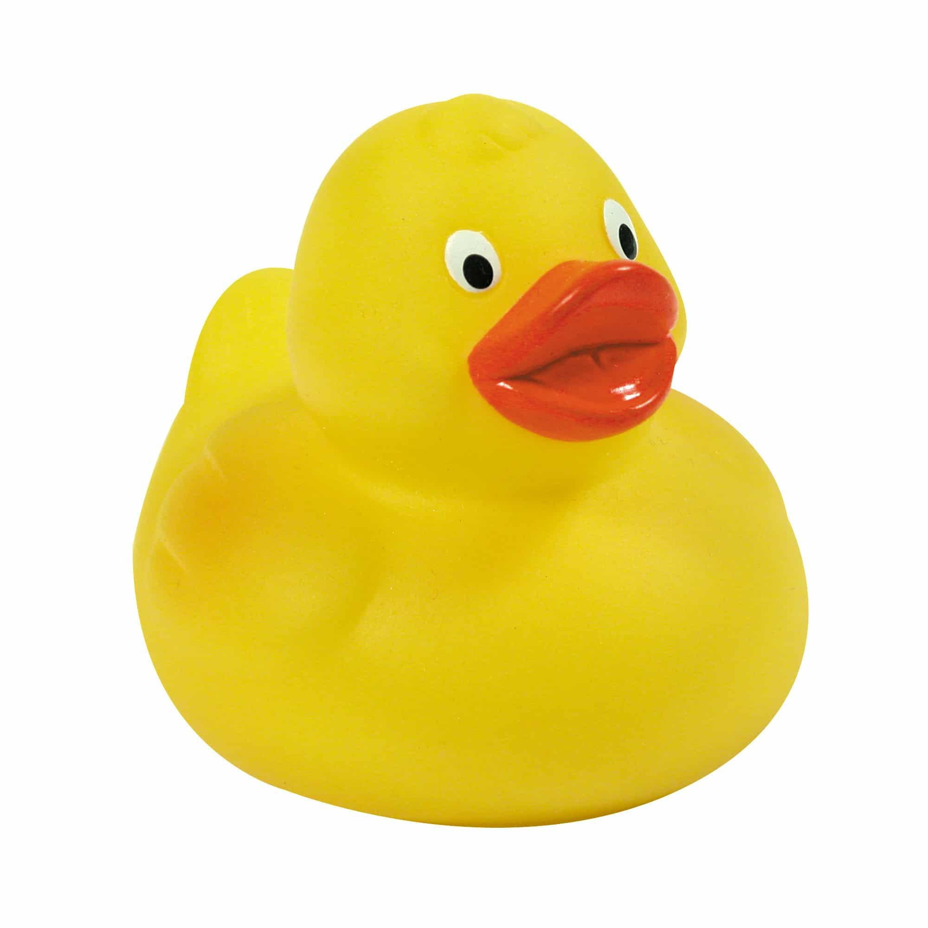
Tools for debugging
Rubber Duck Debugging
Rubber duck debugging means explaining your code line-by-line out loud as if teaching someone else.
The “someone” can be:
  A rubber duck
  A colleague
  Yourself

Slide 16
Why it works
When we explain code:
  We slow down
  We notice assumptions
  We spot logical gaps
Most logic errors are thinking errors.
Explaining reveals them.
Think “Explain it to me like a 5 year-old”

Slide 17
Comparing Strategies
Strategy | Best For | Difficulty | Professional Use
Print Tracing | Simple logic bugs | Easy | Yes
Assertions | Protecting assumptions | Medium | Yes
Breakpoints | Complex bugs | Medium | Yes (very common)
Rubber Ducking | Logic thinking errors | Easy | Surprisingly common

Slide 18

Which debugging method gives you the most information with the least effort?
Which would you use first in an exam?

Slide 19
Python Debugging Challenges
Working Independently
Download a copy of the Lesson 08 Debugging Challenge
Solve and explain each of the issues
Copy and paste back into your OneNote workbooks when complete
30 mins

Slide 20
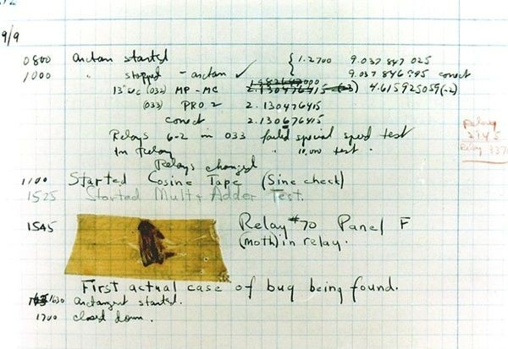
Workbook write-up
Working Independently
Complete the Key Vocabulary list in the OneNote workbook
Write 150-200 words with:
  Definition of bug
  Definition of debugging
  Explain 3 error types with an example each (syntax/runtime/logic)
Reflection:
Which bug took longest? Why?
Which strategy helped most?
What will you do first next time?
15 mins

Slide 21
Extension
Research Logging systems
  What is logging?
  Why is logging useful compared to print()?
  Find one example of log levels: INFO / WARNING / ERROR

