Slide 1
Recall Exercise
Visit:
https://retrieval.toolsforteaching.co.uk
Code: m0s9f3

Slide 2
Phones
a small reminder…
once you have authenticated phones should be in the pockets on the wall

Slide 3
Learning Objectives
By the end of this lesson, students will be able to:
  Define Continuous Integration (CI)
  Identify and describe the key steps in a CI pipeline
  Explain why CI improves software quality and collaboration

Slide 4
Key Vocabulary
Term | Meaning
Continuous Integration
Version Control
Repository
Pipeline
Automated Testing
Workflow
YAML
Complete these definitions before the end of the lesson in OneNote

Slide 5
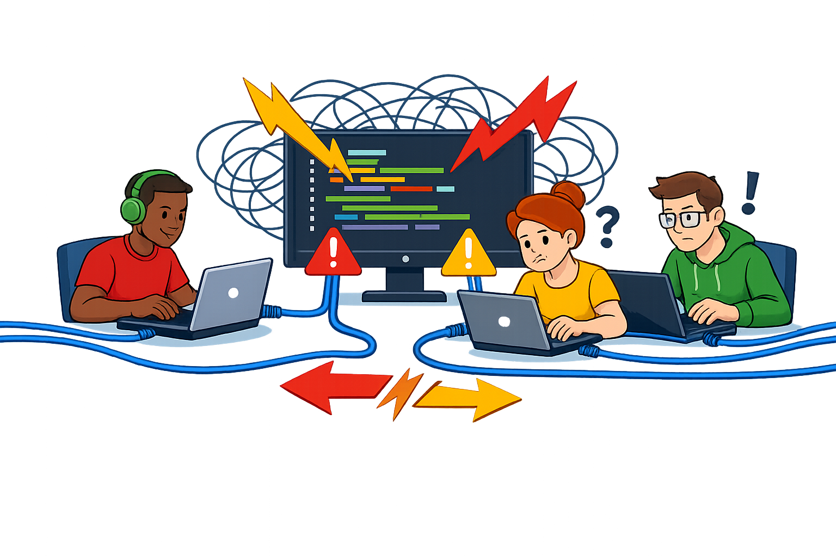
Merge Conflict
This is why we need Version Control and Continuous Integration
Team A changes variable names
Team B changes output formatting
Team C adds validation
What happens when we try and merge these three separate developments?
CHAOS | CONFUSION | BROKEN CODE
Notes:
Scenario Activity: “Team Chaos”
Divide class into groups of 3.
Give each student a printed copy of the same simple Python function.
Each student makes a different change:
Student A: changes variable names
Student B: changes output formatting
Student C: adds validation
Now attempt to combine their changes manually.
Result: Conflicts. Confusion. Overwritten code.
Then ask:
“How do real software teams stop this happening?”
Lead into: Version Control + Continuous Integration

Slide 6
What is Continuous Integration?
Definition:
Continuous Integration (CI) is the practice of regularly merging code changes into a shared repository where automated tests and checks run automatically.
More technically:
  Developers commit code frequently
  Code is automatically built
  Automated tests are run
  Errors are flagged immediately

Slide 7
Where CI Fits in Software Development
Version Control Systems
  Track changes
  Allow collaboration
  Manage merge conflicts
Examples:
  Git
  GitHub
  GitLab

Slide 8
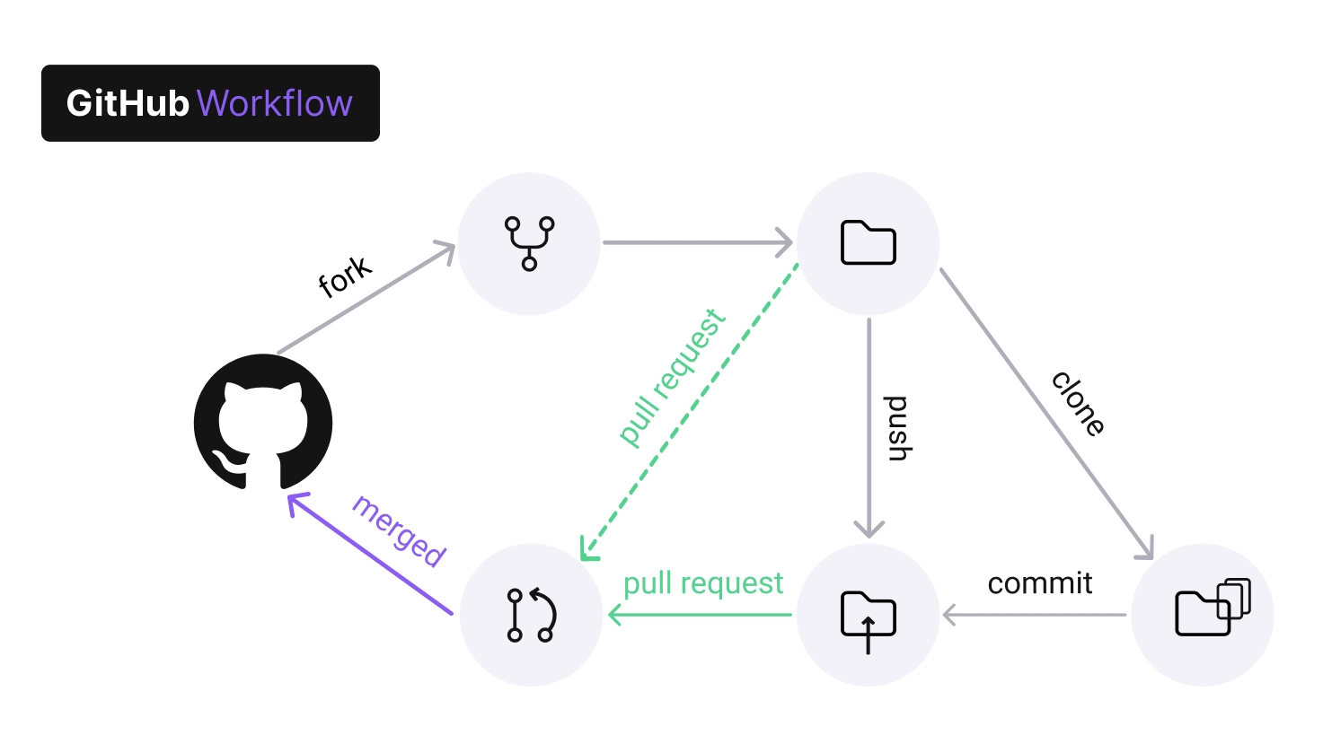

Slide 9
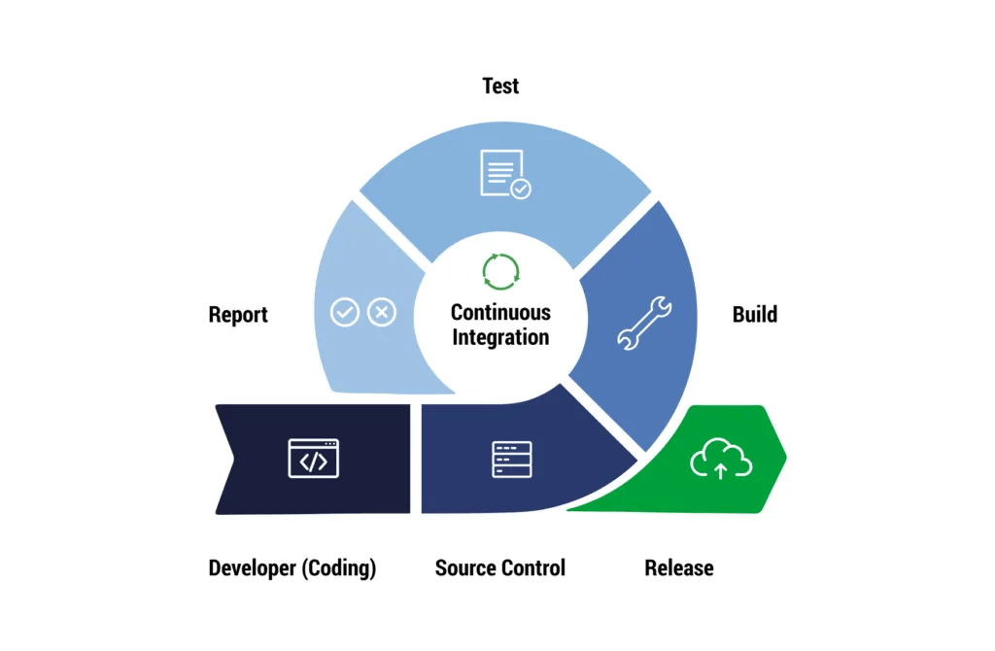

Slide 10
Typical CI Pipeline steps
Developer writes code
Code is committed to repository
Pipeline triggers automatically
Code builds (compiles / packages)
Automated tests run
Pass → merge allowed
Fail → developer fixes issue
Notes:
Write Code
1️⃣ Developer works on a feature or bug fix.
2️⃣ Commit & Push
Code is uploaded to a version control system (e.g., Git hosted on GitHub).
3️⃣ Pipeline Triggers Automatically
A workflow (e.g., GitHub Actions) starts.
4️⃣ Build Stage
The code is compiled / packaged.
5️⃣ Automated Tests Run
Unit tests check that the code works correctly.
6️⃣ Pass or Fail Feedback
✔ If tests pass → code can be merged
✖ If tests fail → developer fixes the issue

Slide 11
Why CI is Important
Without C I | With C I
Bugs found late | Bugs found immediately
Manual testing | Automated testing
Broken code in main branch | Stable shared code
Stress before deadline | Continuous quality checking
CI reduces the need for large-scale debugging later.

Slide 12
Research Task
TIME UP!
Working Independently
Task: Research GitHub Actions
Define:
  What is GitHub Actions?
  What triggers a workflow?
  What file type does it use?
  Where is the file stored?
Expected findings:
  It automates CI/CD
  Triggered on push / pull request
  Uses YAML
  Stored in .github/workflows/
15 mins

Slide 13
Activity: Map a CI Pipeline
TIME UP!
Working Independently
Create a visual pipeline diagram showing:
  Commit
  Build
  Test
  Feedback
  Merge
You may use:
  PowerPoint
  draw.io
You Must include:
  At least 5 labelled stages
  Arrows showing process flow
  One automated stage clearly identified
20 mins

Slide 14
Extension: YAML
14:05
name: Python CI
on: [push]
jobs:
build:
runs-on: ubuntu-latest
steps:
- uses: actions/checkout@v3
- name: Set up Python
uses: actions/setup-python@v4
- name: Install dependencies
run: pip install -r requirements.txt
- name: Run tests
run: pytest
Research YAML
Explain in simple terms:
on: push → triggers when code is pushed
jobs → tasks to run
steps → individual actions

Slide 15

Workbook Write-up
Complete the Vocabulary table in OneNote for this lesson then
Give:
1. Definition
  Define Continuous Integration clearly.
2. Explanation
  Explain how CI works in stages.
3. Example
  Describe how GitHub Actions could automatically test Python code.
Remember to use:
  Clear sequencing
  Technical vocabulary
  Full sentences
Working Independently
20 mins

