Slide 1
Recall Exercise
Visit:
https://retrieval.toolsforteaching.co.uk
Code: 04ooee

Slide 2
Phones
a small reminder…
once you have authenticated phones should be in the pockets on the wall

Slide 3
Learning Objectives
By the end of the lesson, the student will be able to:
Define Continuous Delivery (CD) and Continuous Deployment (CDp).
Explain the difference between Continuous Integration, Continuous Delivery, and Continuous Deployment.
Identify where human approval occurs within a release pipeline.
Describe the stages of a basic release pipeline (build, test, staging, production).
Classify real-world scenarios as CI, CD, or CDp.
Explain why some organisations choose Continuous Delivery instead of Continuous Deployment.
Outline the purpose of rollback strategies in automated release systems.

Slide 4
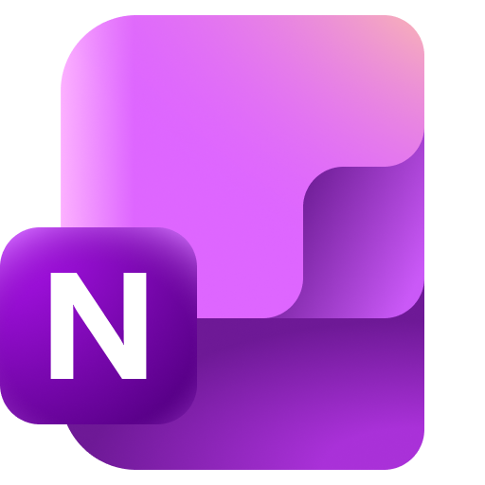
Key Vocabulary
Word | Definition
Continuous Delivery
Continuous Deployment
Pipeline
Staging
Production
Rollback
Complete these definitions by the end of the lesson

Slide 5
Manual vs Automatic Release
Scenario A – Manual
  A developer
    Writes code
    Tests locally
    Emails the file to IT
    IT uploads it to the server
    Website goes live
Scenario B – Automated
  A developer
    Pushes code to GitHub
    Tests run automatically
    Build succeeds
    System automatically releases to users
As we saw last lesson,
CI handles integration. But what happens after the build succeeds?
Which is faster?
Which is safer?
Which is more professional?
Where could things go wrong?

Slide 6

Quick recap on Continuous Integration (CI)
In CI
  Developers frequently merge code into a shared repository
  Automated tests run
  Errors are detected early

Slide 7
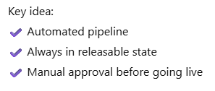
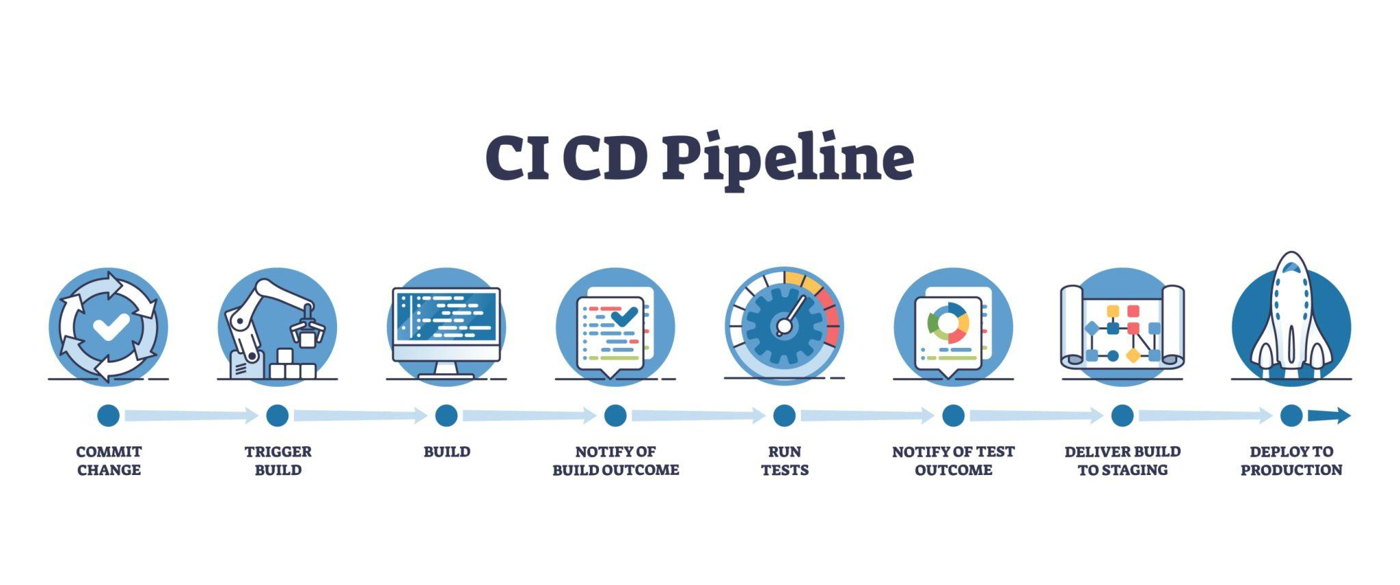
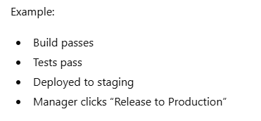
Continuous Delivery (CD)
CD means
  Code is automatically built and tested, and is ready to be released at any time, but a human chooses when to deploy.

Slide 8
Continuous Deployment (CDp)
Continuous Deployment means:
Every successful change is automatically released to users — no manual approval.
Key idea:
  ✔ Fully automated pipeline
  ✔ No human gate
  ✔ Faster delivery
Example:
  Code passes tests
  Automatically goes live within minutes

Slide 9
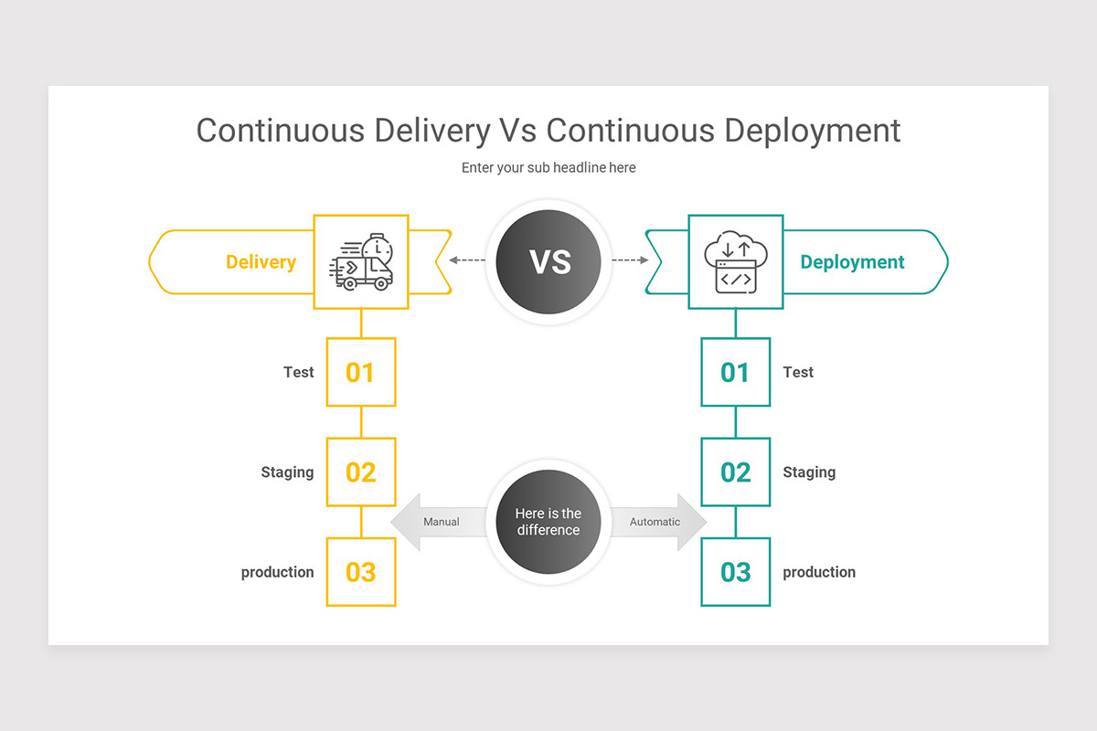

Slide 10
Comparison
Feature | CI | Continuous Delivery | Continuous Deployment
Automated builds | ✔ | ✔ | ✔
Automated testing | ✔ | ✔ | ✔
Manual approval before release | ✖ | ✔ | ✖
Automatically released to users | ✖ | ✖ | ✔
Focus | Integration | Release readiness | Automatic release

Slide 11
Visualising the Release Pipeline
Developer → Git Push → CI Build → Tests → Staging → Production

Slide 12
Visualising the Release Pipeline
Developer → Git Push → CI Build → Tests → Staging → Production

Slide 13
Visualising the Release Pipeline
Developer → Git Push → CI Build → Tests → Staging → Production

Slide 14
Visualising the Release Pipeline
Developer → Git Push → CI Build → Tests → Staging → Production

Slide 15
Visualising the Release Pipeline
Developer → Git Push → CI Build → Tests → Staging → Production

Slide 16
Visualising the Release Pipeline
Developer → Git Push → CI Build → Tests → Staging → Production

Slide 17
Visualising the Release Pipeline
Developer → Git Push → CI Build → Tests → Staging → Production
CI stops at Tests
CD stops at Staging
CDp goes all the way to Production automatically

Slide 18
Research
TIME UP!
Working Independently
App updates every hour automatically if tests pass. | Company requires manager approval before release to users.
Code merges trigger automatic testing and builds. | Updates are packaged automatically but deployed once per month manually
Every successful commit is immediately available to customers | Developers frequently merge changes into a shared repository
15 mins
Classify each as:
Continuous Integration
Continuous Delivery or
Continuous Deployment
Notes:
Scenario 1
“App updates every hour automatically if tests pass.”
Answer: Continuous Deployment
Why:
No human approval
Fully automated release to production
Code goes live immediately after successful tests
Scenario 2
“Company requires manager approval before release to users.”
Answer: Continuous Delivery
Why:
Build and tests are automated
Software is ready for release
A human decides when it goes live
Scenario 3
“Code merges trigger automatic testing and builds.”
Answer: Continuous Integration
Why:
Focus is on integration and automated testing
No mention of release to users
Stops at build/test stage
Scenario 4
“Updates are packaged automatically but deployed once per month manually.”
Answer: Continuous Delivery
Why:
Software is continuously prepared
Release timing is controlled by humans
Deployment is not automatic
Scenario 5
“Every successful commit is immediately available to customers.”
Answer: Continuous Deployment
Why:
Automatic production release
No approval stage
Fully automated pipeline
Scenario 6
“Developers frequently merge changes into a shared repository.”
Answer: Continuous Integration
Why:
Describes frequent integration
No mention of release
Core CI behaviour
Quick Teaching Clarification Rule
If the scenario includes:
Only build + test → CI
Build + test + ready for release + human approval → Continuous Delivery
Build + test + automatic release to users → Continuous Deployment

Slide 19
Answers
Scenario 1
“App updates every hour automatically if tests pass.”
Answer: Continuous Deployment
Why:
No human approval
Fully automated release to production
Code goes live immediately after successful tests
Scenario 2
“Company requires manager approval before release to users.”
Answer: Continuous Delivery
Why:
Build and tests are automated
Software is ready for release
A human decides when it goes live
Scenario 3
“Code merges trigger automatic testing and builds.”
Answer: Continuous Integration
Why:
Focus is on integration and automated testing
No mention of release to users
Stops at build/test stage
Scenario 4
“Updates are packaged automatically but deployed once per month manually.”
Answer: Continuous Delivery
Why:
Software is continuously prepared
Release timing is controlled by humans
Deployment is not automatic
Scenario 5
“Every successful commit is immediately available to customers.”
Answer: Continuous Deployment
Why:
Automatic production release
No approval stage
Fully automated pipeline
Scenario 6
“Developers frequently merge changes into a shared repository.”
Answer: Continuous Integration
Why:
Describes frequent integration
No mention of release
Core CI behaviour

Slide 20
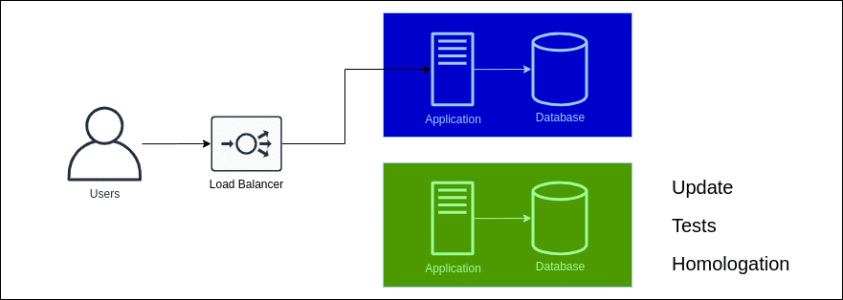
Rollback Strategies
What if something breaks in production?
We need a rollback strategy
Blue-Green Deployment
Blue is our existing setup
Green is new setup
Means ‘passes approval’

Slide 21

Think:
Why is rollback essential in Continuous Deployment?
Which industries would avoid full automation?
Notes:
You always need a backup
Mission Critical Systems
NASA
Nuclear Power Stations
Banks and Trading Systems (remember Chase Knight Capital)

Slide 22
Workbook write up
TIME UP!
Working Independently
20 mins
Complete the Key Vocabulary table in OneNote Workbook
Write 150-200 words including:
  Definition of CI
  Definition of Continuous Delivery
  Definition of Continuous Deployment
  One clear difference
  One advantage of automation
Model sentence starter:
  Continuous Delivery ensures software is always ready for release but requires human approval before going live, whereas Continuous Deployment automatically releases successful changes without manual intervention.

