Slide 1
Recall Exercise
Visit:
https://retrieval.toolsforteaching.co.uk
Code: quz2kz

Slide 2
Phones
a small reminder…
once you have authenticated phones should be in the pockets on the wall

Slide 3
Learning Objectives
By the end of this lesson, students will be able to:
Explain what exception handling is.
Explain what defensive programming means.
Use try/except blocks correctly in Python.
Implement guard clauses to validate inputs.
Prevent common runtime crashes in a small application.

Slide 4

Key Vocabulary
Term | Definition
Exception
Exception handling
try / except
guard clause
optional value
defensive programming
runtime error
Complete this Key Vocabulary Table in OneNote before the end of the lesson

Slide 5
An API call…
import requests
response = requests.get("https://api.fakeaddress1234.com/data")
data = response.json()
print(data["name"])
What could go wrong here?
What if:
  The API is down?
  There is no internet?
  The JSON format changes?
  The key "name" does not exist?

Slide 6
Running it…
import requests
response = requests.get("https://api.fakeaddress1234.com/data")
data = response.json()
print(data["name"])
This is an Exception
>
Connecting.
.
.
> requests.exceptions.ConnectionError
If an exception is unhandled then the program crashes

Slide 7

“Professional software never trusts the outside world”

Slide 8
What is Exception Handling?
https://www.w3schools.com/python/python_ref_exceptions.asp
Exception handling = structured way to respond to runtime errors.
try:
# risky code
except:
# what to do if it fails
try = attempt risky operation
except = handle specific error types
Prevents program termination
Improves user experience
Picks up errors when they happen and responds gracefully.
try:
number = int(input("Enter a number: "))
print(10 / number)
except ValueError:
print("That was not a valid number.")
except ZeroDivisionError:
print("You cannot divide by zero.")
Notes:
'Exception handling is used because without it, a runtime error would crash the entire program — the user would lose their work and see a confusing error message.'
'The except block is included so that the developer can control what happens when something goes wrong, rather than leaving it to chance.’
Example error messages: https://www.w3schools.com/python/python_ref_exceptions.asp

Slide 9
Defensive Programming
Definition:
Defensive programming is writing code that anticipates possible failure and prevents it before it happens.
A wise programmer wants to remind you:
Never trust input. Never trust APIs. Never assume.
Notes:
So that’s how we catch the errors gracefully when they happen. It would be better if we could avoid as many errors as possible, PREVENTION IS BETTER THAN CURE so that is why we practice Defensive Programming.

Slide 10

Guard Clauses
A guard clause checks conditions early and exits safely.
This avoids:
  Runtime crash
  ZeroDivisionError
Note difference:
  Exception handling = reacting to errors
  Defensive programming = preventing errors
def divide(a, b):
if b == 0:
return "Cannot divide by zero"
return a / b
Are we limited to using just one or the other here?

Slide 11

Hold on…
What is the difference between a guard clause and a try/except block?
Notes:
Listen for: guard clause = prevents the error happening; try/except = responds to it after it occurs.
If most students are unclear, take 2 additional minutes to re-model with the divide example before moving on.

Slide 12
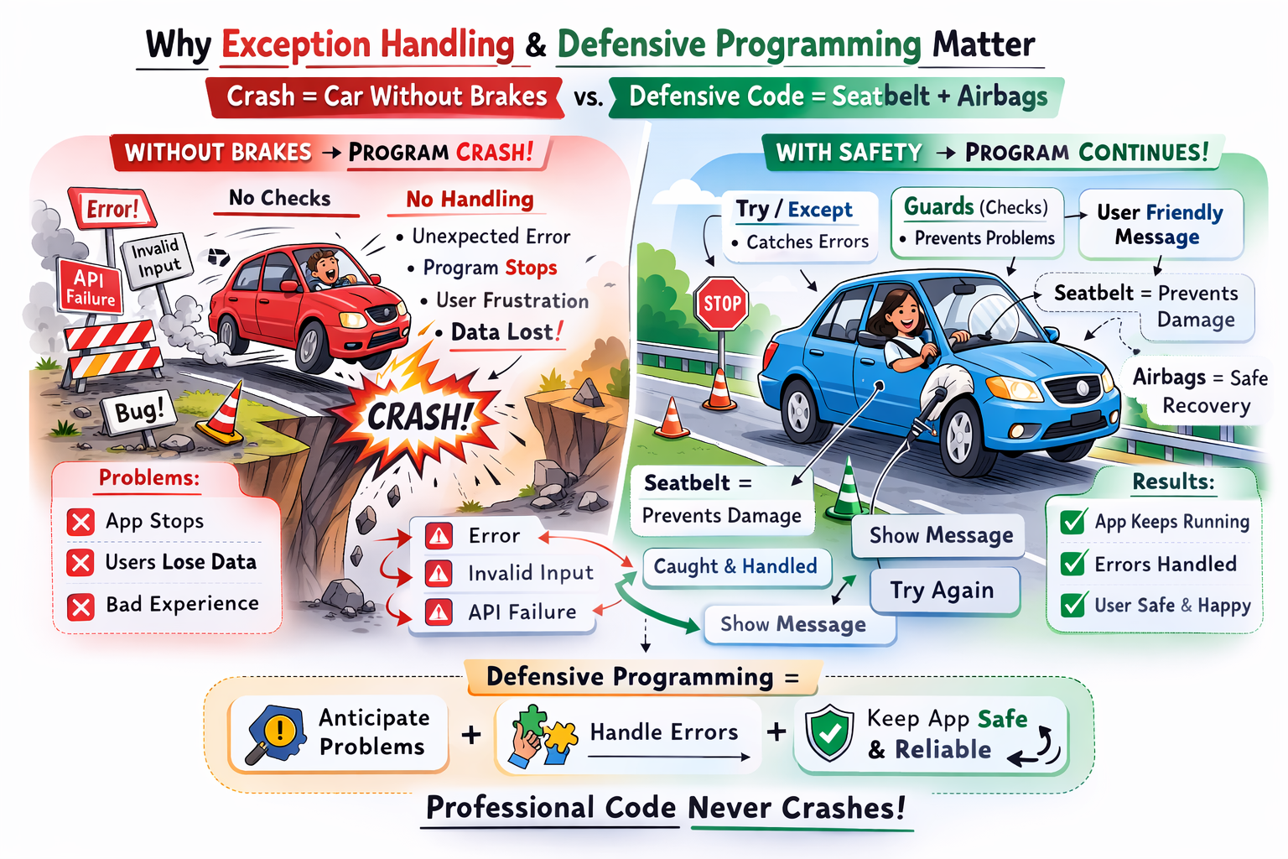
Think of this this way…

Slide 13
Research Task
Working Independently
Why is preventing crashes important in:
  Banking apps?
  Healthcare software?
  Games?
  E-commerce sites?
Think about:
  Data loss
  Security risks
  Financial loss
  Reputation damage
  Legal consequences
Extension:
  What would happen if Amazon crashed during checkout?
10 mins

Slide 14
Applying Defensive Programming
Working Independently
Task: Build a Safe API Call Program
Walk through the ideas below in sentences/pseudocode
  Ask user for a city name.
  Attempt to fetch weather data (or simulated API).
  Handle:
    Connection errors
    Invalid input
    Missing keys
  Display user-friendly messages.
30 mins

Slide 15
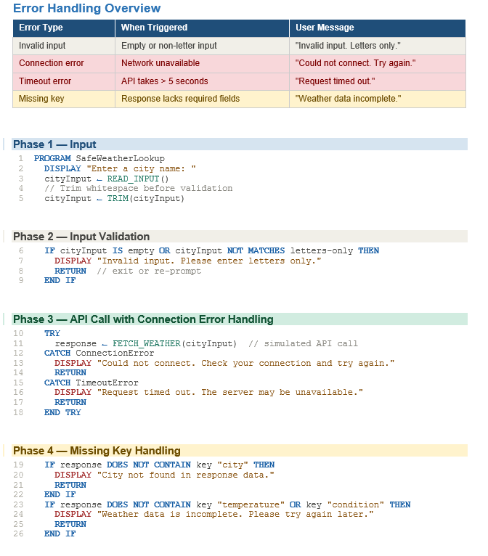
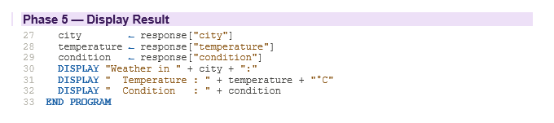

Slide 16
Workbook Write-Up
Working Independently
Complete Key Vocabulary
Section 1 — Definitions
  Exception handling is…
  Defensive programming is…
Section 2 — Why It Matters
  Explain why it matters, what problems it prevents, and provide a real-world example:
Section 3 — Reflection
  How does exception handling make software more professional?
Until EOL

Slide 17

Exit Questions
Name one specific exception type in Python and describe what causes it.
What does a guard clause do, and where in the code does it appear?
Give one real-world reason why defensive programming matters — use a specific context.
Notes:
Try/except
Between input and processing – it stops bad data getting misprocessed
3. In 2003, a software bug in the Therac-25 radiation therapy machine — partly caused by inadequate input validation and missing safety checks — contributed to patients receiving massive radiation overdoses, resulting in deaths and serious injuries. The code assumed operators would enter data in a specific order and within expected ranges. When they didn't, there were no defensive guards to catch the invalid state before the machine acted on it. Defensive programming — validating inputs, handling unexpected states explicitly, and never assuming the caller behaves correctly — exists precisely because real systems are used by real humans in unpredictable ways. In safety-critical software, the absence of those guards doesn't just cause crashes; it can kill people.

