Slide 1
Unit 5 Lesson 01
Notes:
| Term | Explanation |
| --------------------------- | -------------------------------------------------------------------- |
| Communication | Sharing information between people. |
| Internal Communication | Communication within the development team. |
| External Communication | Communication between the team and clients or users. |
| Interpersonal Communication | Direct communication between individuals. |
| Verbal Communication | Spoken communication such as meetings. |
| Non-Verbal Communication | Communication through body language, gestures or facial expressions. |
| Written Communication | Communication recorded in writing such as emails or reports. |
| Presentation | A structured explanation of ideas or results to an audience. |
| Release Notes | Information explaining changes in a software update. |
| Stakeholder | A person or group with an interest in the project. |
| Requirements | The features or functions the software must include. |

Slide 2
Phones
a small reminder…
once you have authenticated phones should be in the pockets on the wall

Slide 3

Reflect
What skills do employers want in programmers?
Notes:
Students should brainstorm answers individually for 1 minute, then share with a partner.
Likely responses:
Programming ability
Problem solving
Teamwork
Communication
Organisation
Attention to detail

Slide 4
Reflect
Is coding a solo job? Why or why not?
Coding is not just about writing code — it involves continuous communication.
Notes:
Discussion points to draw out:
Developers work in teams
Programmers communicate with clients
They collaborate with designers, testers and managers
Code must be understood by other programmers

Slide 5
Learning Objectives
By the end of this lesson you will be able to:
  Explain why communication is important in software development.
  Identify the difference between internal and external communication in coding teams.
  Describe several methods of communication used by programmers.
  Give examples of how communication is used during a software project.
  ⭐ Evaluate how poor communication can cause problems in a software project.

Slide 6

Key Vocabulary
Key Term | Definition (students complete) | Example in a Coding Environment
Communication
Internal Communication
External Communication
Interpersonal Communication
Verbal Communication
Non-Verbal Communication
Written Communication
Stand up meeting
Presentation
Release Notes
Stakeholder
Requirements
Complete during the lesson in OneNote
Notes:
Communication Sharing information between people.
Internal Communication Communication within the development team.
External Communication Communication between the team and clients or users.
Interpersonal Communication Direct communication between individuals.
Verbal Communication Spoken communication such as meetings.
NonVerbal Communication Communication through body language gestures or facial expressions.
Written Communication Communication recorded in writing such as emails or reports.
Stand up Meeting A quick gathering often with no agenda to enable everyone to catch up on progress
Presentation A structured explanation of ideas or results to an audience.
Release Notes Information explaining changes in a software update.
Stakeholder A person or group with an interest in the project.
Requirements The features or functions the software must include.

Slide 7
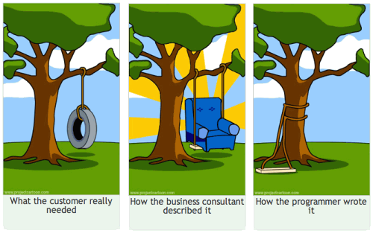
Why Communication Matters

Slide 8
Key Reasons Communication is Critical
1. Understanding Requirements
Developers must understand:
  What the client wants
  What the software must do
  What the constraints are
Poor communication here leads to building the wrong product.

Slide 9
Key Reasons Communication Is Critical
2. Team Collaboration
Software projects involve multiple roles:
  Programmers
  Designers
  Testers
  Project managers
Team members must communicate to:
  share progress
  report issues
  coordinate tasks

Slide 10
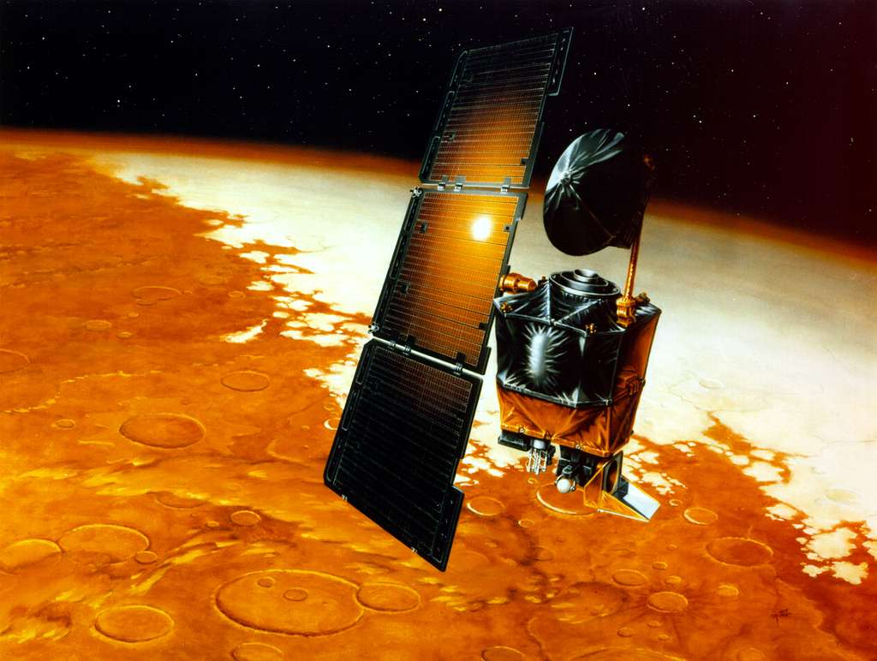
Key Reasons Communication Is Critical
Working Independently
3. Preventing Errors
Miscommunication can lead to:
  incorrect features
  bugs
  duplicated work
  wasted time
5 mins
Research The Mars Climate Orbiter (1999)
And write a quick summary in your OneNote workbook (5 mins)

Slide 11
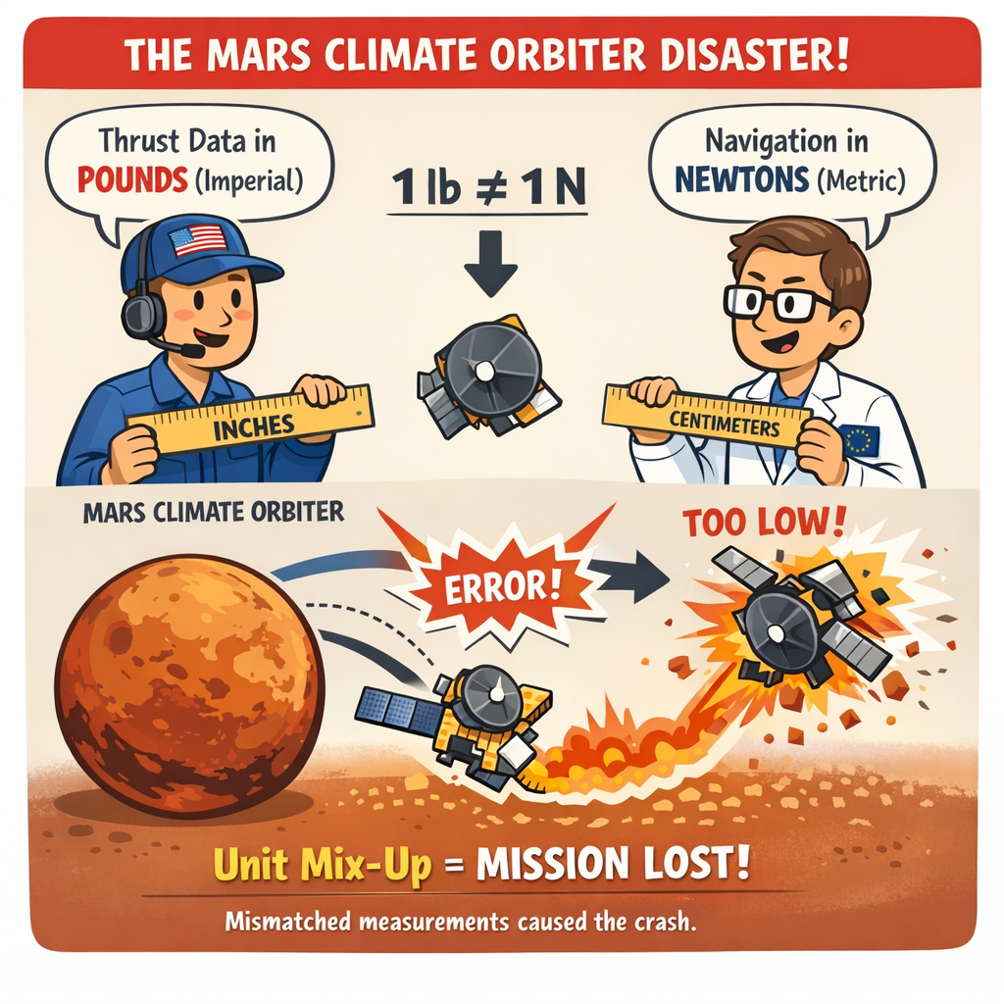
$193
million wasted!
Notes:
One engineering team measured rocket thrust using Imperial units, while another team’s software assumed metric units.
Because nobody checked the mismatch, the spacecraft’s navigation calculations were wrong and it flew too low into Mars’ atmosphere — destroying a $193 million mission.

Slide 12
Key Reasons Communication Is Critical
4. Maintaining Software
Code must often be maintained by other developers.
Good communication includes:
  clear documentation
  comments
  clear commit messages

Slide 13
Real Impact of Poor Communication
Impact | Example
Time delays | Developers misunderstand requirements
Financial loss | Company must rebuild features
Reputational damage | Buggy release damages trust
Project failure | Software never launches

Slide 14
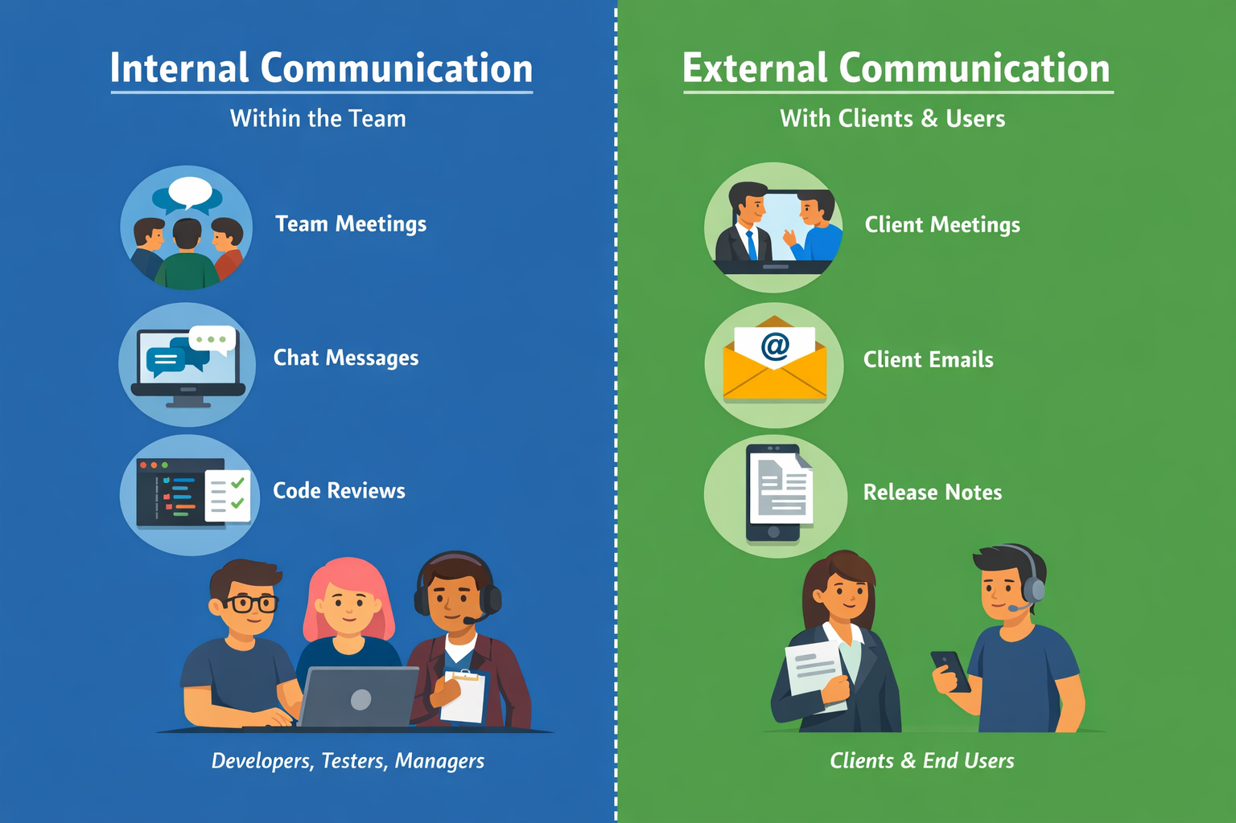

Slide 15

Activity 1 – Software Disaster Case Study
03:52
Working Independently
Research the issues surrounding the launch of Cyberpunk 2077
Write up in your OneNote Worksheet:
  What communication failed?
  Who needed the information?
  What was the impact?
  What would better communication have looked like?
20 mins
Factor | Example
Method | meeting, email, report
Audience | developers, clients
Timing | earlier in project

Slide 16

03:10

Slide 17
Activity 2 - Communication Methods Research
03:07
These are six forms of communication used within Computing
  Interpersonal
  Verbal
  Non-verbal
  Written
  Presentations
  Release Notes
For each one:
  Research a definition of what it means
  An example of how it is used
  Strengths and limitations
Working Independently
20 mins

Slide 18
Plenary
00:00
Why is communication important in coding?

Slide 19
Workbook Task
TIME UP!
Working Independently
Complete the Key Vocabulary grid
Write a structured paragraph explaining:
  why communication is important in coding
  what happens if communication fails
  examples of communication used in software teams
Describe at least three communication methods, including:
  definition
  example in a coding environment
  strengths and limitations
15 mins

