Slide 1
Unit 5 Lesson 02

Slide 2
Recall Exercise
Visit:
https://retrieval.toolsforteaching.co.uk
Code: j4bmer

Slide 3
Phones
a small reminder…
once you have authenticated phones should be in the pockets on the wall

Slide 4
Learning Objectives
By the end of this lesson you will be able to:
  Choose an appropriate communication method for different situations in a software project.
  Adapt communication for different audiences (technical and non-technical).
  Demonstrate active listening skills during discussions.
  Explain how misunderstandings occur in development teams.
  Present information clearly using appropriate language and tone.

Slide 5

Key Vocabulary
Term | Definition
Audience
Stakeholder
Technical Audience
Non-technical Audience
Jargon
Active Listening
Clarifying Questions
Summarising
Complete during the lesson in OneNote

Slide 6
Scenario Matching
Software developers communicate with many different people during a project.
Different situations require different communication methods.
Examples of communication methods include:
  Email
  Face-to-face meeting
  Video call
  Instant message / chat / Slack / Teams / Discord
  Written documentation
  Issue tracker or bug report system

Slide 7
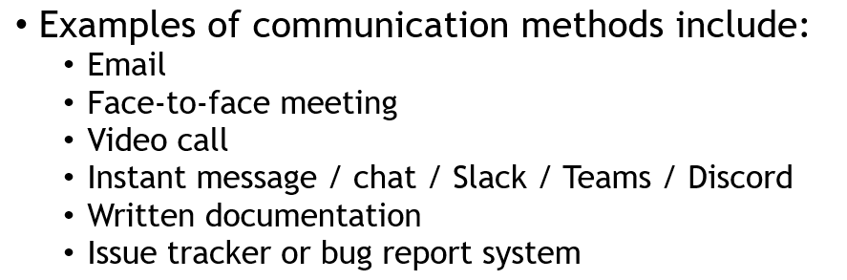
Scenario Matching Starter
Match each scenario to the communication method you think would work best
Working Independently
5 mins
Scenario | Best Communication Method | Why is this method appropriate?
A client wants clarification about how a feature works
A team is planning tasks for the next development sprint
A user has reported a bug in the system
A developer must explain a delay in completing a task
A new feature needs to be shared with the whole team

Slide 8
Understanding your audience
When communicating in software development, you must consider who you are speaking to.
Different audiences have different levels of technical knowledge.

Slide 9

Technical Audiences
Examples:
  Other developers
  Software engineers
  System administrators
These audiences usually understand technical terminology such as:
  APIs
  Databases
  Frameworks
  Debugging
Communication can therefore include technical detail and specialist terms.

Slide 10

Non-Technical Audiences
Examples:
  Clients
  Customers
  Managers
  End users
These audiences may not understand technical terms. Communication should therefore:
  Avoid unnecessary jargon
  Use plain English
  Focus on the outcome or impact, not the technical process

Slide 11
Example
Technical explanation:
  “The authentication service failed due to a token validation error in the API gateway.”
Non-technical explanation:
  “The system could not verify user logins because one part of the security system stopped working.”

Slide 12
Tone and Clarity
These are skills for life, not just for Developers!
Good communication should always be:
  Clear
  Accurate
  Respectful
  Appropriate for the audience
Developers should avoid:
  Overly complex explanations
  Too much jargon
  Unclear or vague descriptions
Instead, aim for:
  Short sentences
  Clear structure
  Plain language where possible

Slide 13
Active Listening
These are skills for life, not just for Developers!
Communication is not only about speaking or writing.
It is also about listening carefully to others.
Active listening means:
  Paying full attention to the speaker
  Not interrupting
  Asking questions to clarify understanding
  Confirming what you heard
Example techniques:
Summarising
  “So you’re saying the login system stops working after several users log in at the same time?”
Clarifying questions
  “Do you mean the problem happens on the website or on the mobile app?”
These techniques help reduce misunderstandings.

Slide 14
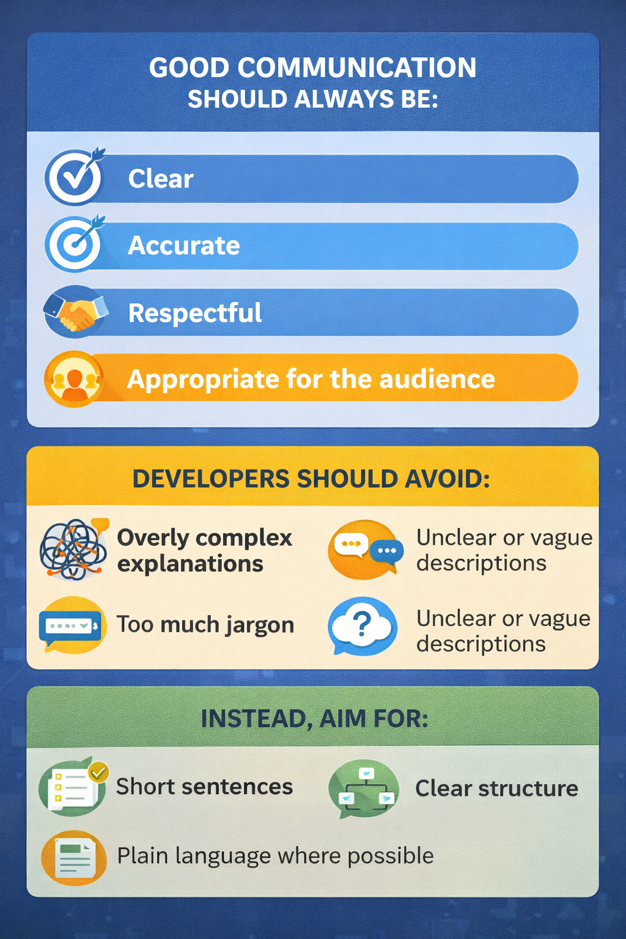
Simple diagrams and infographics also work well

Slide 15
Why Miscommunication Happens in Software Projects
Miscommunication is one of the most common causes of software project problems.
It can lead to:
  Delays
  Incorrect features being built
  Increased costs
  Frustrated clients and users
Common causes include:
  Unclear requirements
  Too much technical jargon
  Poor listening
  Not confirming understanding
Good developers often confirm information by:
  Repeating key points
  Summarising decisions
  Asking questions
  Writing down agreed outcomes

Slide 16

Death by PowerPoint
Research the incident that affected Space Shuttle Mission STS-107 on February 1st 2003
What was the technical problem?
What was the communication problem?
Working Independently
5 mins
Especially check this article

Slide 17
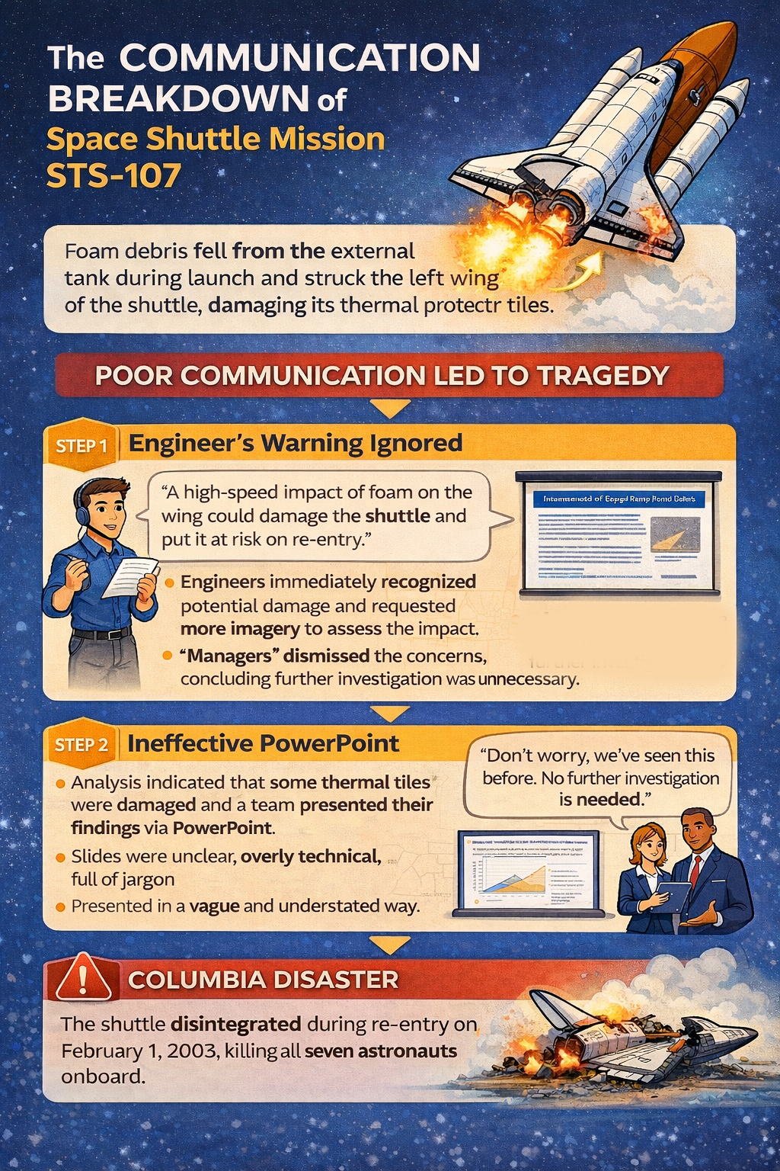

Slide 18
Mini Practical – Rewrite for a Different Audience
Below is a technical explanation written for developers.
“The application experienced a database timeout caused by inefficient queries during high traffic. We need to optimise the SQL queries and implement caching to prevent further performance issues.”
Task
Rewrite this paragraph so it is suitable for a non-technical audience, such as:
  A client
  A manager
  A parent
Your explanation should:
  Keep the same meaning
  Remove or explain technical jargon
  Be clear and easy to understand
Working Independently
15 mins

Slide 19
Activity – Communication Role Play
Scenario
A developer must explain a delay in completing a feature.
However, the explanation must be adapted for different audiences.
Task
Work in pairs or small groups.
Prepare how you would communicate the delay to each of the following people…

Slide 20
Audience | Key Points to Communicate | How will you adapt the explanation?
Project Manager
Client
Junior Developer
Consider:
Level of technical detail
Use of jargon
Tone and clarity

Slide 21
Role Play
In small groups
Each group will either:
  Act out the conversation, or
  Write a short script of what would be said.
During presentations you should evaluate:
15 mins
Evaluation Criteria | Notes
Was the explanation clear?
Was the language appropriate for the audience?
Was technical jargon used appropriately?
Did the explanation address the delay clearly?

Slide 22

Reflect
15 mins
Answer the following questions.
Why is it important to adapt communication for different audiences?
How does active listening help prevent misunderstandings?
Give one example of how technical jargon could confuse a client.
What strategies can developers use to confirm they have understood something correctly?

