Slide 1
Unit 5 Lesson 03
Release Notes

Slide 2
Recall Exercise
Visit:
https://retrieval.toolsforteaching.co.uk
Code: mu6v1t

Slide 3
Phones
a small reminder…
once you have authenticated phones should be in the pockets on the wall

Slide 4
Learning Objectives
By the end of this lesson, learners will be able to:
  Identify and explain the key sections of real-world release notes.
  Explain who reads release notes and why clarity and transparency matter.
  Produce a basic set of release notes using a structured template.

Slide 5

Release Note Spotting
Examine the example in the Lesson 03 One Note Workbook
Let’s identify the following:
  The version number
  New features or improvements
  Bug fixes
  Known issues (if present)

Slide 6
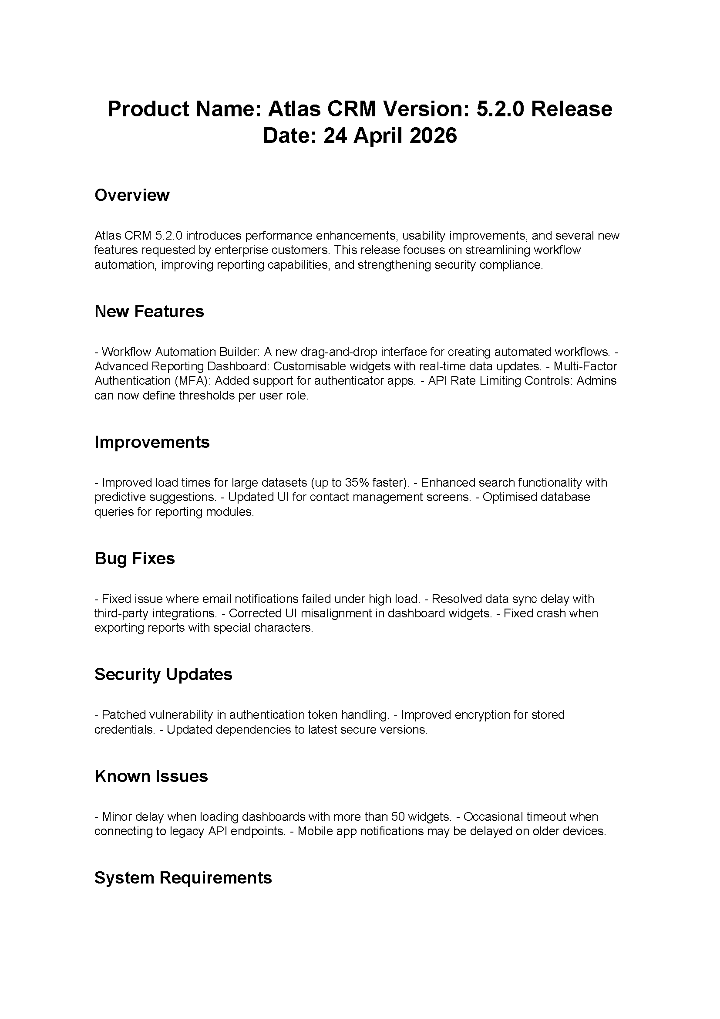
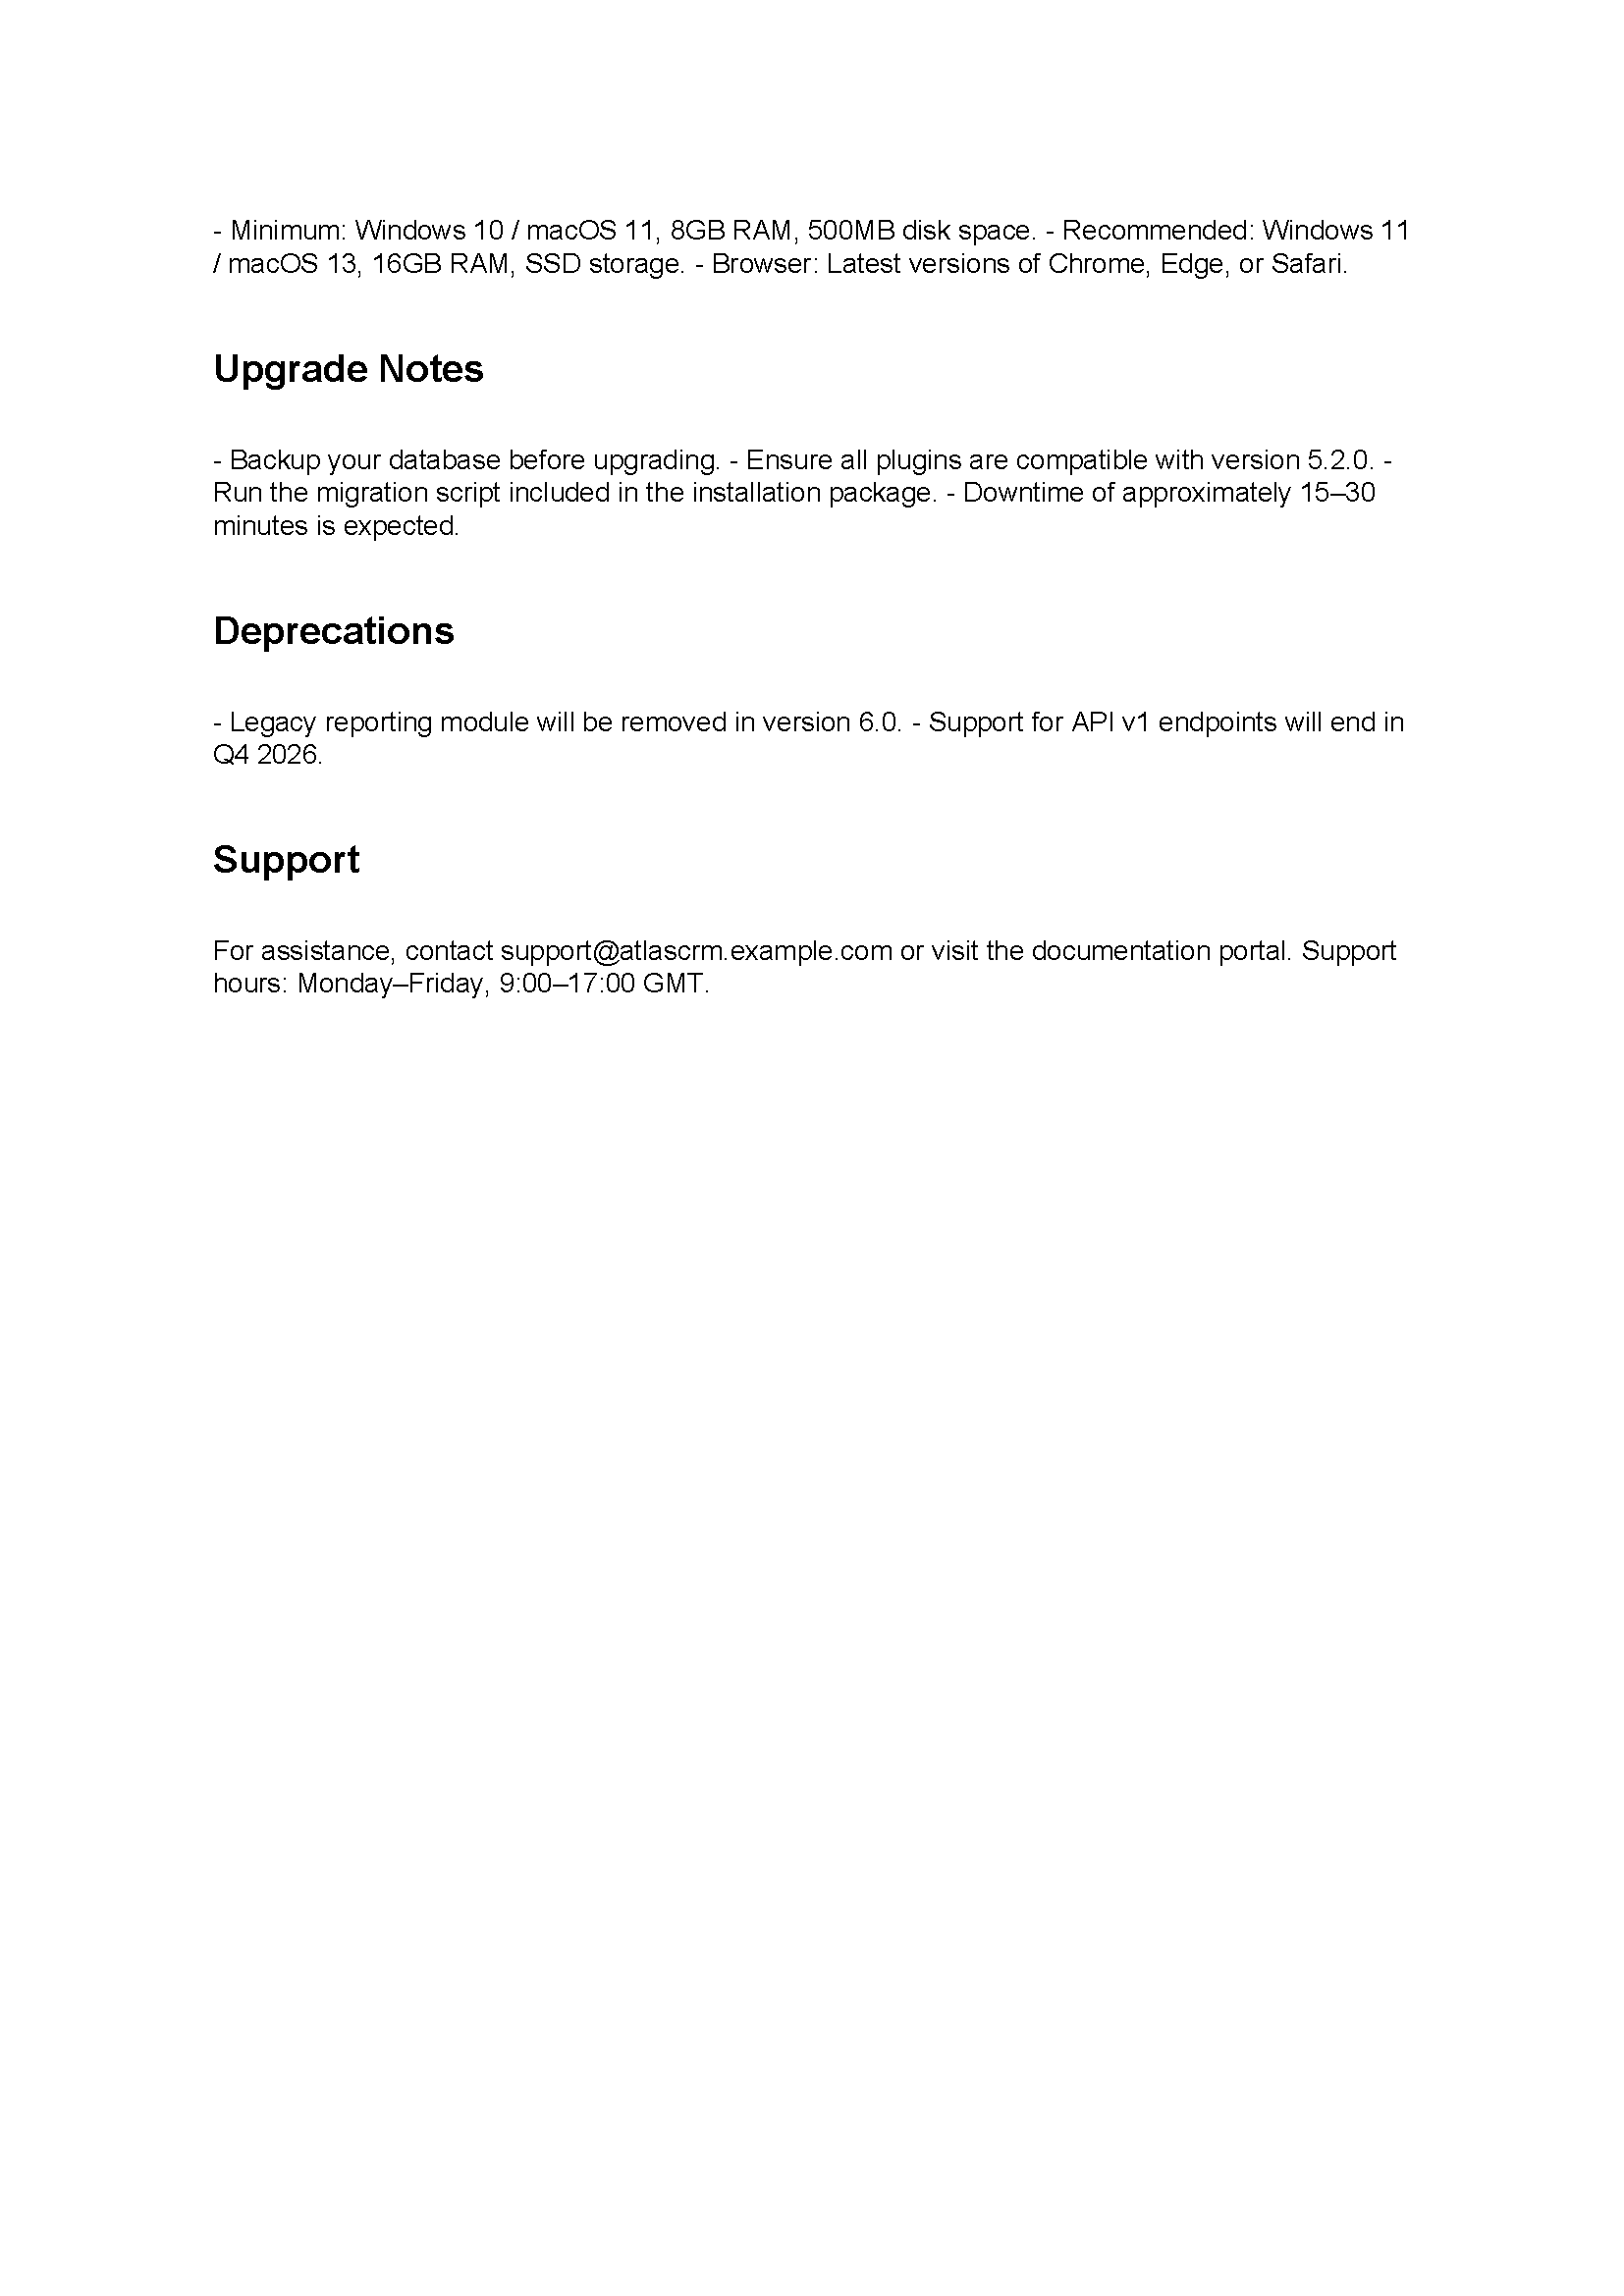

Slide 7
What Are Release Notes?
Definition:
Release notes are a written record of all changes in a new version of a software product.
Who reads them?
  End users
  Testers/QA
  Support staff
  Stakeholders and Managers
  Other developers.

Slide 8
Why do they matter?
They ensure:
  Transparency
  Trust
  Reduced support queries
  A clear audit trail

Slide 9
The 6 principle sections of release notes
Version number
Summary
New features
Bug fixes
Known issues
How to update
How to get help.
Identifies this release
Quick outline of the release
What’s new in the code
Past errors that have been fixed
What hasn’t yet been fixed
Installing it
How to let us know that it’s still broken

Slide 10
Release Notes Example
Section | Purpose | Example
Version number | Uniquely identifies the release so users, testers, and support can refer to exactly the right update. | v2.4.1 / Version 14.3
Summary / headline | A plain-English overview of what this update is about — helps skim-readers understand the change at a glance. | "This update fixes a crash on startup and adds a dark mode option."
New features / improvements | Lists what has been added or improved so users know what to explore and stakeholders can see progress. | "Added: Export to PDF function in reports section."
Bug fixes | Describes what problems have been resolved. Builds trust and reassures users who reported issues. | "Fixed: App crash when saving large files on iOS 16."
Known issues | Honest disclosure of problems that are not yet fixed. Prevents users from reporting them and shows transparency. | "Known issue: Dark mode may not apply correctly on older Android devices."
How to update / get help | Practical guidance so users know what to do next. Reduces support contacts. | "Update via the App Store or visit help.example.com"

Slide 11
Research Task: Find real Release Notes
Find a real set of release notes from any product or service you actually use
(a game, social media app, browser, phone OS update, productivity tool, etc.)
Step 1: Find your example. Take a screenshot or note the URL. Paste into your OneNote page.
Step 2: Label each section you can identify (version number, features, fixes, known issues, etc.).
Step 3: For each section, write one sentence explaining what it communicates and to whom.
Step 4: Write a short paragraph (3–5 sentences) explaining how these release notes as a whole help the people who read them. You must include the word 'because' at least twice.
Working Independently
20 mins
Stuck?
If you can’t think of a product, try Microsoft Word, Microsoft PowerToys, Adobe Media Encoder

Slide 12
Create Task: Write Release Notes Using the Template
Working Independently
A | A simple calculator app — bug fix (crash on large numbers) and a new calculation history feature has been added.
B | A student homework tracker app — new deadline reminder notifications added, login error fixed, known issue with dark mode on older devices.
C | A school canteen ordering app — vegetarian filter added, payment glitch fixed, slow load times on some devices still under investigation.
20 mins
Choose one of these scenarios.
Using the template in OneNote, write your own Release Notes
Complete all six template sections in plain English suitable for a non-technical user.
Remember: your audience is someone who uses the app, not a developer.

Slide 13
Workbook preparation
Working Independently
Explain how release notes are used to communicate information to others.
You can use the sentence starters in the OneNote Workbook to help you
15 mins

Slide 14

Finally…
Name two sections you would always find in release notes.
Give one reason why a support worker would read release notes.
What is the difference between a 'bug fix' and a 'known issue'?

