Slide 1
Unit 5 Lesson 04
Feedback

Slide 2
Recall Exercise
Visit:
https://retrieval.toolsforteaching.co.uk
Code: in2o7q

Slide 3
Phones
a small reminder…
once you have authenticated phones should be in the pockets on the wall

Slide 4
Learning Objectives
By the end of this lesson, you will be able to:
  Describe at least two ways of seeking feedback on communications (LO2.1).
  Explain why feedback is valuable for developing communication skills — using specific reasons (LO2.2).
  Explain what productive feedback is and identify its key characteristics (LO2.3).
  Apply the productive feedback model to peer review your own Lesson 3 release notes.
  Reflect on feedback received and explain how it could improve your communication.

Slide 5
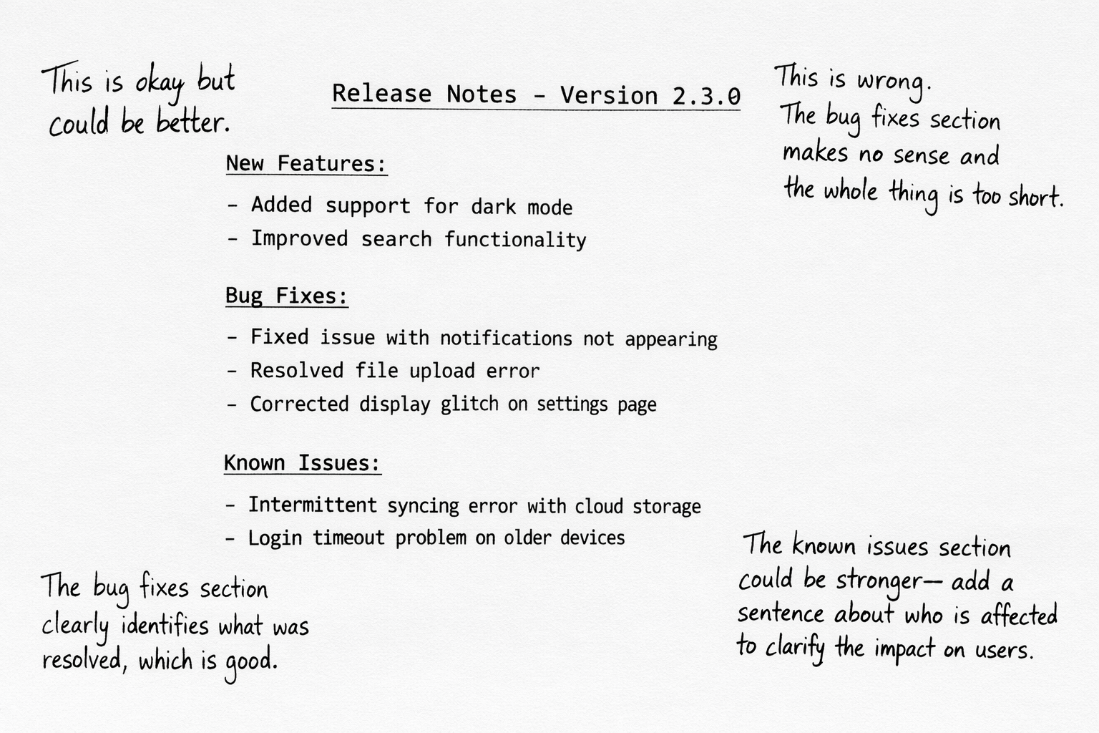
Feedback sorting activity
In small groups
5 mins
Which of these is
  Vague/Unhelpful
  Destructive/Negative
  Productive

Slide 6
Types of feedback and how feedback is sought
Informal verbal feedback
  a colleague commenting during a stand-up or code review.
Formal written feedback
  a structured peer review, a manager's written appraisal, a client's emailed response.
User testing feedback
  usability testing reports, bug reports submitted by users.
Automated feedback
  code linting tools, test suite results, CI/CD pipeline reports.
Self-review / reflection
  reviewing your own work against a checklist or set of criteria.

Slide 7
Why feedback develops communication skills
Identifies blind spots
  the sender often cannot see how their message is received.
Closes the gap between intention and impact
  what you meant to communicate and what the reader understood may be very different.
Creates a feedback loop
  software development relies on iteration; communication improves the same way.
Builds professional habits
  developers who seek and act on feedback become more effective communicators over time.

Slide 8
The productive feedback model
Characteristic | What it means | Example
🎯 Specific | Points to an exact part of the work rather than making a general comment. The receiver knows precisely what to look at. | 'The version number section is missing from the top of your release notes — without it, a user cannot identify which update they are reading.'
⚖️ Balanced | Acknowledges what has worked as well as what needs improvement. Avoids being purely negative, which can demotivate. | 'Your bug fixes section is well written and uses clear language. The known issues section is currently very brief and would benefit from more detail.'
✅ Actionable | Gives a clear next step — the receiver knows what to do differently. Vague suggestions like 'make it better' are not actionable. | 'I would suggest adding one sentence for each known issue explaining which users are affected and when a fix is expected.'

Slide 9
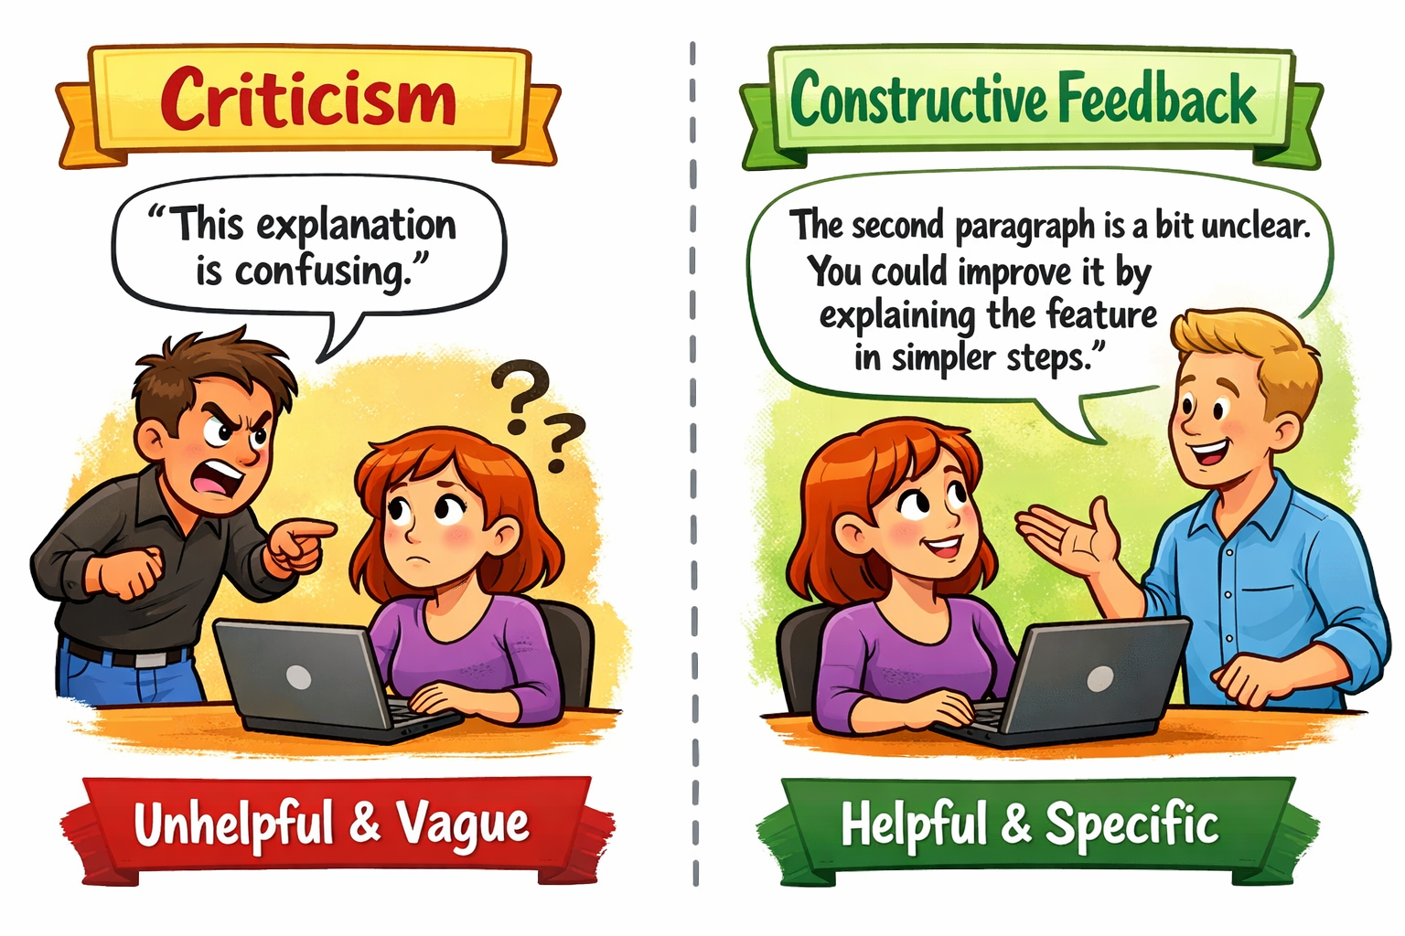

Slide 10
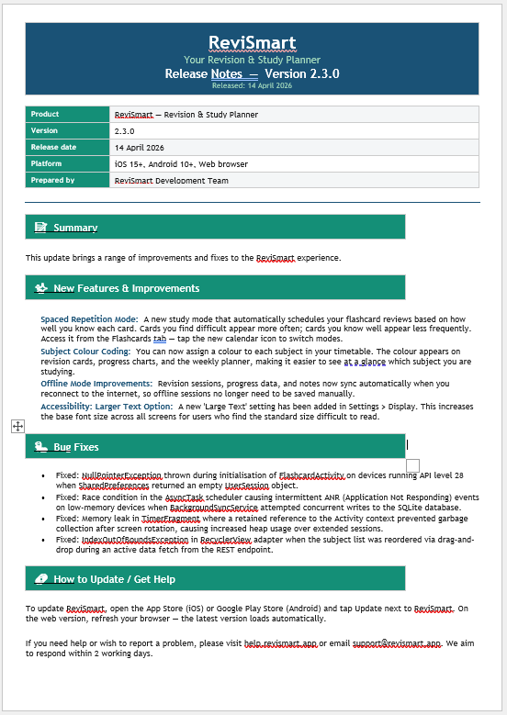

Review Task
TIME UP!
I will give you some Release Notes
Read the work carefully.
Complete the structured feedback form in OneNote
The form requires:
  At least one piece of feedback for each of the three productive feedback criteria:
    Specific
    Balanced
    Actionable.
  A brief overall summary — one or two sentences about the overall quality and the most important improvement.
Remember: feedback is written to help, not to judge.
The goal is to give something genuinely useful — one real improvement, clearly explained.
Working Independently
30 mins
Notes:
Circulate actively. Prompt students who write vague comments: 'You've said it could be clearer — which section? What specifically would you change?' Redirect students who are only writing positives: 'What is the one thing your partner could improve? What would you tell them to do differently?'

Slide 11
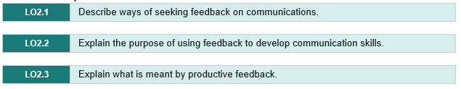
Workbook update
Working Independently
Until EOL
Complete in the OneNote Workbook
At least one paragraph per learning objective
Use the sentence starters as you need

