Slide 1
Unit 5 Lesson 05
Project Management

Slide 2
Recall Exercise
Visit:
https://retrieval.toolsforteaching.co.uk
Code: gx99fu

Slide 3
Phones
a small reminder…
once you have authenticated phones should be in the pockets on the wall
Notes:
`

Slide 4
Learning Objectives
By the end of this lesson, you will be able to:
  Define what is meant by project management — in a full sentence, in your own words (LO3.1).
  Define the role of a Project Manager — including at least two specific responsibilities (LO3.2).
  Describe the four stages of the project lifecycle.
  Complete a mini project plan covering: Goal, Stakeholders, Timeline, and Roles.
  Link project management to the communication skills developed in earlier lessons.

Slide 5
Project or Task?
Which of these are Projects and which are Tasks.
Sending a daily status email to a manager — task.
Building a school event app for the college — project.
Running a virus scan on a single laptop — task.
Launching a new internal website with multiple contributors — project.

Slide 6

Four Hallmarks of a Project
Defined goal
A start and end date
Multiple people or resources
A deliverable.
Who would manage all of these?
The PROJECT MANAGER

Slide 7

What is Project Management?
Definition:
Project management is the process of planning, organising, and controlling work to meet a specific goal — on time, within budget, and to the right quality.
Without these three pillars, of planning organising and controlling a project can easily fail

Slide 8
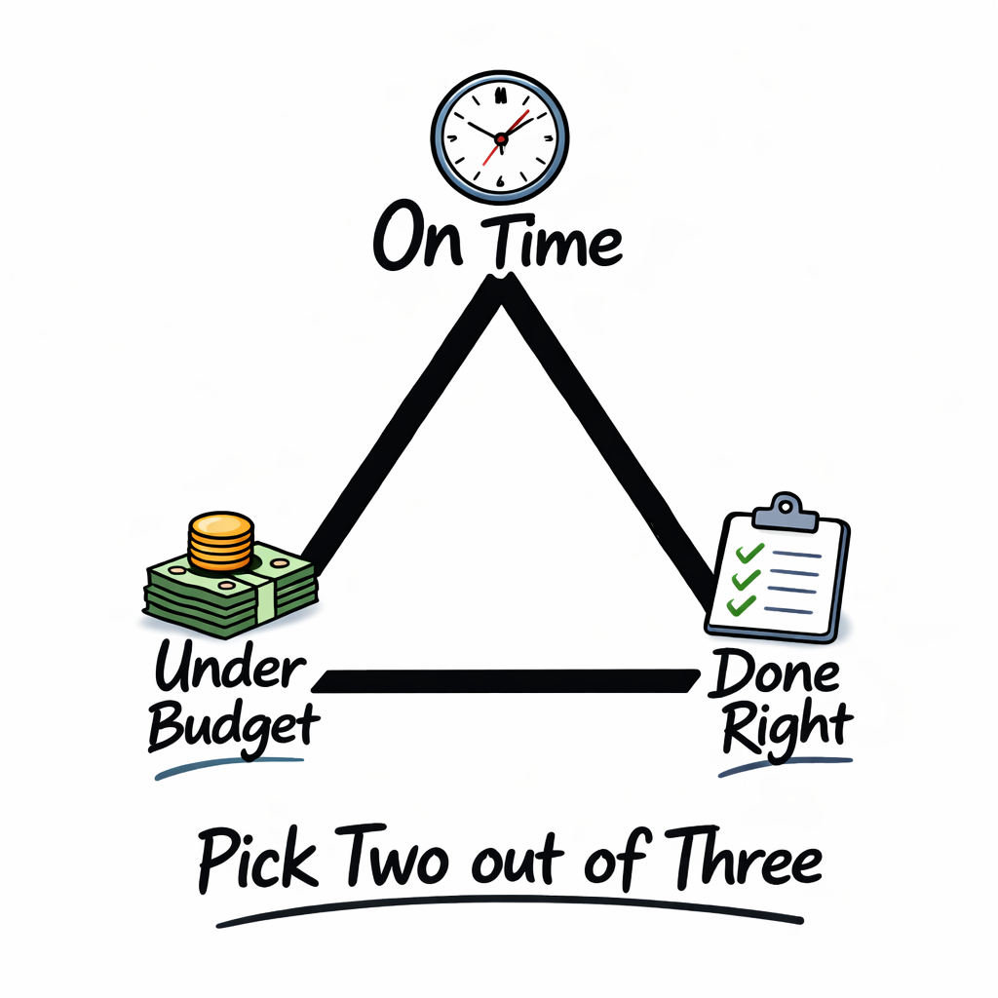
Project Manager’s Dilemma

Slide 9
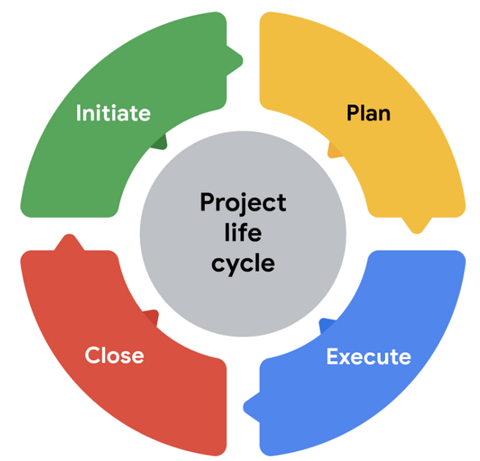
Project Management Lifecycle
Which phase is most likely to go wrong?
Phase | What happens
1. Initiate | Define goal, identify stakeholders, assess feasibility.
2. Plan | Create schedule, assign roles, identify risks.
3. Execute | Build and test — the main work phase.
4. Close | Hand over, review, document lessons learned.
Why?
Notes:
Ask: which phase do you think is most likely to go wrong, and why? Accept answers — planning (underestimating time) and delivery (scope creep, bugs) are the most common. Use this to introduce the idea of risk management.

Slide 10

Role of the Project Manager
Coordination
  keeps the team aligned and on track.
Risk Management
  identifies and plans for things that could go wrong.
Stakeholder Management
  communicates with clients, teams, and sponsors.
Triple Constraint
  balances scope, time, and cost.

Slide 11
Mini Project Planning Activity
In small groups
Scenario:
'Build a School Event App’.
Groups complete all four sections in the OneNote page.
Remember: You are not building the App or planning its design, but planning the project
30 mins
Notes:
Goal Students write tasks ('build a login page') rather than outcomes. Prompt: 'What does success look like when the whole project is finished?'
Stakeholders Students only list 'users'. Prompt: 'Who else has an interest? Teachers? Parents? The school admin team? The developers themselves?'
Timeline Students write vague phases with no dates. Prompt: 'If this started next Monday, what would happen in week 1? Week 4?'
Roles Students only list 'developer'. Prompt: 'Who tests? Who talks to the client? Who makes sure it's delivered on time?'

Slide 12
Workbook Writeup
Working Independently
Write a paragraph each to explain these two questions:
What is meant by Project Management?
Define the role of a Project Manager
Use the sentence starters if you need to.
20 mins

Slide 13

Final Questions
In one sentence: what is project management?
Name two things a Project Manager is responsible for.
Which lifecycle phase involves the actual build work?

