Slide 1
Unit 5 Lesson 06
Lean, Waterfall & the Triple Constraint

Slide 2
Recall Exercise
Visit:
https://retrieval.toolsforteaching.co.uk
Code: 8tveva

Slide 3
Phones
a small reminder…
once you have authenticated phones should be in the pockets on the wall

Slide 4
Learning Objectives
By the end of this lesson, learners will be able to:
  Identify and explain the key principles of Lean project management.
  Identify and explain the key principles of Waterfall project management.
  Compare Lean and Waterfall, identifying where each is most suitable.
  Explain the triple constraint (scope, time, cost) and describe how each element affects the others.
  Apply the triple constraint to a realistic client scenario and justify a decision.

Slide 5
Key Vocabulary
Term | Definition
Lean
Waterfall
Triple constraint
Scope
Change control
Continuous improvement
Waste (Lean)
Complete these during the lesson

Slide 6
Your client has just called.
They want 10 new features added to the app.
The deadline is in two weeks.
The budget is already spent.
In pairs
3 mins
Notes:
'What is the problem here?'
'If you cannot say no - what would you have to sacrifice?'
'Have you ever been in a situation where someone wanted more but was not willing to give more time or money?'

Slide 7
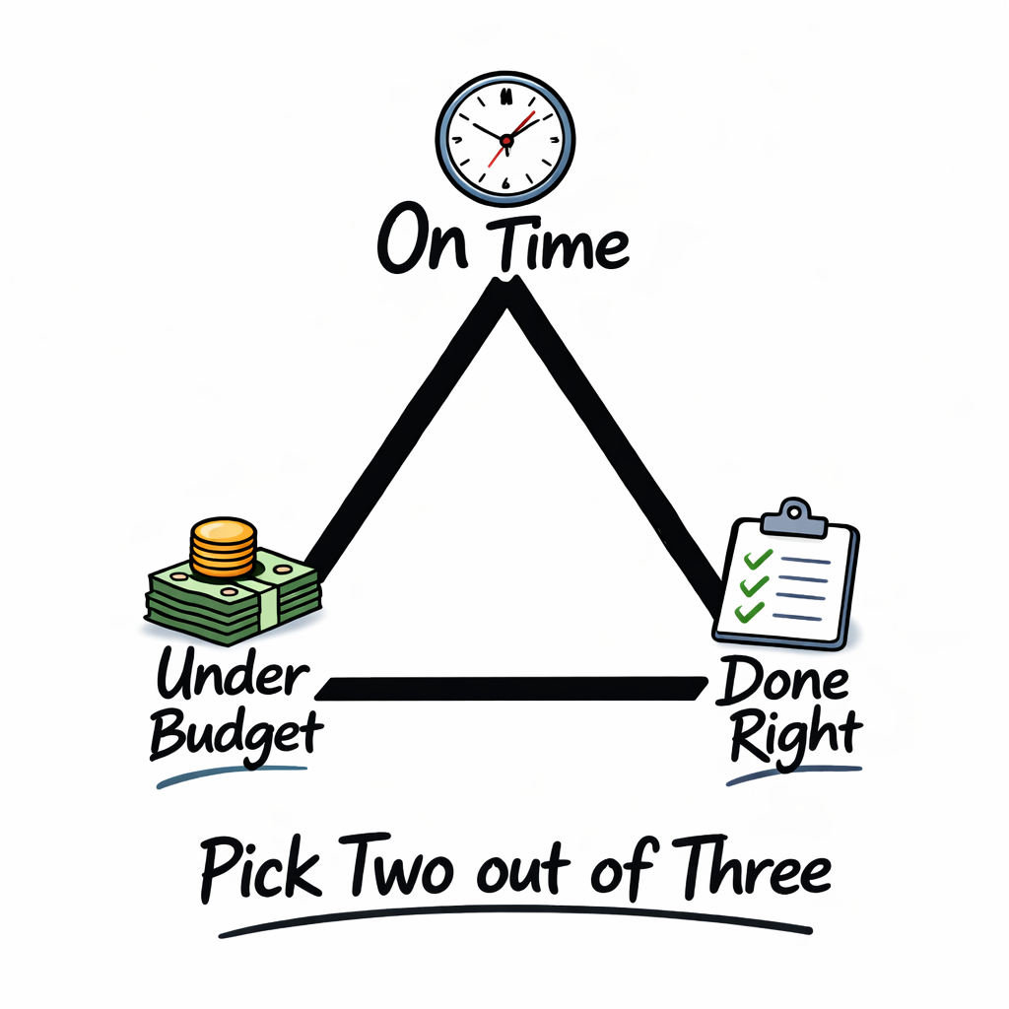
The Triple Constraint
aka
“Project Manager’s Dilemma”

Slide 8
Lean Project Management
Core purpose: eliminate waste so the team delivers more value with the same effort.
Five Lean principles:
  define value (from the customer's perspective);
  map the value stream (remove non-value activities);
  create flow (work moves without interruption);
  establish pull (only work on what is needed now);
  pursue perfection (continuous improvement - Kaizen).
Notes:
1. Define Value
To better understand the first principle of defining customer value, it is important to understand what value is. Value is what the customer is willing to pay for. It is paramount to discover the actual or latent needs of the customer. Sometimes customers may not know what they want or are unable to articulate it. This is especially common when it comes to novel products or technologies. There are many techniques such as interviews, surveys, demographic information, and web analytics that can help you decipher and discover what customers find valuable. By using these qualitative and quantitative techniques you can uncover what customers want, how they want the product or service to be delivered, and the price that they afford.
2. Map the Value Stream
The second Lean principle is identifying and mapping the value stream. In this step, the goal is to use the customer’s value as a reference point and identify all the activities that contribute to these values. Activities that do not add value to the end customer are considered waste. The waste can be broken into two categories: non-valued added but necessary and non-value & unnecessary. The later is pure waste and should be eliminated while the former should be reduced as much as possible. By reducing and eliminating unnecessary processes or steps, you can ensure that customers are getting exactly what they want while at the same time reducing the cost of producing that product or service.
3. Create Flow
After removing the wastes from the value stream, the following action is to ensure that the flow of the remaining steps run smoothly without interruptions or delays. Some strategies for ensuring that value-adding activities flow smoothly include: breaking down steps, reconfiguring the production steps, leveling out the workload, creating cross-functional departments, and training employees to be multi-skilled and adaptive.
4. Establish Pull
Inventory is considered one of the biggest wastes in any production system. The goal of a pull-based system is to limit inventory and work in process (WIP) items while ensuring that the requisite materials and information are available for a smooth flow of work. In other words, a pull-based system allows for Just-in-time delivery and manufacturing where products are created at the time that they are needed and in just the quantities needed. Pull-based systems are always created from the needs of the end customers. By following the value stream and working backwards through the production system, you can ensure that the products produced will be able to satisfy the needs of customers.
5. Pursue Perfection
Wastes are prevented through the achievement of the first four steps: 1) identifying value, 2) mapping value stream, 3) creating flow, and 4) adopting a pull system. However, the fifth step of pursuing perfection is the most important among them all. It makes Lean thinking and continuous process improvement a part of the organizational culture. Every employee should strive towards perfection while delivering products based on the customer needs. The company should be a learning organization and always find ways to get a little better each and every day.
Applying the Principles
The five Lean principles provide a framework for creating an efficient and effective organization. Lean allows managers to discover inefficiencies in their organization and deliver better value to customers. The principles encourage creating better flow in work processes and developing a continuous improvement culture. By practicing all 5 principles, an organization can remain competitive, increase the value delivered to the customers, decrease the cost of doing business, and increase their profitability.

Slide 9
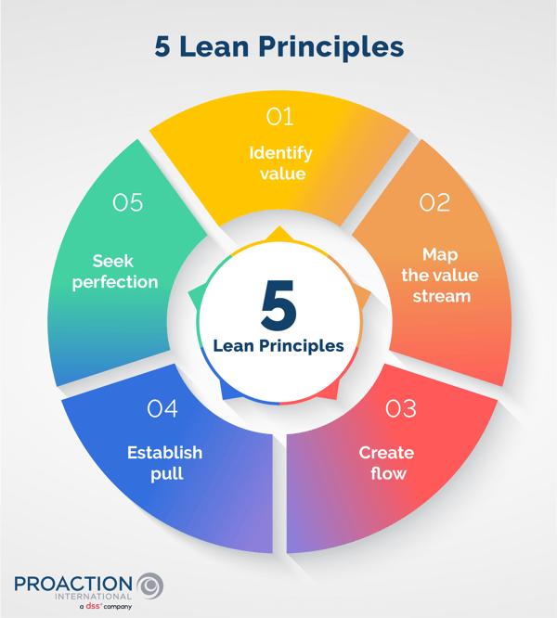
Notes:
Define Value
Find out exactly what the customer wants and is willing to pay for — including needs they may not have clearly expressed.
Map the Value Stream
Look at every step in the process. Label each step as: adds value, necessary but no value, or waste.
Create Flow
Make sure the steps that remain run smoothly and continuously, without delays or stoppages.
Establish Pull
Only produce what is needed, when it is needed. Avoid building up excess stock or inventory. (this is the heart of Just-in-Time JIT)
Pursue Perfection
Continuously look for ways to improve every process — make this a permanent part of the organisation's culture.

Slide 10
# | Principle | What Does It Mean? | How Is It Done? | Real-World Example
1 | Define Value | Find out exactly what the customer wants and is willing to pay for — including needs they may not have clearly expressed. | Use surveys, interviews, and data analysis to understand what customers value in a product or service. | A smartphone company surveys users to find they care most about battery life — so that becomes the top priority in the next model.
2 | Map the Value Stream | Look at every step in the process. Label each step as: adds value, necessary but no value, or waste. | Remove steps that are pure waste. Reduce steps that are needed but don't directly benefit the customer. | A clothing manufacturer finds that storing unsold stock for months costs money and adds no value — so they reduce overproduction.
3 | Create Flow | Make sure the steps that remain run smoothly and continuously, without delays or stoppages. | Reorganise tasks, cross-train staff to cover multiple roles, and balance workloads evenly across the team. | A bakery rearranges its kitchen so that dough preparation, baking, and packaging happen in a smooth, uninterrupted sequence.
4 | Establish Pull | Only produce what is needed, when it is needed. Avoid building up excess stock or inventory. | Let customer orders drive production — known as Just-in-Time (JIT). Work backwards from customer demand. | A restaurant only preps and cooks dishes after a customer orders, so food is fresh and nothing is wasted.
5 | Pursue Perfection | Continuously look for ways to improve every process — make this a permanent part of the organisation's culture. | Encourage all staff to suggest improvements. Review processes regularly and never accept 'good enough'. | A delivery company holds weekly team meetings where drivers suggest better routes, reducing fuel costs over time.
Notes:
Define Value
Find out exactly what the customer wants and is willing to pay for — including needs they may not have clearly expressed.
Map the Value Stream
Look at every step in the process. Label each step as: adds value, necessary but no value, or waste.
Create Flow
Make sure the steps that remain run smoothly and continuously, without delays or stoppages.
Establish Pull
Only produce what is needed, when it is needed. Avoid building up excess stock or inventory.
Pursue Perfection
Continuously look for ways to improve every process — make this a permanent part of the organisation's culture.

Slide 11
Coding context
A team spending
  30% of its time in unnecessary meetings,
  re-doing poorly specified work,
  or waiting for approvals
is experiencing Lean waste.
Tools such as Kanban boards and work-in-progress limits help address this.

Slide 12
Kanban Boards
A Kanban board is a visual tool that shows the status of tasks as they move through a process — from 'To Do' through to 'Done'.
To Do | In Progress | Done
Write report | Design logo | Research topic
Book meeting |  | Send email
Notes:
Use post-its to illustrate

Slide 13
Kanban Boards
It comes from Toyota's manufacturing system in the 1940s
The word Kanban is Japanese for "visual signal" or "signboard“
It helps teams spot bottlenecks — if the "In Progress" column is overflowing, something is blocking the flow
It supports the Lean principle of flow — keeping work moving steadily without pile-ups
Modern versions (like Trello or Jira) are digital, but the idea is identical

Slide 14

Kanban in practice
To Do | In Progress | Done
Notes:
NEED POST-IT-NOTES

Slide 15
Waterfall Project Management
Core principle:
  complete each phase fully before moving to the next.
Phases:
  Requirements >
  Design >
  Build >
  Test >
  Deploy >
  Maintain.
Why it suits certain projects:
  requirements are fixed; the client knows exactly what they want upfront; the product cannot be delivered incrementally.
The cost of change:
  a change made during testing costs significantly more than if caught during requirements.
  This is why change control is a formal process in Waterfall.
Coding context example:
  A major NHS Project to procure and install a Nursing Information System
Crescendo (1998) Hastings and Rother NHS Trust.
Project Manager: Simon Rundell

Slide 16
The Triple Constraint
Fast
Scope: the features and deliverables. Adding scope without adding time or cost results in lower quality or missed deadlines.
Time: the deadline. Shortening without reducing scope requires more cost (more people/resources) or lower quality.
Cost: the budget. Cutting the budget without reducing scope requires a longer timeline or lower quality.
Cheap
Good

Slide 17
Your client has just called.
They want 10 new features added to the app.
The deadline is in two weeks.
The budget is already spent.
Using the triangle, what must happen?
Quality suffers OR scope must be negotiated.

Slide 18
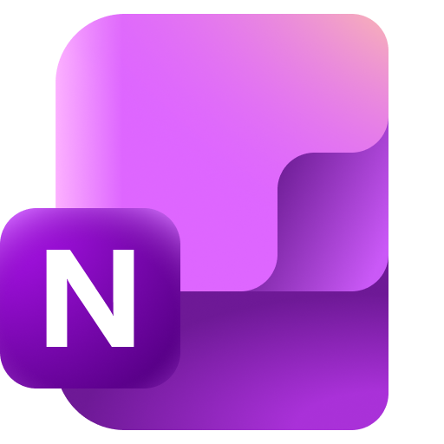
Research - Lean vs Waterfall Comparison Table
TIME UP!
Working Independently
Aspect | Lean | Waterfall
Key principles
Where it works well
Where it struggles
Example project types suitable for each
25 mins
Then answer the question: Based on your comparison, which method would you recommend for a hospital patient records system and why?

Slide 19
Activity 2: Triple Constraint Scenario
18:38
Working Independently
Scenario: The Client Wants More You are Project Manager for a school event booking app. Here is the current project status: Budget: 12,000 - fully allocated across the team. Deadline: 8 weeks - fixed because the school year starts then. Agreed scope: basic event listing, parent booking form, and email confirmations. The Head Teacher has now asked you to add: a payments system, a waiting list feature, and a mobile app version. They have said the deadline and budget cannot change.
15 mins
Answer the questions in Activity 2

Slide 20
Workbook Preparation
18:39
Working Independently
Write about 150-200 words on each of these areas:
Identify the principles of Lean project management.
Identify the principles of Waterfall project management.
Explain what is meant by the triple constraint.
20 mins

Slide 21

Final Questions
Name one principle of Lean project management.
In Waterfall, what must happen before the next phase begins?
If a client increases the scope of a project but does not increase the budget or deadline, what must happen?
Notes:
LEAN
Define Value
Map value stream
Create flow
Establish pull
Pursue perfection
Waterfall:
The previous phase must end
Triangle
Quality will suffer

