Slide 1
Unit 5 Lesson 07 – Introduction to Agile

Slide 2
Recall Exercise
Visit:
https://retrieval.toolsforteaching.co.uk
Code: msgbx4

Slide 3
Phones
a small reminder…
once you have authenticated phones should be in the pockets on the wall

Slide 4
Learning Objectives
By the end of this lesson, learners will be able to:
  Define Agile development and explain how it differs from traditional (Waterfall) approaches.
  Identify and describe the key characteristics of Agile development.
  Explain the advantages and disadvantages of Agile, using real-world project examples to justify.
  Generate Workbook evidence

Slide 5
Key Vocabulary
Term | Definition
Agile
Iteration
Scope creep
Waterfall
Customer collaboration
Responding to change
Backlog
Sprint
Complete these definitions during the lesson

Slide 6


Slide 7

Reflect
What did Agile look like compared to Waterfall?
What was the same? What was different?
What kind of projects do you think Agile would suit best — and why?
Notes:
Take 3–4 verbal responses using cold calling. Do not over-explain at this stage — capture student language on the board (words like 'flexible', 'faster', 'small steps') and return to them during teaching input to validate and refine.

Slide 8
The Agile Methodology
Agile is an iterative approach to software development in which requirements and solutions evolve through collaboration between self-organising, cross-functional teams.
Key idea:
  Work is delivered in short cycles (iterations or sprints), with each cycle producing something working that can be reviewed and improved before the next begins.
Agile was formalised in the Agile Manifesto (2001), which sets out four values and twelve principles.

Slide 9
The 4 Values of the Agile Manifesto
The Agile Manifesto (2001) states that while there is value in the items on the right, the items on the left are valued more:
  Individuals and interactions over processes and tools
  Working software over comprehensive documentation
  Customer collaboration over contract negotiation
  Responding to change over following a plan

Slide 10
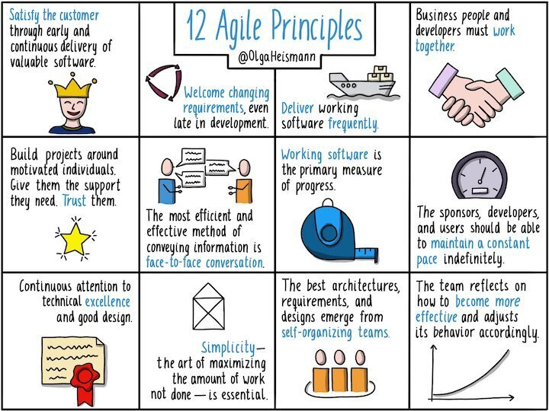

Slide 11
Key Characteristics of Agile
Iterative development — a team builds a login screen in week 1, tests it, gets feedback, then refines it in week 2 before moving on to the next feature.
Customer collaboration — the client attends a review at the end of each sprint to see what has been built and suggest changes before the next iteration begins.
Frequent delivery — a usable version of the product is available after every sprint, not just at the very end of the project.
Responding to change — if user testing reveals confusing navigation, the team adjusts the backlog and addresses it in the next sprint, rather than waiting until the end.
Cross-functional teams — developers, testers, and designers work together within the team rather than passing work between separate departments.
Continuous feedback — short feedback loops at the end of each sprint keep the product aligned with user needs throughout development.

Slide 12
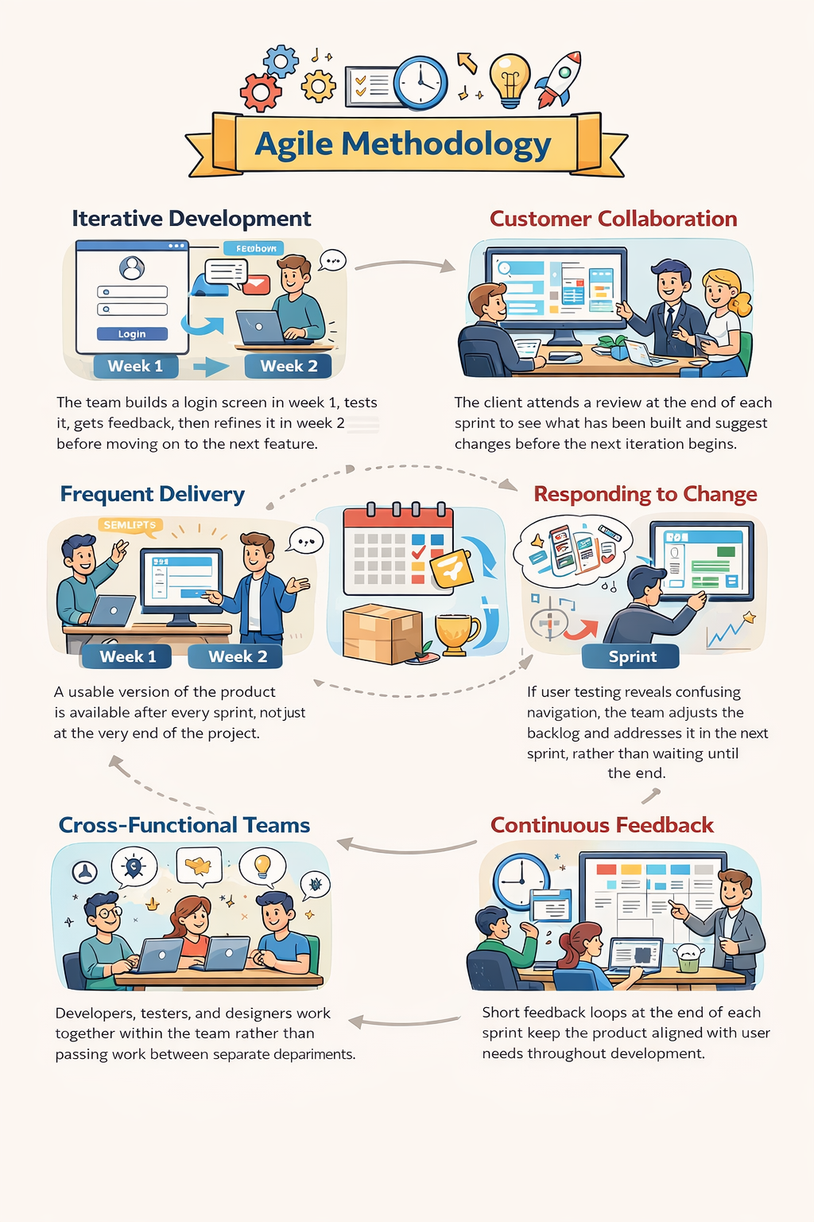

Slide 13
Advantages vs Disadvantages
Speed and flexibility — teams can respond to changing requirements quickly; useful when user needs are not fully known at the start (e.g. a startup building a new app).
Frequent delivery — stakeholders see progress early and can raise concerns before significant resources have been committed.
Higher quality — continuous testing and feedback during iterations catches defects early, reducing the cost and effort of fixing them later.
Risk of scope creep — because requirements can change at any time, the project can expand beyond the original budget or timeline if change requests are not controlled.
Less predictability — it is harder to give a fixed end date or cost because scope is not locked at the start; a problem for clients with fixed budgets or legal deadlines.
Requires strong collaboration — Agile depends on regular communication between team and client; if the client is unavailable or disengaged, the process breaks down.
Documentation can suffer — the focus on working software over documentation can mean technical records are incomplete, creating problems for future maintenance.

Slide 14
Debate Preparation: Waterfall vs Agile: Which Suits Each Project?
10 mins
Preparation:
Each team builds their arguments. They must reference at least one real constraint per scenario (e.g. compliance requirements, rate of change, budget predictability, client involvement). Students record arguments in the debate planning frame on their OneNote page.
Let’s have two teams: Team Agile and Team Waterfall
Below (and in OneNote) are the same 3 scenarios
Your team must argue your method’s suitability for each one.
The three project scenarios:
  Banking software — an online payments system for a major high street bank handling millions of transactions daily. Must comply with financial regulations. Any error could cause financial loss or legal liability.
  Mobile game — a casual puzzle game for iOS and Android. The target audience is broad (ages 12–40). The market moves quickly and player feedback after early release will shape future features.
  Government database — a national records system storing sensitive citizen data. Requirements are defined in law. The system must be independently audited. Changes after launch require parliamentary approval.

Slide 15
Debate
20 mins
The three project scenarios:
  Banking software — an online payments system for a major high street bank handling millions of transactions daily. Must comply with financial regulations. Any error could cause financial loss or legal liability.
  Mobile game — a casual puzzle game for iOS and Android. The target audience is broad (ages 12–40). The market moves quickly and player feedback after early release will shape future features.
  Government database — a national records system storing sensitive citizen data. Requirements are defined in law. The system must be independently audited. Changes after launch require parliamentary approval.
Notes:
What constraint makes your method safer here?

Slide 16
Verdict – Is one method better than the other?
The right methodology depends on the project
  its requirements
  stability
  compliance needs
  client availability
  risk tolerance.

Slide 17
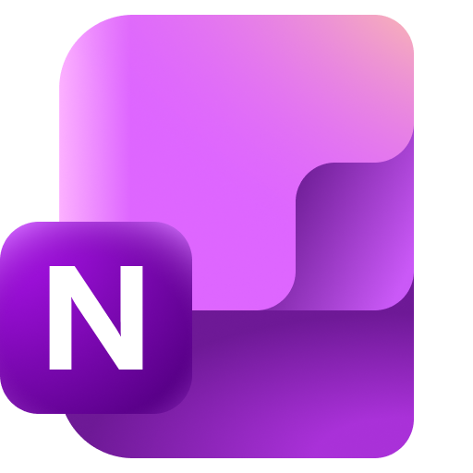
Workbook Preparation
Working Independently
Write 150-200 words in OneNote to answer these questions:
  Define what is meant by an Agile development.
  Identify the key characteristics of an Agile development.
  Identify the advantages and disadvantages of an Agile development.
20 mins

Slide 18

Final Questions
Give one word that describes Agile that does not apply to Waterfall.
Name one advantage and one disadvantage of Agile development.
Why might a government database project NOT be well suited to Agile?
Notes:
Iterative
Advantage: Flexible Disadvantage: Scope Creep
Needs greater accountability and budgetary constraints

