Slide 1
Unit 5 Lesson 08
Scrum Roles

Slide 2
Recall Exercise
Visit:
https://retrieval.toolsforteaching.co.uk
Code: o3ifo0

Slide 3
Phones
a small reminder…
once you have authenticated phones should be in the pockets on the wall

Slide 4

Learning Objectives
I’m actually a qualified Certified Scrum Developer
By the end of this lesson, learners will be able to:
  Describe what is meant by Scrum and explain how it relates to Agile.
  Explain the role and responsibilities of the Product Owner.
  Explain the role and responsibilities of the Scrum Master.
  Explain the role and responsibilities of the Scrum Team.
  Describe how the three roles support communication and delivery within a project.

Slide 5
Key Vocabulary
Term | Definition
Scrum
Product Owner
Scrum Master
Scrum Team
Product Backlog
Sprint Backlog
Impediment
User story
Complete these definitions during the lesson
Notes:
Scrum
A specific Agile framework for managing and completing complex work. Scrum organises work into short time-boxed iterations called sprints, with defined roles, events, and artefacts that structure how the team operates.
Product Owner
The Scrum team member responsible for defining what needs to be built and in what order. They own and manage the Product Backlog and represent the voice of the customer.
Scrum Master
The team member responsible for facilitating the Scrum process. They coach the team, remove blockers, and ensure Scrum events happen correctly. They do not manage the team - they serve it.
Scrum Team
The developers, designers, and testers who do the actual building. The team is self-organising (decides how to do the work) and cross-functional (has all the skills needed).
Product Backlog
A prioritised list of all features, improvements, and fixes needed for the product. Owned by the Product Owner. Items are added, removed, and re-prioritised as the project evolves.
Sprint Backlog
The subset of Product Backlog items the team commits to completing during one sprint. Chosen during Sprint Planning.
Impediment
Anything that slows down or blocks the team from making progress. The Scrum Master is responsible for identifying and removing impediments quickly.
User story
A short description of a feature from the perspective of the user. Format: 'As a [user], I want to [action] so that [benefit].' Used to populate the Product Backlog.

Slide 6

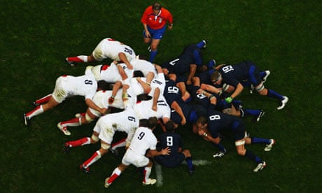
Recap
What is Agile in one sentence?
What does iterative mean?
What is a sprint?
Has anyone heard the word Scrum before - in any context?

Slide 7

In Rugby…
The Scrum is where a group of people work closely together to achieve a common goal
In Software Development…
We do the same thing
Agile tells us the values and principles we should follow.
Scrum gives us the structure: the specific roles, the meetings, and the way we organise our sprints.
Today we focus on the three Scrum roles.

Slide 8
Scrum as an Agile Framework
Scrum is a specific Agile framework for managing and completing complex work. It provides the structure that turns Agile values into day-to-day practice.
Agile is the philosophy; Scrum is one way of applying it.
  Other Agile frameworks include Kanban and SAFe – but are not required for this unit
Scrum organises work into time-boxed iterations called sprints (typically 1-4 weeks).
At the end of each sprint, a working product increment is produced and reviewed.
Scrum uses three artefacts:
  Product Backlog (all the work to be done),
  Sprint Backlog (work for this sprint)
  Product Increment (the working product after each sprint).
Scrum has three roles and five events. This lesson covers the roles; We’ll cover the events next lesson.

Slide 9
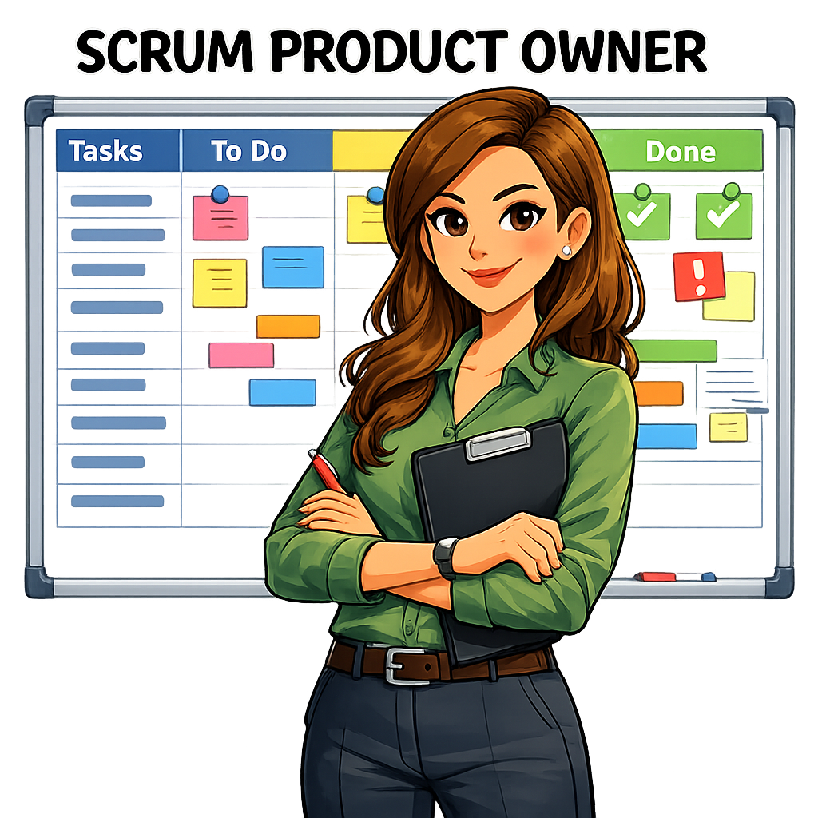
Product Owner
Represents the needs of the customer, users, and stakeholders.
Owns and manages the Product Backlog: the prioritised list of all features and tasks.
Decides what gets built and in what order - sets the sprint goals.
Accepts or rejects completed work at the end of each sprint.
Acts as the bridge between the development team and the outside world.
Communication focus: translates business requirements into actionable tasks for the Scrum Team.

Slide 10
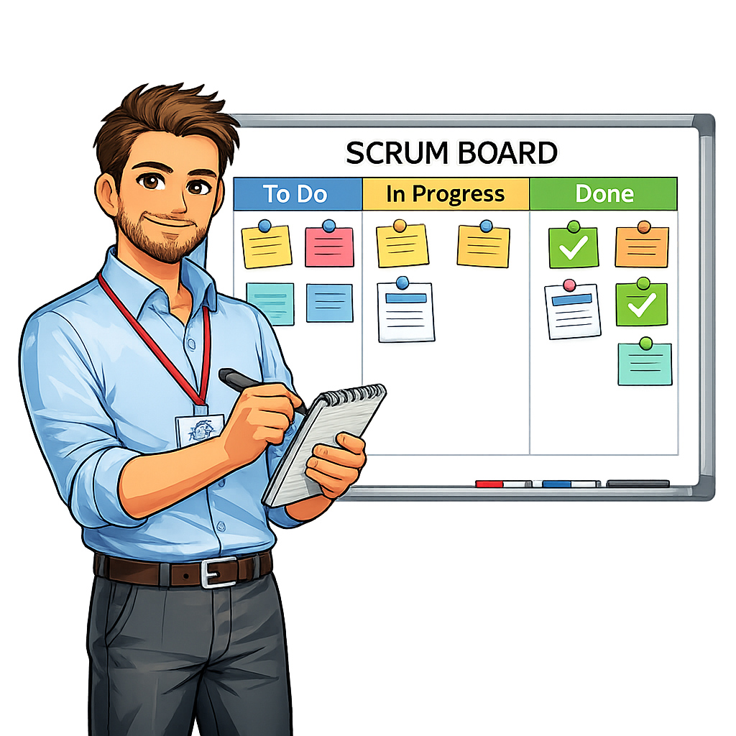
Scrum Master
Facilitates the Scrum process: ensures the team follows Scrum events and practices.
Removes impediments (blockers) that prevent the team from making progress.
Coaches the Scrum Team on Agile values and the Scrum framework.
Shields the team from external distractions and scope changes during a sprint.
Facilitates all Scrum events (sprint planning, daily scrum, sprint review, retrospective).
Communication focus: promotes open communication within the team and resolves process issues quickly.

Slide 11
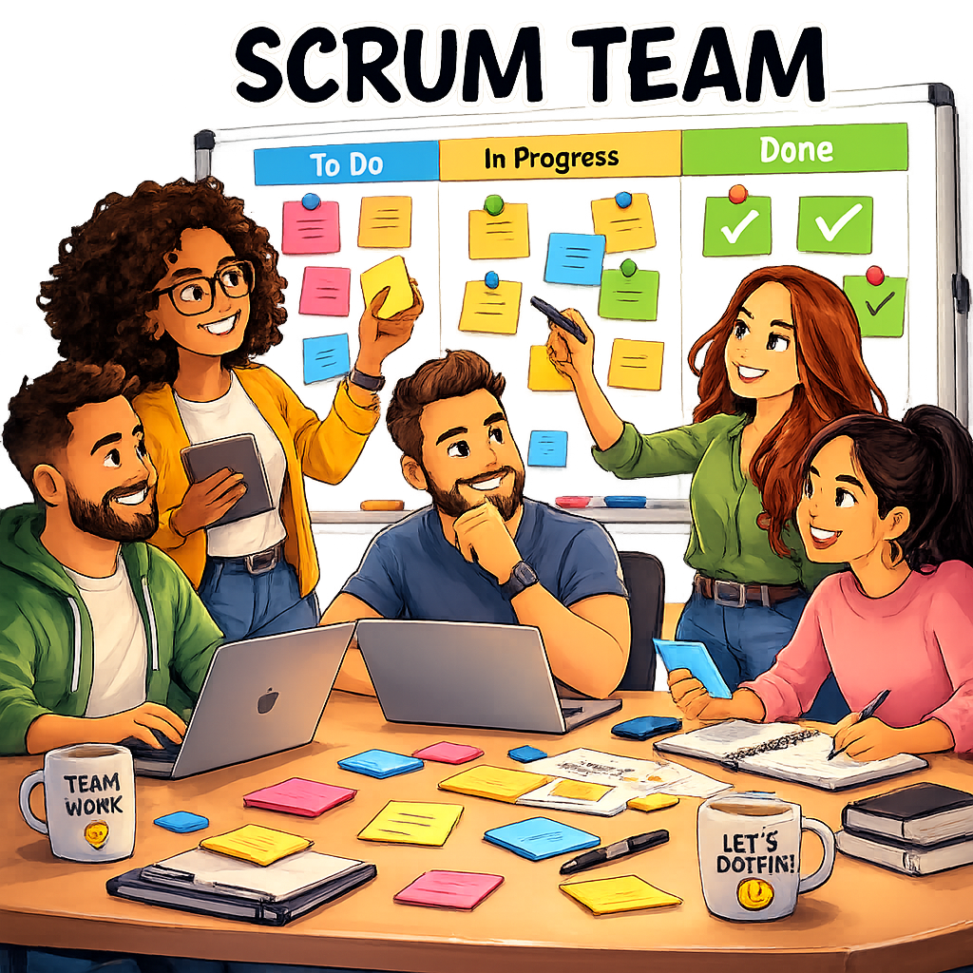
Scrum Team
The developers, designers, and testers who do the actual work of building the product.
Self-organising: the team decides how best to complete the sprint backlog items.
Cross-functional: together the team has all the skills needed to deliver the sprint goal.
Typically 3-9 people - small enough to be agile, large enough to complete meaningful work.
Commits to and owns the sprint backlog during a sprint.
Communication focus: daily stand-up meetings (Daily Scrum) keep everyone aligned on progress and aware of blockers.

Slide 12

Research: How the Roles Support Communication and Delivery
Communication link | What is communicated | Why it matters
Product Owner -> Scrum Team | The Product Owner clarifies requirements and answers questions during sprint planning and throughout the sprint. Clear communication here prevents the team building the wrong thing. | Keeps the development team closely focused upon what the client wants Keeps the client aware of development progress
Scrum Master -> Everyone | The Scrum Master facilitates communication across the whole team, removing blockers and ensuring Scrum events happen correctly. They protect the team from scope changes mid-sprint. | Prevents issues derailing or slowing development Ensures the sprint lifecycle is adhered to
Scrum Team -> Product Owner | At the Sprint Review, the team presents what they have built. The Product Owner gives feedback, accepts or rejects items, and updates priorities for the next sprint. | Ensures a deliverable iteration of the product at each stage Ensures that the next Sprint is absolutely appropriate

Slide 13
Let’s Plan a SCRUM Project
Visit
https://scrummastery.toolsforteaching.co.uk

Slide 14
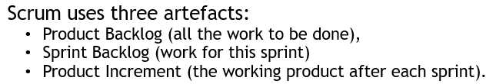
Scrum Role Simulation
Activity phases:
  Phase 1 - Role familiarisation (5 min)
  Phase 2 - Build the backlog (15 min)
  Phase 3 - Prioritise the sprint (10 min)
  Phase 4 - Record and label (5 min)
In small groups
35 mins
In your allocated roles, work through the activity in OneNote
Notes:
Circulate prompt during Phase 2: 'You have added [feature] to the backlog. Who specifically benefits from this? What happens if it is NOT in the first sprint - does the app still work?' This pushes students from listing features to justifying priorities.
Circulate prompt during Phase 3: 'You have put [feature] as a Must Have. What would the Product Owner say to the client to explain why [other feature] is a Could Have this sprint?' This links back to LO1 communication skills.

Slide 15
Debrief and Consolidation
Show us your Sprint 1 Backlog
What features did you choose?
What did you leave out and why?
What did the Product Owner have to decide that the Scrum Team could not decide for them?
What would the Scrum Master have done if the team started arguing about which features to include?
How is a Product Backlog different from a to-do list?

Slide 16
Remember…
Scrum is an Agile framework that structures work into sprints, with defined roles that each support communication and delivery.
The Product Owner prioritises the work; the Scrum Master facilitates the process; the Scrum Team does the building.
A prioritised Product Backlog ensures the team always works on the most valuable features first - this reduces waste and keeps the project aligned with user needs.

Slide 17
Workbook Preparation
Working Independently
Write 150-200 words on:
Describe what is meant by Scrum.
Explain the role of:
  Product Owner
  Scrum Master
  Scrum Team.
15 mins

Slide 18

Final Questions
In one sentence, describe what Scrum is.
Name the three Scrum roles.
Who owns the Product Backlog?
What is the Scrum Master's main job when the team has a blocker?

