Slide 1
Unit 5 Lesson 09
Scrum Events

Slide 2
Recall Exercise
Visit:
https://retrieval.toolsforteaching.co.uk
Code: sm63ni

Slide 3
Phones
a small reminder…
once you have authenticated phones should be in the pockets on the wall

Slide 4
Learning Objectives
By the end of this lesson, learners will be able to:
  Describe the purpose, timing, and output of all five Scrum events.
  Explain how each Scrum event supports communication and delivery.
  Experience all five Scrum events through a full Sprint simulation.
  Produce a range of portfolio evidence: sprint notes, prototype, Review summary, and Retrospective reflection.

Slide 5
Key Vocabulary
Term | Definition
Sprint
Sprint Planning
Sprint Goal
Daily Scrum
Sprint Review
Sprint Retrospective
Increment
Time-box
Complete these definitions during the lesson
Notes:
Sprint
A time-boxed period (typically 1-4 weeks) during which the Scrum team works to complete a set of backlog items and produce a working product increment. All other Scrum events happen inside a sprint.
Sprint Planning
The event at the start of each sprint where the team selects backlog items, sets a sprint goal, and plans how the work will be done. Attended by all three Scrum roles.
Sprint Goal
A single, clear sentence that describes what the team is aiming to achieve by the end of the sprint. It gives the team a shared focus and helps the Product Owner explain the sprint's value to stakeholders.
Daily Scrum
A 15-minute stand-up meeting held every day of the sprint. Each team member answers three questions: What did I do yesterday? What will I do today? Are there any blockers?
Sprint Review
The event at the end of each sprint where the team demonstrates the working product increment to the Product Owner and stakeholders. Feedback is gathered and the Product Backlog is updated.
Sprint Retrospective
A team reflection held after the Sprint Review. The team discusses what went well, what could be improved, and agrees one concrete change for the next sprint. Focused on improving process, not blaming people.
Increment
The working, potentially shippable version of the product produced at the end of each sprint. Each increment builds on the previous one.
Time-box
A fixed maximum time limit for a Scrum event. Time-boxing prevents meetings running over and keeps the team focused. For example, the Daily Scrum is time-boxed to 15 minutes.

Slide 6

Recap
Name the three Scrum roles. Who does what?
Who owns the Product Backlog?
What is the Scrum Master's job when there is a blocker?
Notes:
Last lesson gave us the three Scrum roles.
Today we add the five events - the structured meetings that make Scrum work.
And rather than just talking about them, we are going to run a full sprint today.
Each of you will experience every single Scrum event before the lesson ends.

Slide 7
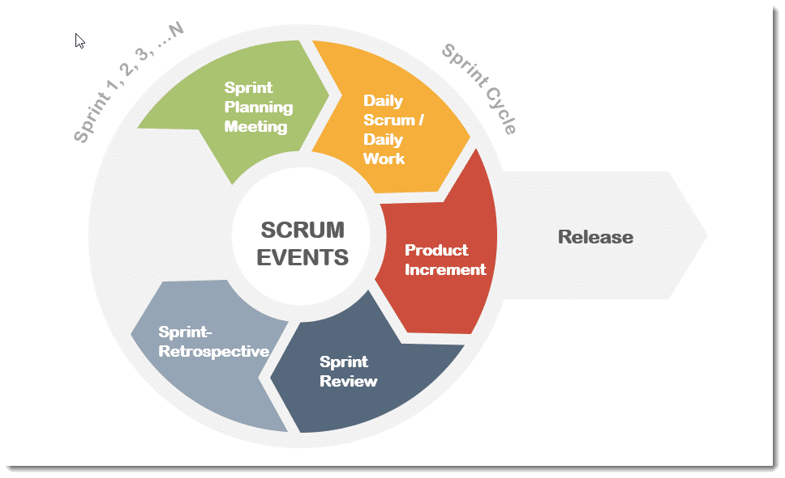
Scrum Events

Slide 8
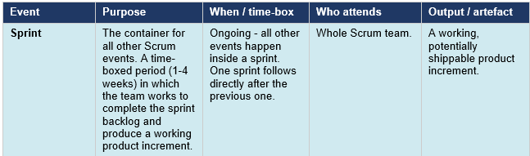
Scrum Events

Slide 9
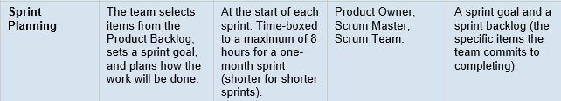
Scrum Events

Slide 10
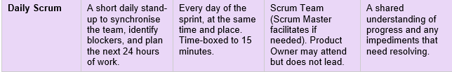
Scrum Events

Slide 11
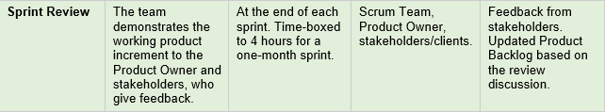
Scrum Events

Slide 12
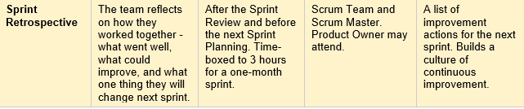
Scrum Events

Slide 13
Scrum Events
All events happen inside a Sprint
  the Sprint is the container, not just a single event.
Every event is time-boxed - this is deliberate.
  Time-boxing creates focus and prevents endless meetings.
The Sprint Review and Sprint Retrospective are NOT the same.
  The Review is about the product (what was built).
  The Retrospective is about the process (how the team worked).
  This distinction is commonly misunderstood.
The Daily Scrum is not a status report to the Scrum Master or Product Owner
  It is the team synchronising with each other.

Slide 14

Sprint Planning
In small groups
We will form Sprint Teams and use the Product Backlog from https://scrummastery.toolsforteaching.co.uk
Teams must complete all three outputs before moving on.
  Sprint goal: one sentence describing what the app will be able to do at the end of Sprint 1. Prompt: 'If a user downloaded this app after Sprint 1, what one thing would it let them do?'
  Sprint backlog: 5-7 features selected from their Product Backlog. Must Haves from Last Lesson take priority.
  Task assignments: who in the team is responsible for building/sketching each feature?
20 mins
Notes:
Circulate prompt: 'You have selected [feature]. Can your team realistically sketch or prototype this in 15 minutes? If not, what is the simplest version you could show that still demonstrates the idea?'

Slide 15
Build Phase and Daily Scrum
Teams create a paper prototype, screen sketches, or a storyboard of their sprint.
  The aim is not a polished design - it is a low-fidelity representation of what the app would look like and do.
  Minimum: 2-3 screen sketches showing the key features from the sprint backlog.
After a certain amount of time, I will call for a ‘Daily Scrum’ and there will be a three-minute discussion
  Each person answers (standing if possible, 30 seconds each):
    'What did I do?
    What will I do next?
    Any blockers?'
  Scrum Master ensures everyone speaks and timekeeps strictly.
  No problem-solving during the stand-up - blockers are noted and resolved after.
  Resume building after the Daily Scrum. Teams screenshot their prototype before the Sprint Review.
In small groups
15 mins
Notes:
Circulate prompt during the build: 'Your Daily Scrum is in 5 minutes. Make sure you can answer all three questions.' This keeps students aware of the rhythm of Scrum even in a compressed simulation.

Slide 16
Sprint Review
Each team presents their prototype to the class
5 minutes per group.
  The Scrum Team demonstrates what they built (2-3 min), describing each screen and how it meets the sprint goal.
  The class / Product Owner asks 1-2 questions or gives feedback using the peer feedback form (1-2 min).
  The Product Owner responds: 'This meets our sprint goal / Here is what we would change for Sprint 2.'
Notes:
Circulate prompt for presenters: 'Start with your sprint goal. Tell us what you committed to and whether you achieved it. Then walk us through the screens.' This mirrors real Sprint Review practice.
Circulate prompt for reviewers: 'Give specific feedback: not 'it looks good' but 'the task list screen would be clearer if...' or 'I liked how you showed...' This links back to LO2 productive feedback.

Slide 17
Sprint Retrospective
Teams complete the Sprint Retrospective template in their OneNote.
The Scrum Master facilitates - keeping discussion constructive and time-focused.
Teams answer three questions:
  What went well this sprint?
    Communication, teamwork, time management, clarity of roles.
  What did not go well or what could be improved?
    Honest and specific - refer to the process, not people.
  One concrete action for next sprint: ‘
    Next time, we will...’
    This must be specific and actionable.
In small groups
10 mins

Slide 18
Workbook Preparation
Working Independently
Complete the Key Vocabulary Table
Write 300 words on the following:
Describe different Scrum events.
You must include:
  Sprint
  Sprint Planning
  Daily Scrum
  Sprint Review
  Sprint Retrospective.
10 mins

Slide 19

Final Questions
Name all five Scrum events in order.
What is the difference between a Sprint Review and a Sprint Retrospective?
What is the Daily Scrum time-boxed to?
Notes:
Sprint
Sprint Planning
Daily Scrum
Sprint Review
Sprint Retrospective
One reviews the product, one reviews the process
15 minutes

